Slide 1

MaxEnt_Disaggregation
Center for Nuclear Engineering and Sciences
Center for Energy and Environmental Sciences
Divide your data and Rule the correlations!
Arthur Jakobs, Simon Schulte, Rick Lupton
BrightCon Grenoble October 2025

Slide 2
Question: B > A ?
A
B
0
1
Notes:
Having solid understanding about model uncertainty is paramount robust decision making as well as effiently prioitising data collection efforts.
However, quantitative uncertainty analysis often lacking in studies in IE.
Uncertainty analysis becomes even more challenging when correlations are present, thus they are often ignored. However, impo

Slide 3
Question: B > A ?
I
II
Notes:
Having solid understanding about model uncertainty is paramount robust decision making as well as effiently prioitising data collection efforts.
However, quantitative uncertainty analysis often lacking in studies in IE.
Uncertainty analysis becomes even more challenging when correlations are present, thus they are often ignored. However, impo

Slide 4
Question: Uncertainty B + A ?
I
II
Notes:
Having solid understanding about model uncertainty is paramount robust decision making as well as effiently prioitising data collection efforts.
However, quantitative uncertainty analysis often lacking in studies in IE.
Uncertainty analysis becomes even more challenging when correlations are present, thus they are often ignored. However, impo

Slide 5
Sources of correlations in uncertainty
Many real-life sources of correlations (e.g. mass balances):
  Need to be modelled individually if information is present
Statistical correlations due to data manipulation:
  Disaggregation (uncertainty on shares)

Slide 6

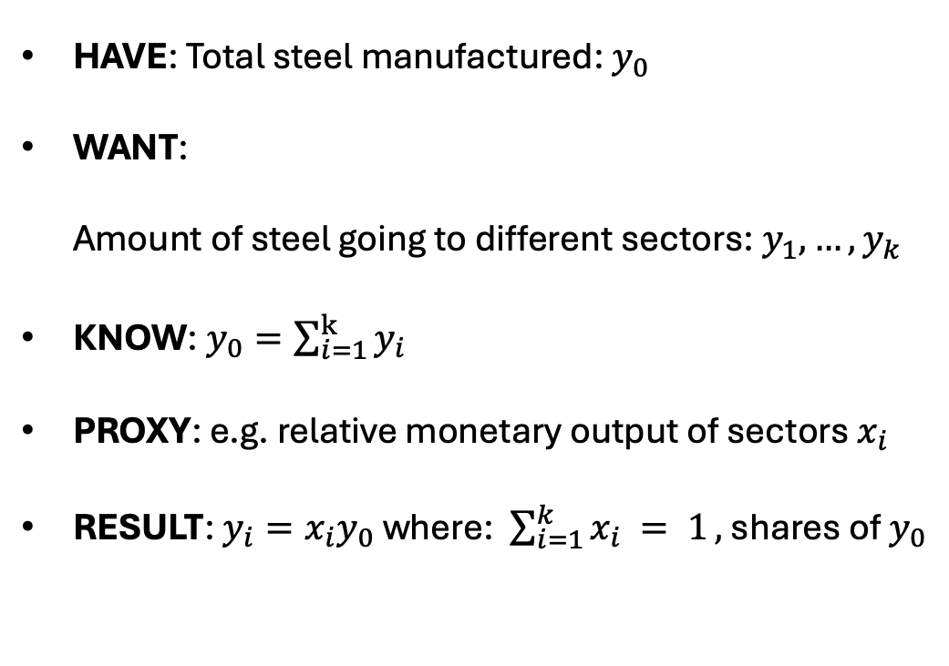


The disaggregation problem
HAVE: Total steel manufactured: $y_{0}$
WANT:
Amount of steel going to different sectors: $y_{1},…,y_{k}$
KNOW: $y_{0}=\sum_{i=1}^{k}{y_{i}}$
PROXY: e.g. relative monetary output of sectors $x_{i}$
RESULT: $y_{i}=x_{i}y_{0}$ where: $\sum_{i=1}^{k}{x_{i} = 1},$shares of $y_{0}$
Steel
manufacturing
$$y_{0}$$
$$y_{1}$$
$$y_{2}$$
Buildings
Cars

Slide 7
The disaggregation problem in IE research
  MFA (see previous example, or Streeck et al. 2023 doi: 10.1111/jiec.13380)
  Input-output analysis: allocation of emissions to end-use sectors
  (Schulte et al. 2024 doi: 10.5194/essd-16-2669-2024)
  LCA: allocation of inputs and emissions to co-products (often hidden in the background database, might be a foreground issue as well)
  LCA correlated sampling of market shares
  (Kim et al. 2025 doi: 10.1111/jiec.70036)

Slide 8

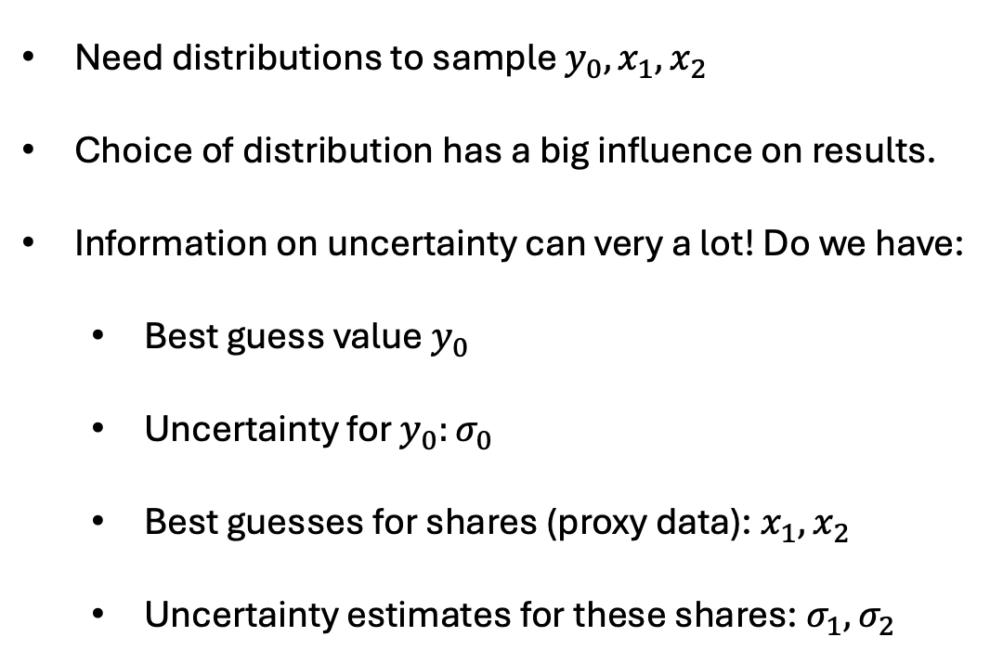

Choosing the right distribution
Need distributions to sample $y_{0},x_{1},x_{2}$
Choice of distribution has a big influence on results.
Information on uncertainty can very a lot! Do we have:
  Best guess value $y_{0}$
  Uncertainty for $y_{0}:σ_{0}$
  Best guesses for shares (proxy data): $x_{1},x_{2}$
  Uncertainty estimates for these shares: $σ_{1},σ_{2}$
Steel
manufacturing
$$y_{0}$$
$$y_{1}=x_{1}y_{0}$$
$$y_{2}=x_{2}y_{0}$$
Buildings
Cars

Slide 9
Maximum entropy principle
Only use the available information, no implicit assumptions
Choose the distribution that maximises the Entropy
(Jaynes 1957, doi: 10.1103/PhysRev.106.620) given the constraints.

Slide 10
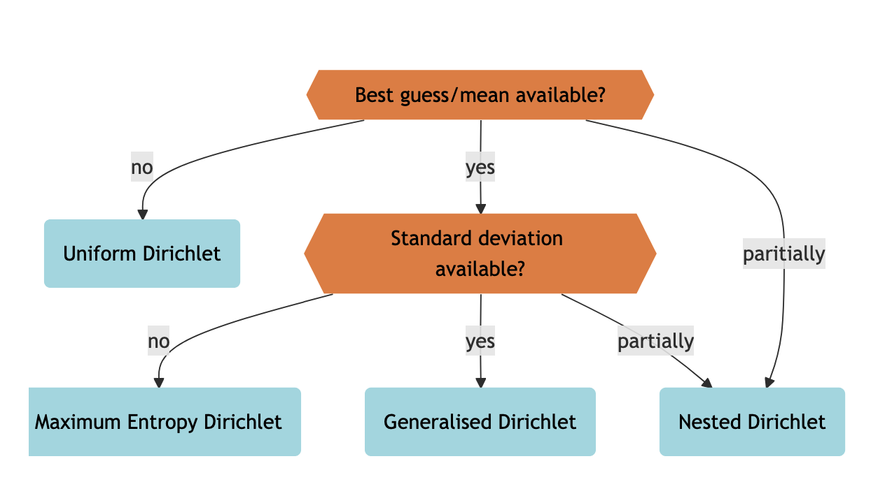

Maximum Entropy distributions for disaggregation
Shares $x_{1},…x_{k}$:

Slide 11
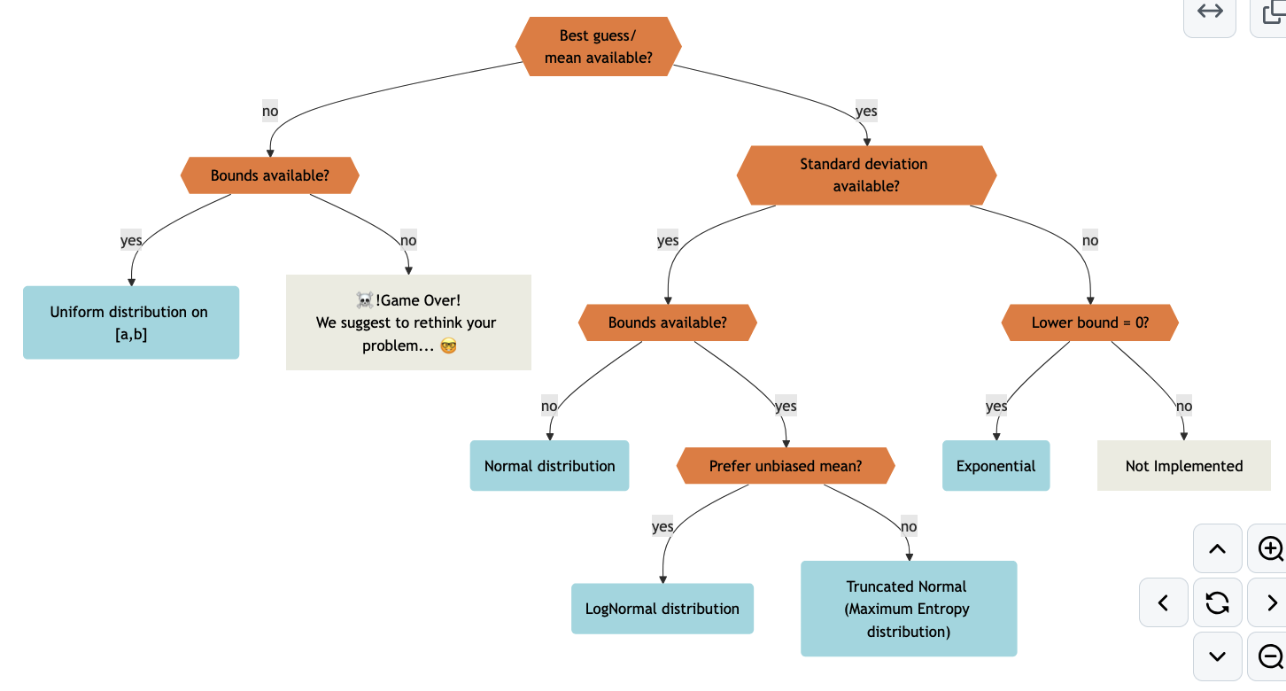
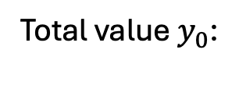
Maximum Entropy distributions for disaggregation
Total value$y_{0}$:

Slide 12

Maximum Entropy distributions for disaggregation
Schulte, S., Jakobs, A., Lupton, R. (2025). When Correlation Matters: A Practical Guide to Dealing with Uncertainty in the Case of Data Disaggregation. Under Review in the Journal of Industrial Ecology

Slide 13



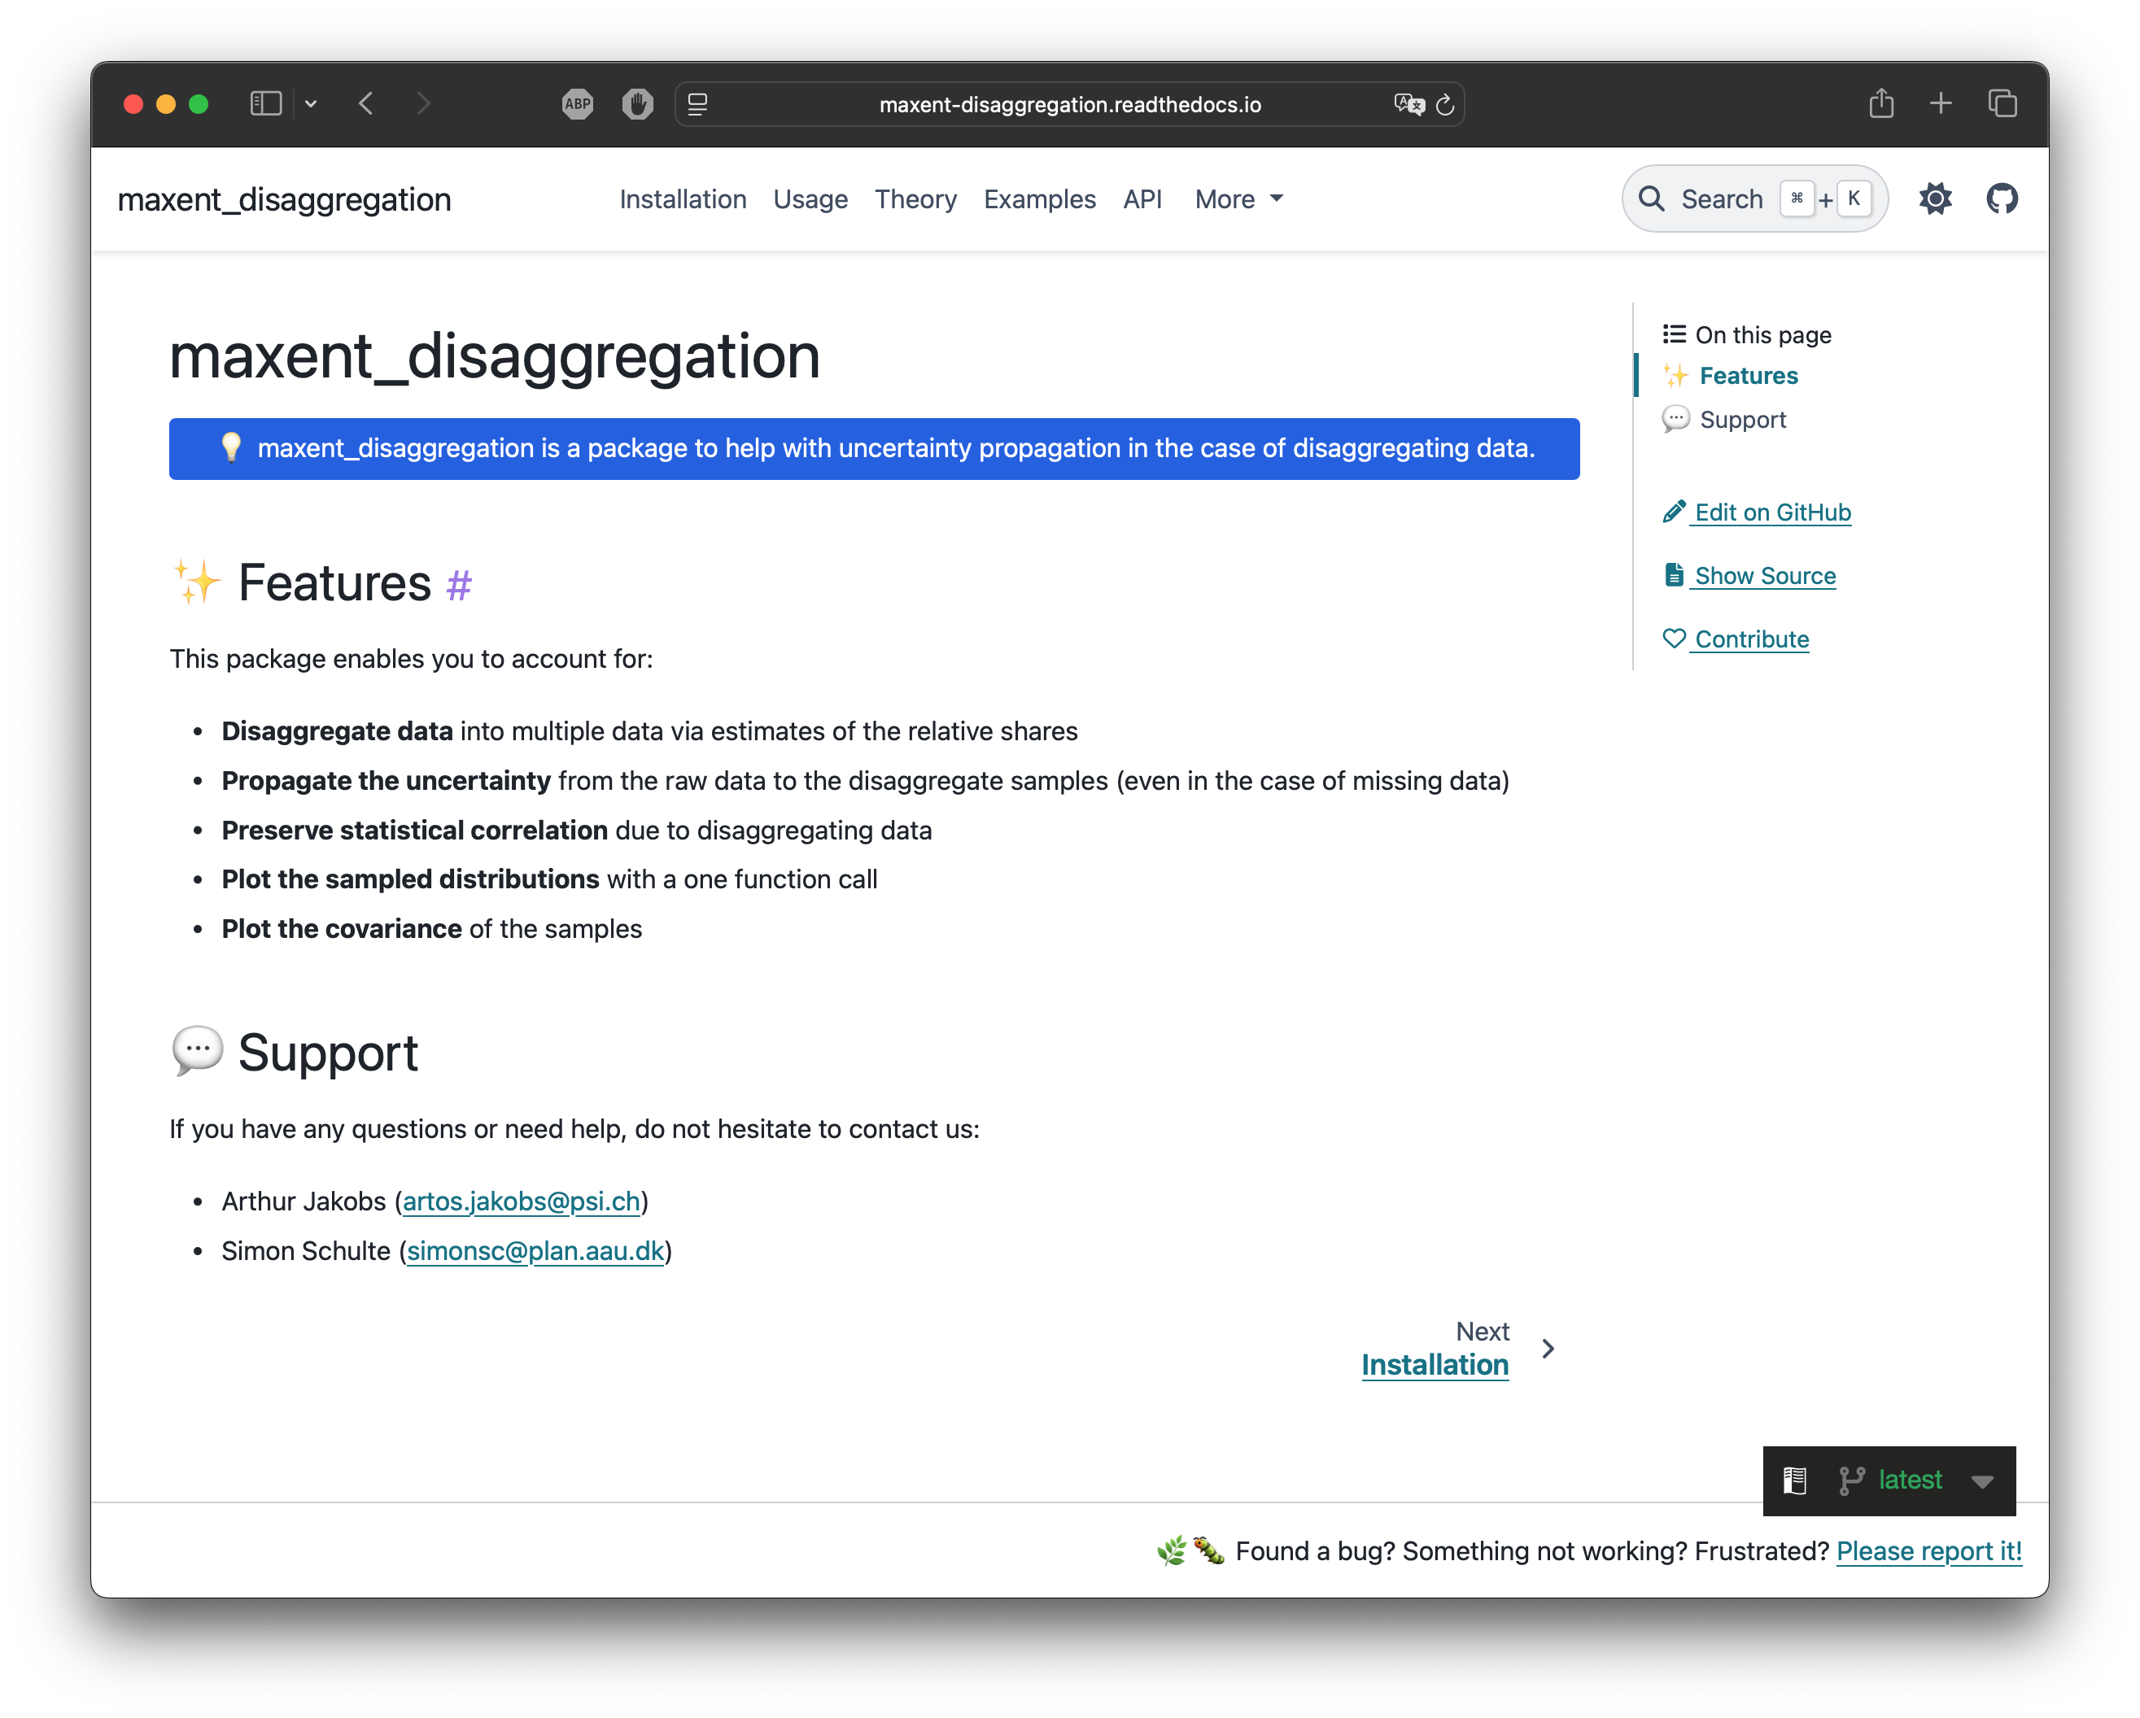
maxent_disaggregation
Samples shares, totals, and disaggregate values
Handles partial or missing information
Maximises Entropy
Easy to use (plug in what you know)
Available in Python AND R
Fully Documented

Slide 14
maxent_disaggregation
Let’s see how it works! 👩‍💻
→ Open UseCaseExample.ipynb

