Slide 1



Industrial Ecology Data Commons - IEDC
A new type of database for industrial ecology and socio-metabolic research
Stefan Pauliuk on behalf of the IEDC team

Slide 2

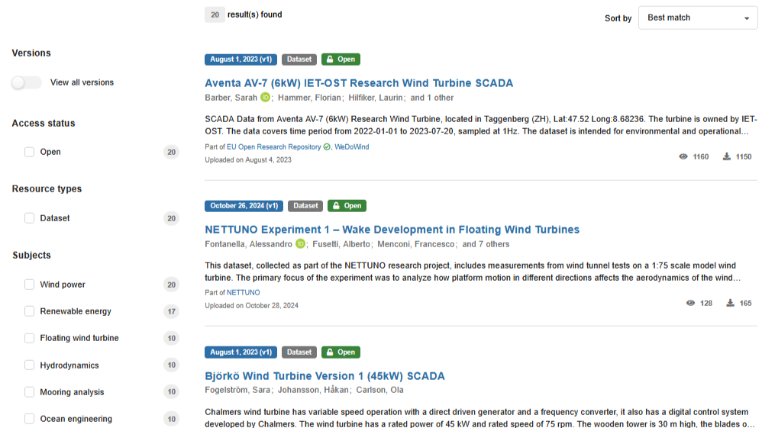
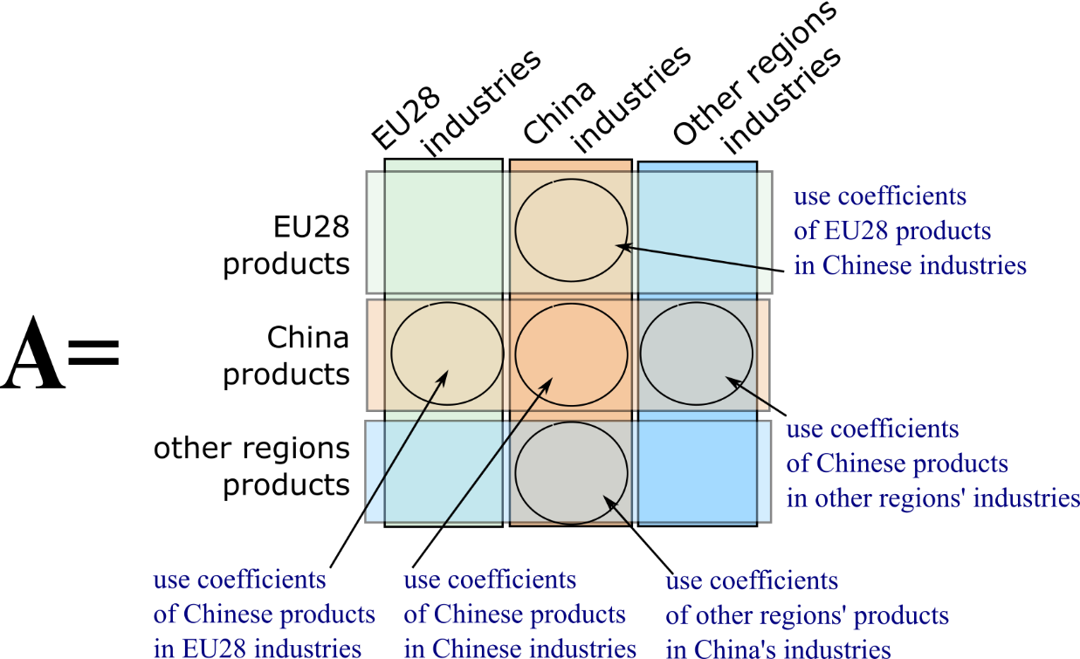

Types of databases and their business cases
Data lakes
Integrated databases
missing link
· broad scope
· co-existence
· systematic structure
· consistent labels
„Thou shalt not be forgotten“
„right tool to get the job done“
· link data to the phenomena
they describe
· data are not linked to tools but
interoperable across tools
· open access and transparency
· small data
· spreadsheet
workflow
‚The usual mess‘
„quick and dirty“

Slide 3
Socio-metabolic data in a systems context
Quantitative information on processes, stocks, flows, etc., in socioeconomic metabolism has three components:
Value. The actual numerical information, including unit and uncertainty
System location (semantic metadata). The information needed to locate the data in the systems context, i.e., the link between data and the system dimensions (process, time, region, material, …)
Metadata. Information like provenance, source document, author and version information, and license.
Metadata
Value
System location
(semantic metadata)
Source: „A General Data Model for Socioeconomic Metabolism and its Implementation
in an Industrial Ecology Data Commons Prototype “, by Pauliuk et al. (2019), JIE, DOI: ﻿10.1111/jiec.12890

Slide 4
Schematic overview of the IEDC data categories and data types
 | Objects: goods, products, substances, commodities, waste | Processes: industries, markets, end-use sectors, use-phase
Extensive (at scale) | Flows (1) Flow (1_F_) | Process inventory (1_PI_) Births/Deaths (1_BD_) | Lorenz curve flows (1_LC_) | Extensive process properties (5) Process output capacity (5_CAP_) Process parameters (5_PP_)
 | Stocks (2) Stock (2_S_) | In-use stock (2_IUS_) | Population (2_P_) Stock change (2_DS_) | Lorenz curve stocks (2_LC_)
Intensive (per unit) | Intensive object properties (3) Product material composition (3_MC_) | Product lifetime (3_LT_) | Specific energy consumption (3_EI_) | Price (3_PR_) Shares (3_SHA_) | characterisation. factors (3_CF_) | Intensive process properties (4) Process yield factors (4_PY_) | Process environmental extensions per output (4_PE_) | Process operating costs per output (4_PC_) | unit process inventory (4_UPI_) | transfer coefficients (4_TC_)
General ratios | General ratios (6) Per capita stock (6_PCS_) | Per capita flows (6_PCF_) | Material substitution coefficient (6_MSC_) | miscellaneous intensive properties (6_MIP_) | criticality metrics (6_CR_) | impact indicators (6_IMP_)
(7) Classifications and correspondence tables: 7_CT
(8) Non-numeric data, Boolean data types: 8_FLG
Data that don‘t fit into the IEDC data model: geospatial data, live-streamed data, event-based data like protocols, decision trees or flow diagrams,
functional relationships, data with conditions such as thresholds, constraints across data points (summation constraints, Dirichlet distributions)

Slide 5
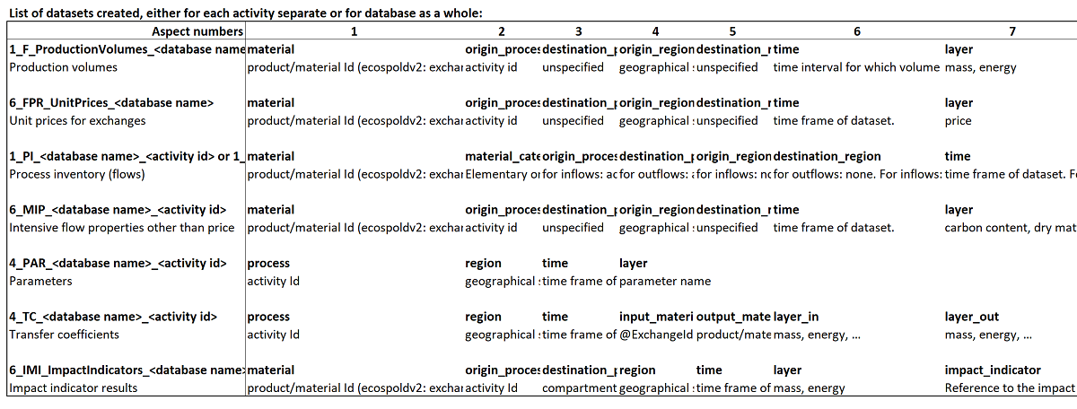
Example: mapping ecoSpold2 to IEDC data types
Why do we need this? Doesn’t LCA already have a comprehensive data model in form of ecospold?
Ecospold contains activity/process inventories (exchanges) and related data: price and production volumes of reference flows and the composition (carbon content, water content) of substances.
But there are many more data that are needed in industrial ecology research, including: product lifetimes, breakdown of products into components and materials, process capacities, population, economic statistics, trade flows, inequality data, or economy-wide and sector-specific material flow accounts.
ecoSpold2
dataset
IEDC
data
types
IEDC data group
IEDC aspects/
dimensions
metadata
https://github.com/IndEcol/IE_data_commons/blob/master/doc/LCI_IEDC_Correspondences_V1.xlsx

Slide 6
Industrial ecology data commons (IEDC)
History
BrightCon 2025 – Plenary Talk on the industrial ecology data commons (IEDC)

Slide 7
IEDC history: The Yale Stocks and Flows database
YALE-STAF: Systematic attempt to conduct and MFA for large parts of the periodic table
Need to have a systematic database arose early
Barbara Reck and Daniel B Müller worked on a first systematic attempt
Data from STAF project were published eventually by Myers et al. (2019)
https://cie.research.yale.edu/research/stocks-and-flows-project-staf
Myers, Reck, and Graedel (2019): YSTAFDB, a unified database of material stocks and flows for sustainability science https://doi.org/10.1038/s41597-019-0085-7

Slide 8
IEDC history: The GAIA database at Indecol NTNU, Trondheim
Daniel Müller brought the idea to Trondheim and continued pushing for a common stocks and flows database for MFA, where all data are formatted into a single large table (one row for each datapoint)
Stefan Pauliuk implemented an SQL-based version of such a database as part of his ‚duty work‘ for the department: GAIA.
GAIA contained a few common classifications (chem. elements, regions, processes), and had rather rigid aspects (5 time aspects, 3 space aspects, 4 process aspects, and 2 for product/material) and was used for flow and stock data only.
This prototype fulfils some requirements of industrial ecology 2.0 (Davis et al. 2010): tailored data model, machine and human-readable data, open source tools, open data, shared vocabulary.

Slide 9
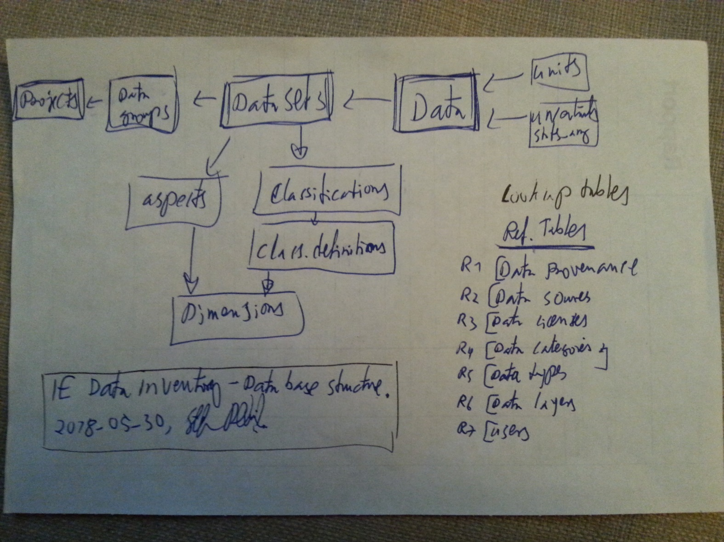
IEDC history: The Freiburg revival
Stefan Pauliuk brought the idea to Freiburg and continued working on it as a ‚pet project‘.
Further development of the data model to be generally applicable, link to established classifications
Decision to not only build a catalogue of available data but to actually reformat and compile the data into a common database
With Mahadi Hasan, we built the group‘s public dabatase as first implementation of the data model in 2018.
Tested first with own research results, later
expanded to broad coverage of IE data.
https://www.blog.industrialecology.uni-freiburg.de/index.php/2018/10/17/launching-the-prototype-for-an-industrial-ecology-data-inventory/

Slide 10
IEDC history: The general data model and the Freiburg prototype
Published the data model and the structure of the database implementation as JIE article in 2019.
Since 2019: regular updates (2x per year) to the iedc prototype, 30-40 new datasets each year.
With Nildem Atasayar, we added new search and validation features.
2024: The iedc prototype became the IEDC.
2025: EU Horizon CIRCOMOD input data hub and IEDC Critical Mass Sprint flushed in heaps of new data!
https://doi.org/10.1111/jiec.12890

Slide 11
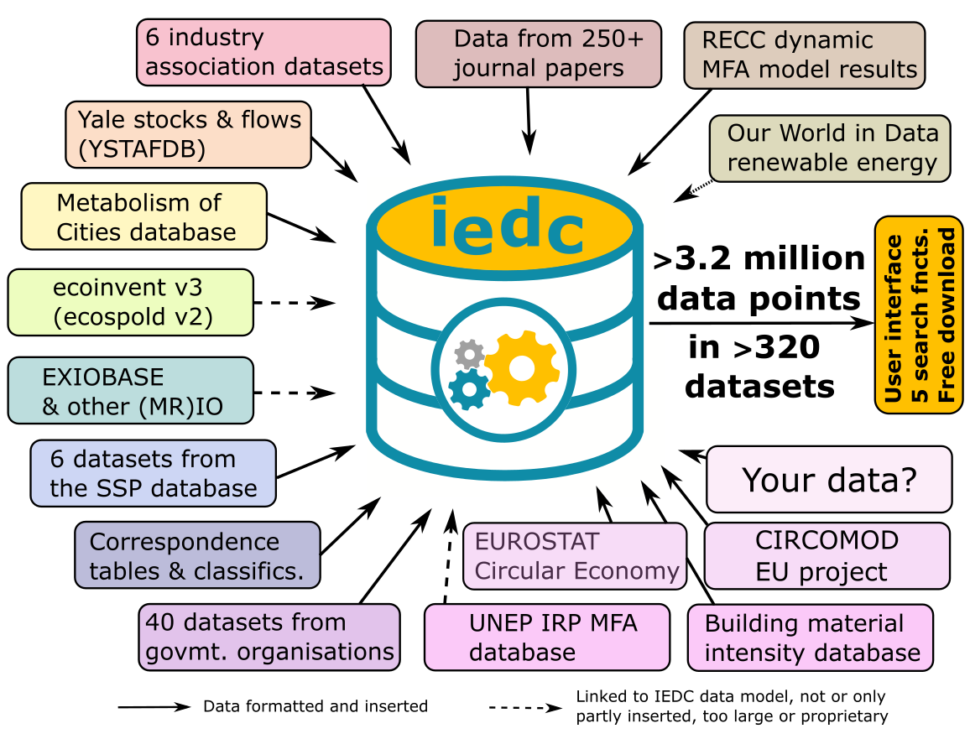

IEDC present: 2025 IEDC Critical Mass Sprint
Collect, format, and upload a larger number (100+) of datasets on product material composition, energy intensity, and lifetimes
Products include appliances, buildings, vehicles, infrastructure, industrial assets, and energy system technologies
Critical mass sprint goal: By the end of 2025, the IEDC contains enough relevant data that searching the IEDC becomes a useful screening step / first iteration for MFA and LCA researchers and consultants
https://www.database.industrialecology.uni-freiburg.de/
https://www.blog.industrialecology.uni-freiburg.de/index.php/2025/03/03/2025-iedc-critical-mass-sprint/

Slide 12
Industrial ecology data commons (IEDC)
Data model
BrightCon 2025 – Plenary Talk on the industrial ecology data commons (IEDC)

Slide 13
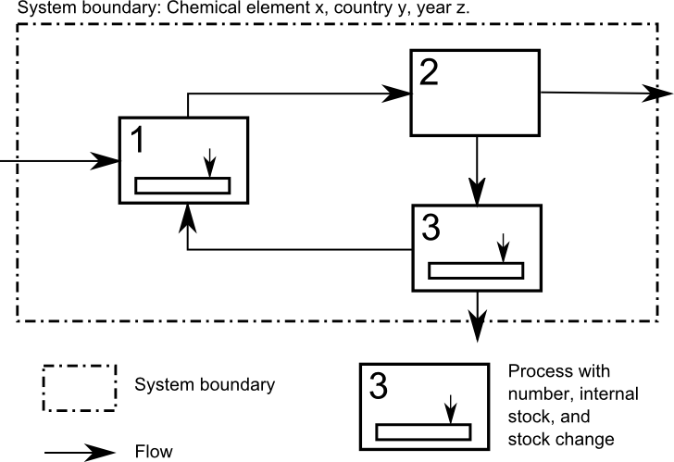
All socio-metabolic data can be placed in a system definition
System boundary:
Shows what processes are part of the system studied.
System needs to be specified in space and time.
Process: Element of a system were material or energy
is transformed, stored, or distributed.
Stock: Storage of material, products, or energy. A stock
is always associated with a process. It is measured at
a given point of time t. ‚snapshot‘
Flow: Transport of material products, or energy across
the system. A flow always connects two processes or
one process with the environment. It is measured over
an interval [t₁,t₂].

Slide 14
Placing socio-metabolic data in a system definition: Dimensions
System definition prescribes a number of dimensions along which the system content is described:
the time dimension is used to order events by the time of their occurrence
the location dimension is used to order objects by their location
the process dimension is used to identify balance volumes or to group events
the object dimension is used to identify different goods or substances
the layer dimension is used to indicate the unit in which the data are measured
Source: „A General Data Model for Socioeconomic Metabolism and its Implementation
in an Industrial Ecology Data Commons Prototype “, by Pauliuk et al. (2019), JIE, DOI: ﻿10.1111/jiec.12890

Slide 15
Placing socio-metabolic data in a system definition: Aspects
To locate data in a system definition, one has to specify the aspects of the data that describe how the given values relate to time, region, processes, etc. dimensions in the system.
The aspects describe how the system dimensions relate to the data.
For example, a flow has a starting node and a terminating node. Here, the system dimension 'process' is used to describe two aspects of a flow, namely the starting and terminating process node.
A stock is always associated with a node where it is located, and therefore, 'residence process' is an aspect of the 'process' dimension needed to locate a stocks
Source: „A General Data Model for Socioeconomic Metabolism and its Implementation
in an Industrial Ecology Data Commons Prototype “, by Pauliuk et al. (2019), JIE, DOI: ﻿10.1111/jiec.12890

Slide 16
The IEDC data model assigns to each data type its ‘right’ aspects
Flows 1_F: A flow is an extensive system variable describing the relocation of objects: [Flow] of [objects] from [process A] in [region of origin] to [process B] in [region of destination] in [time period] is [value/uncertainty] for [layer].
Stocks 2_S: A stock is an extensive system variable describing the location of objects: [Stock] of [objects] of [age-cohort (*)] in [process] in [region of location] at [time point] is [value/uncertainty] for [layer].
Product lifetime 3_LT: The lifetime is an intensive object property describing the residence time of a good/substance in a process: [Lifetime] of [good/substance] of [age-cohort (*)] in [process] in [region] is [value/uncertainty] for [layer].
Source: „A General Data Model for Socioeconomic Metabolism and its Implementation
in an Industrial Ecology Data Commons Prototype “, by Pauliuk et al. (2019), JIE, DOI: ﻿10.1111/jiec.12890

Slide 17
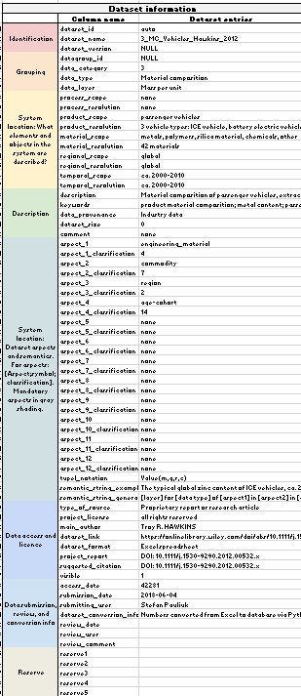
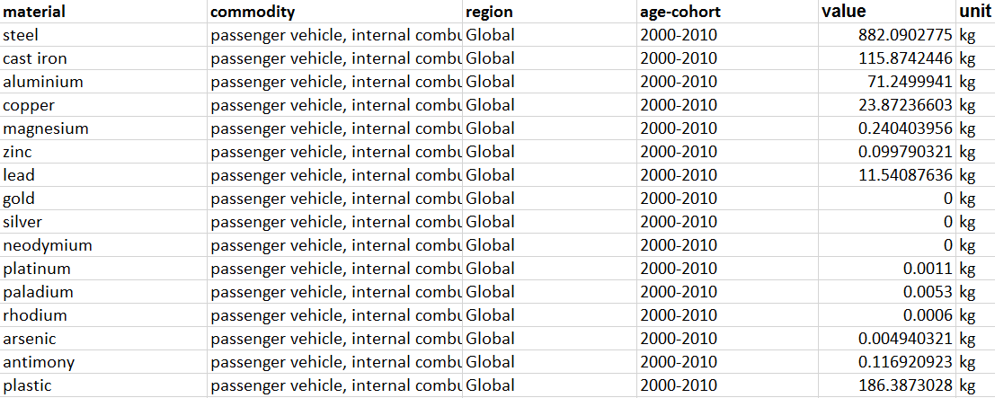
dataset table entry
Organising and validating
the data in xlsx templates
dataset id and description
data table entry: List of tuples (table data are also possible)
dataset aspects
aspects and classification items value unit
dataset metadata
Source: „A General Data Model for Socioeconomic Metabolism and its Implementation
in an Industrial Ecology Data Commons Prototype “, by Pauliuk et al. (2019), JIE, DOI: ﻿10.1111/jiec.12890

Slide 18
Industrial ecology data commons (IEDC)
Features
BrightCon 2025 – Plenary Talk on the industrial ecology data commons (IEDC)

Slide 19




IEDC infrastructure, services, and data workflow
Sourcing data
Core IEDC infrastructure
Finding data
Data providers
Data users
Data sourced from publicly available datasets from different sources in diff. formats
Search the data catalogue by type, DOI, or keyword, preview, download
Direct upload via custom scripts
Search for all available data for a given label, like ‚copper‘, ‚batteries‘, or ‚recycling‘
Data sources: Journal papers, paper supplements, industry association and government institution datasets, official statistics, and other databases
Data formats: flexible, pdf and xlsx are the most common
Find all datasets of a given type and typical aspect, e.g., lifetime by product
Final checks and upload via IEDC_tools (Python)
Find all datasets for up to three aspects (like material, region, time) and download
MySQL database server with web interface for download, Python scripts for upload and updates
Validation of template against IEDC data model and classifications
Support by IEDC team members
Filter a given dataset to find data for specific materials, regions, etc.
Data templates archived on Zenodo
MySQL dump archived with ISIE*
Find matching classification items*
Manual or script-based reformatting to IEDC templates
Download selected
dataset in list format
as xlsx template
Python scripts archived on GitHub
Sample templates provided online
Automatic display of system definition and Sankey diagrams*
*) Still under development, feature will be available by mid 2026.
IEDC resources: Industrial ecology data commons homepage with links to documentation and tutorials: https://www.database.industrialecology.uni-freiburg.de/
Classifications overview page: https://www.database.industrialecology.uni-freiburg.de/classifications.aspx
Data validator: https://www.industrialecology.uni-freiburg.de/iedcValidate.aspx
Search options: See links on IEDC homepage Zenodo archive: https://zenodo.org/uploads/14217322

Slide 20
Structure of the IEDC database (relations between )
IEDC tables
Consistency with lookup tables, checked with IEDC data validator
Excel data templates: Cover sheet Data sheet
IEDC dataset table (catalogue of datasets)
IEDC data table (core table)
Unique Dataset ID (245)
Dataset name (1_F_Copper_Production)
Datapoint ID Dataset ID | Aspects 1 … up to 12 | Value-Unit-Uncert. | Comment/ Source
Each single value (data point) of a given dataset is recorded and described on a separate line, linked to a dataset via the dataset ID
Datasets typically contain between 5 and 50000 data points, all linked to a common dataset description by the unique dataset ID
145744 | 245 | Peru | Cu | 2022 | Refining | Market | 2.45 Mt/yr | DOI xyz
145745 | 245 | Chile | Cu | 2018 | Refining | Market | 5.83 Mt/yr | DOI xyz
…
…
IEDC data categories
Dataset version (v2025)
IEDC data types
IEDC data layers
Definition & description
(type, layer, scope, resolution)
Linked by dataset ID (e.g., 245)
IEDC data aspects
Aspect structure: Up to 12 different aspects to locate the dataset in a suitable system definition
(semantic metadata)
IEDC classifications
Provenance
Metadata: Data provenance, type of data source, license, user who provided and reviewed data
Data source types
Licenses
Data groups (group of related datasets)
Units table
Users
Projects (group of related datagroups)
Uncertainty coding table (‘stats_array’)
IEDC classification scheme, based on system dimensions, related data aspects and classifications, and classification items (‚labels‘)
Classification definitions table (ISO 3166 country codes, years, materials, ISIC industries, HS commodities, chem. elements, …)
Classification items table (Peru | PE | PER as country // Copper | Cu | 29 as chemical element, …)
Data table
System dimensions (space/region, time, product, process, material, scenario, …)
Data aspects (region -> region of origin, region of destination; time -> year of measurement, year of production, …)
Datasets

Slide 21
IEDC classifications: A large and comprehensive compilation
of general classifications for socio-metabolic data
IEDC classification scheme, based on system dimensions, related data aspects and classifications, and classification items (‚labels‘)
Classification definitions table (ISO 3166 country codes, years, materials, ISIC industries, HS commodities, chem. elements, …)
Classification items table (Peru | PE | PER as country // Copper | Cu | 29 as chemical element, …)
Data table
System dimensions (space/region, time, product, process, material, scenario, …)
Data aspects (region -> region of origin, region of destination; time -> year of measurement, year of production, …)
Datasets
About 100 classifications are available for consistent data labelling:
  ISO regions, chemical elements,
  materials
  products and components
  trade codes
  industry codes and industries/processes
  LCI compartments and layers
All classifications can be browsed and downloaded via
https://www.database.industrialecology.uni-freiburg.de/classifications.aspx

Slide 22
Overview of the different IEDC search options
I am looking for…
… all datasets that match a given keyword
… all datasets of a given data type
… datasets from a given first author or DOI
Data catalogue search by keyword
(see bottom of this page)
… all datasets that contain a certain product/material/region
e.g., what data are there on copper / Brazil ?
Find all datasets with a given label
(see link via button below)
… all datasets of a given type that contain a certain product/material/region
e.g., are there any lifetime data for bicyles?
Search for datasets by main aspects
(see link via button below)
https://www.database.industrialecology.uni-freiburg.de/
… all datasets of a given type that contain any combination of labels (material, product, process) for up to three different aspects
Search for datasets by all aspects
(see link via button below)
…data for a specific label (material, region, product, process, …) in a given dataset
Filter a dataset for a given label
(see link via button below)
…data from a specific publication (DOI) or from a certain author
Search for datasets by DOI or author
(coming soon!)
IEDC Excel data template
Cover sheet | Data sheet
Download button on the different search pages

Slide 23
Typical IEDC Use Cases
LCA – quick access to foreground data material composition of products, specific energy requirement of product operation, product lifetime, manufacturing yield, process parameters
MFA – stocks, flows, and parameters
Large library of MFA study results for stocks and flows of products and materials, MFA system parameters such as material composition of products, EoL-recovery rates
Policy analyses
Data on material criticality, environmental pressure indicators
Urban metabolism studies
City-level stocks, flows, and impacts
Scenario modelling
Data on service provision, in-use stocks, alternative technology process inventories, potentials for resource efficiency in manufacturing and recycling
https://tinyurl.com/iedc-freiburg

Slide 24
Industrial ecology data commons (IEDC)
Future
BrightCon 2025 – Plenary Talk on the industrial ecology data commons (IEDC)

Slide 25
IEDC future: 2026
Finish Critical mass sprint with in total about 130 new datasets (+50%)
Offer seminars, documentation, and other training material to promote the use of the IEDC (both upload and download), the general data model behind it, the data templates, and the IEDC classifications
Continue adding data to establish the IEDC as a platform for a broad spectrum of socio-metabolic and industrial systems data. Focus on the following data types:
  LCI foreground data: Material composition (3_MC), specific energy consumption (3_EI), and lifetime (3_LT) of products, buildings, vehicles, and infrastructure, and related process descriptions (4_PY, 4_PE, 4_UPI)
  Sankey diagrams and other MFA stock and flow data (1_F, 2_S, 2_IUS)
  Inequality-related data (Lorenz curves for flows, stocks, and normalized: 1_LCF, 2_LCS, 3_LC)
Up next: explore the use of AI-based tools to gather and format data
  Need to ensure accuracy and traceability for the data gathered
https://www.database.industrialecology.uni-freiburg.de/

Slide 26



Future: The IEDC between cathedral and bazar
Data scope: specialized vs. broad?
Classifications: harmonized vs. flexible?
Access: Via ISIE only or open?
Data sources: only open or all sources?
Quality: Very selective or permissive?
Freiburg Cathedral, 1200-1530
Bazar on Cathedral Square
What is a sustainable business model for missing link databases such as the IEDC?

Slide 27
Credits go to….
Nildem Atasayar and Mahadi Hasan for the web application
Niko Heeren for the validation and upload tools
Daniel Müller and his academic mentors at Yale for the initial database concept
Freiburg team and student assistants for data collection and validation
CIRCOMOD EU Horizon Project for shuffling in high-quality data in large amounts
The many data suppliers and colleagues who provided feedback

Slide 28
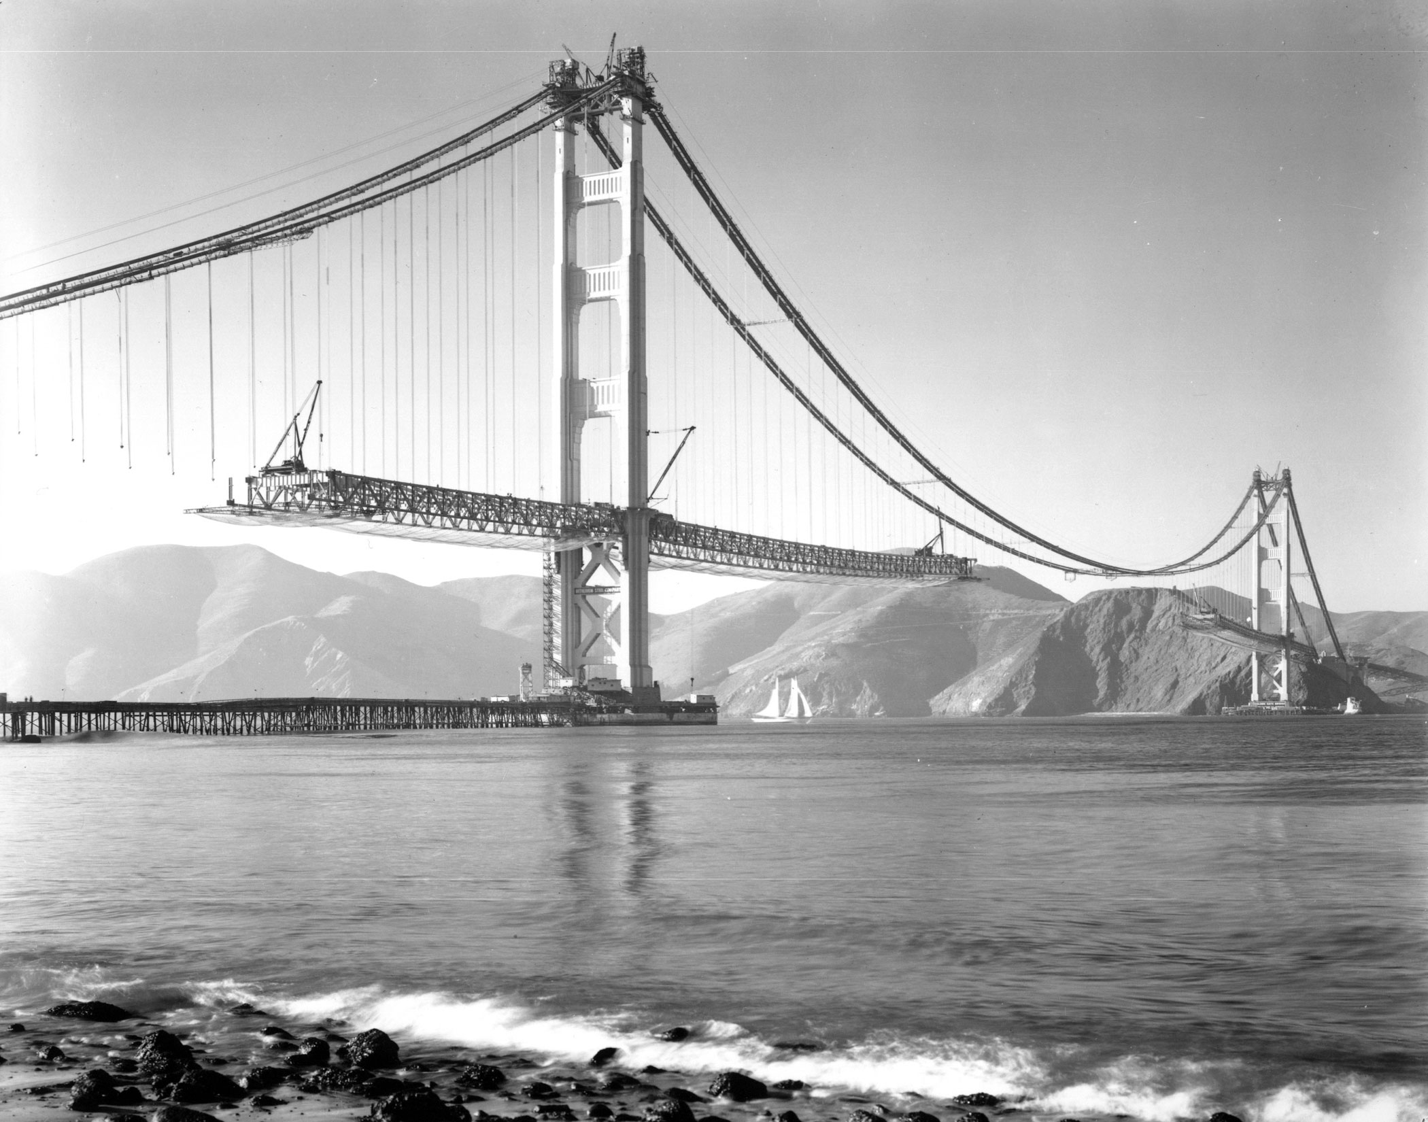
Thanks a lot
for your interest!
https://www.database.industrialecology.uni-freiburg.de/

