Slide 1
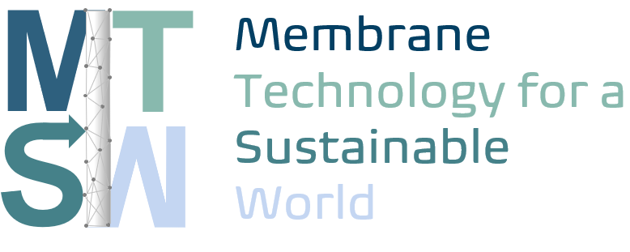


AI-Assisted Extraction and Harmonization of Life Cycle Inventory Data for Emerging Technologies
BrightCon 2026 - September 23 - Aalborg, Denmark
Javid Isayev - PhD student
Prof. Patricia Luis
Catholic University of Louvain
Prof. Guido Sonnemann
University of Bordeaux
Horizon MSCA-2023-DN
Funded by the European Union

Slide 2

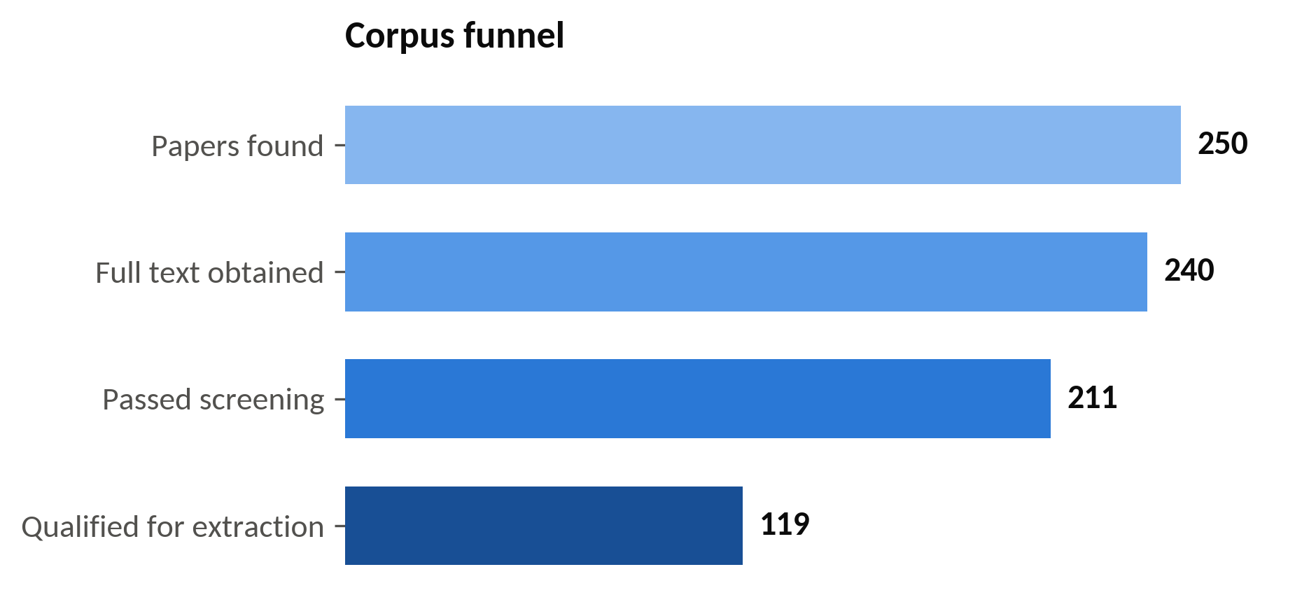


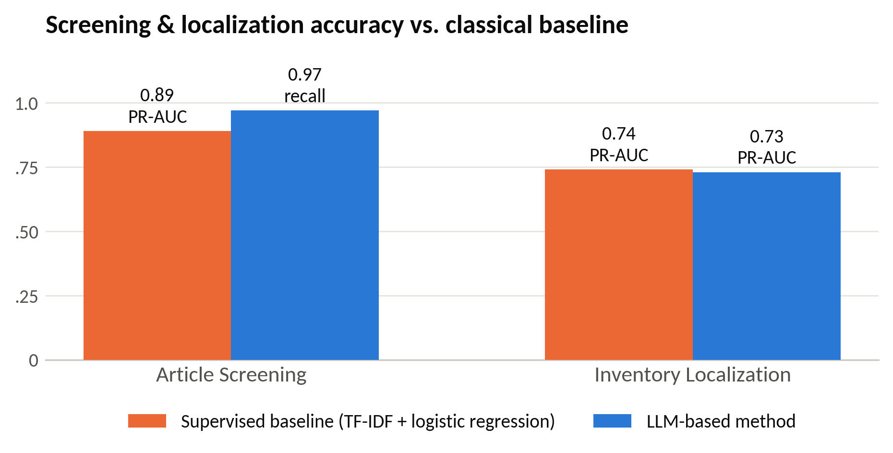


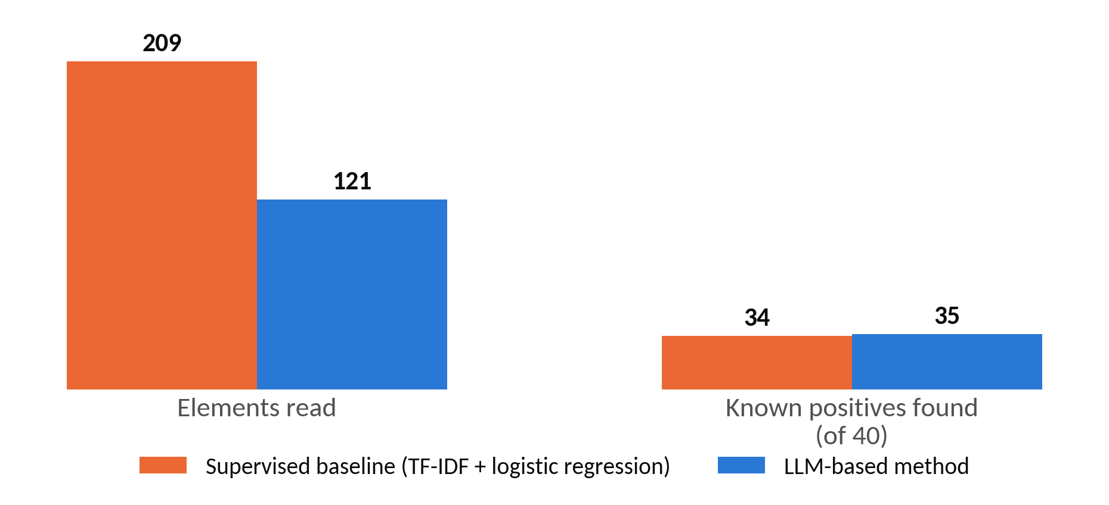

AI-Assisted Extraction and Harmonization of Life Cycle Inventory Data for Emerging Technologies
Motivation
Scientific publications contain valuable LCI information, but the data are often:
distributed across articles and supplementary files;
reported in different formats and terminology;
embedded in text, tables and figures;
difficult to extract systematically at large scale.
AI-Assisted LCI Extraction Workflow
Case study
Natural fiber production for composite materials
1
Literature Collection
Systematic search & full-text retrieval
2
Figure 1. Corpus funnel
Preparation
File verification, merging, OCR & cataloguing
3
Article Screening
Eligibility assessment for inclusion
4
Figure 2. Screening and localization performance compared with the supervised baseline
Inventory Localization
Identify relevant tables & figures
5
LCI Data Extraction
Structured extraction & source verification
6
Figure 3. Extraction-targeting efficiency compared with the supervised baseline
LCI Data Harmonization
Standardization & dataset consolidation
PR-AUC - Precision-Recall Area Under the Curve
TF-IDF - Term Frequency-Inverse Document Frequency

