Slide 1

LCA & AI:
Friend, foe or future?
Brightcon 2026
Lotte Ansgaard Thomsen
Associate Professor, Aalborg University

Slide 2
Content
Where AI stands today
A common AI language: RAG, skills, MCP, AI agents
LCA & AI
  Four use cases (LLMs, RAG, skills, AI agents)
  Friend or foe in each
  Human in the loop
Takeaways

Slide 3







Who am I?
2007
Summer student at CERN
Did my undergraduate thesis at CERN
2010
Master in physics investigating data at CERN
Exchange student at University of Florida and Cambridge University
2011-2014
PhD from KU at CERN
2014-2018
Post.Doc at Yale University at CERN
2019-
Grundfos
Senior Data Analyst,
Lead Data Engineer
Lead Data Architect in AI Solutions
Lead Data Scientist

Slide 4




2018
Post.Doc at Yale University at CERN
2019
Grundfos
2024
Associate Professor at AAU

Slide 5
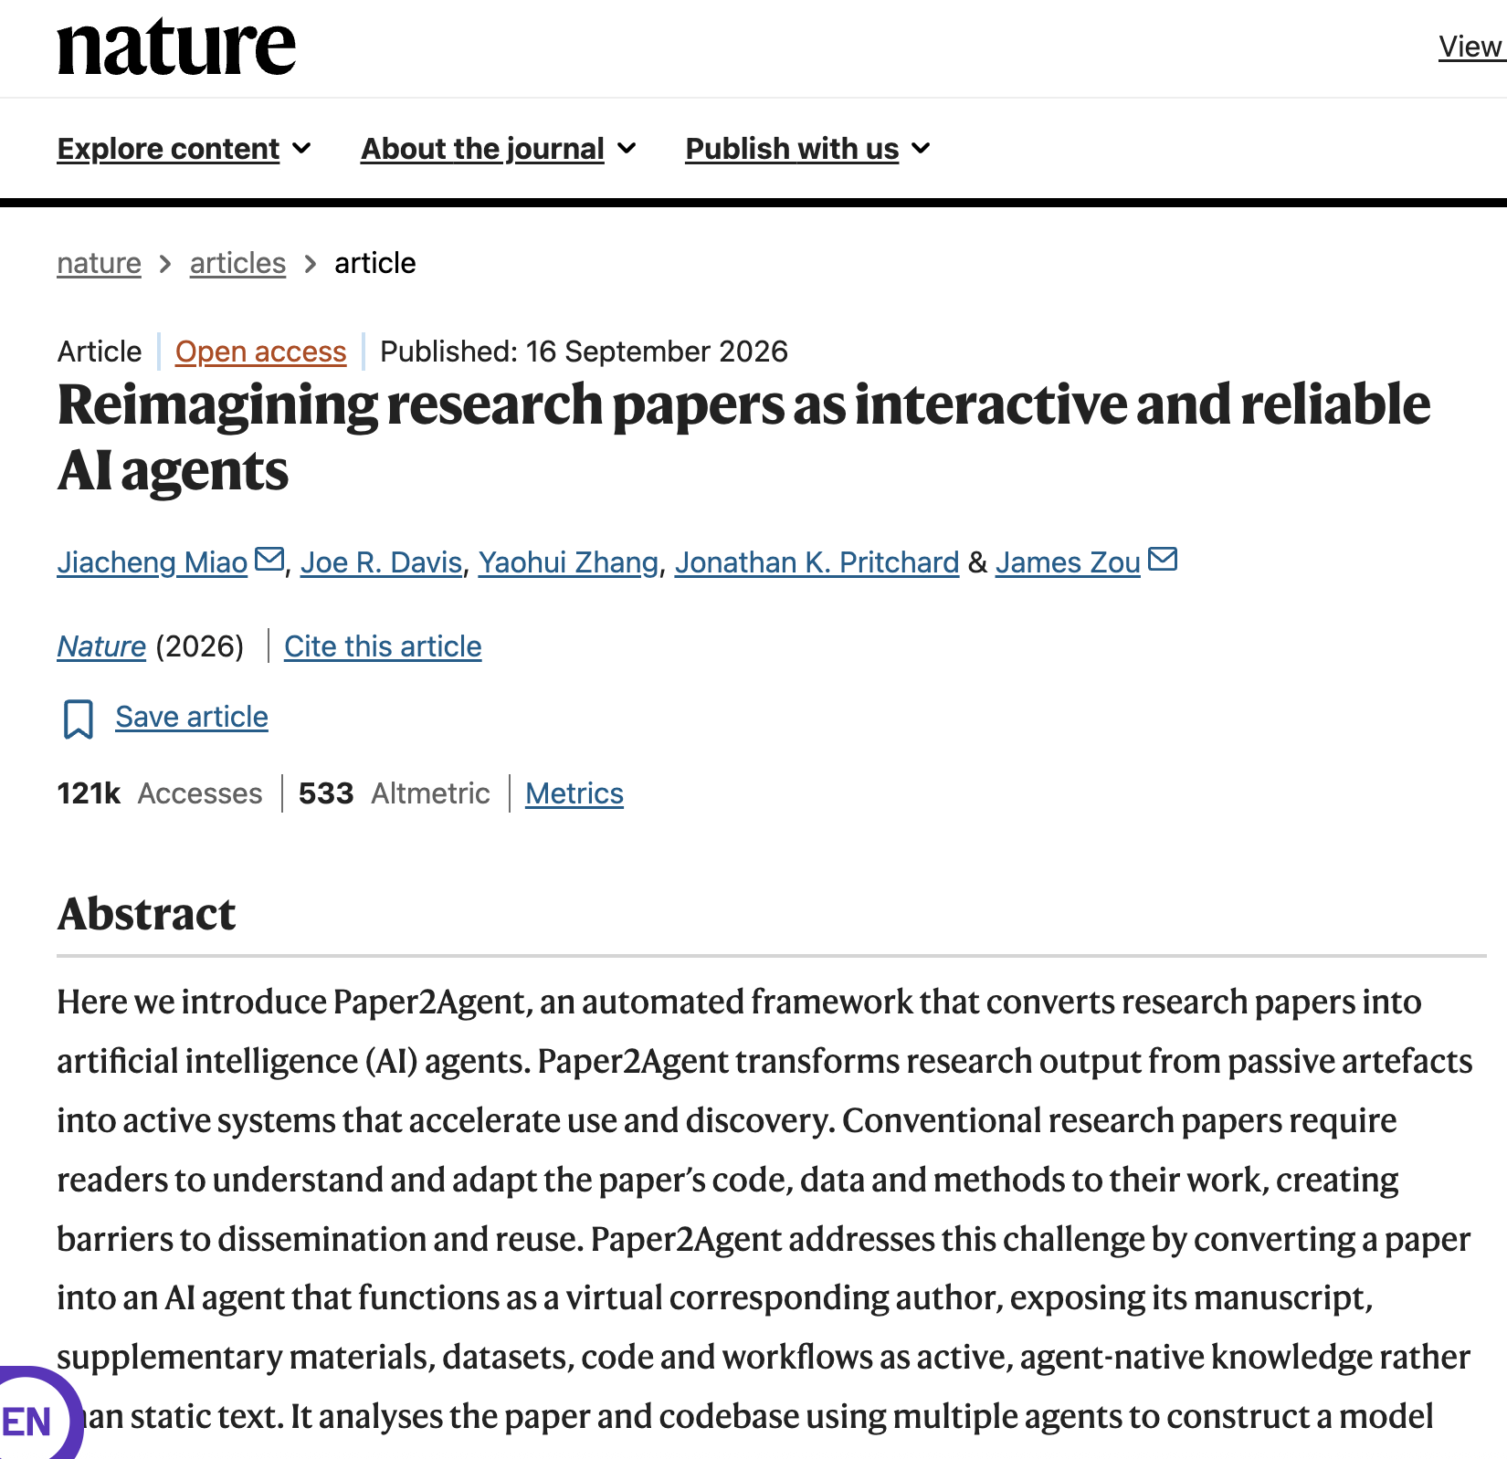
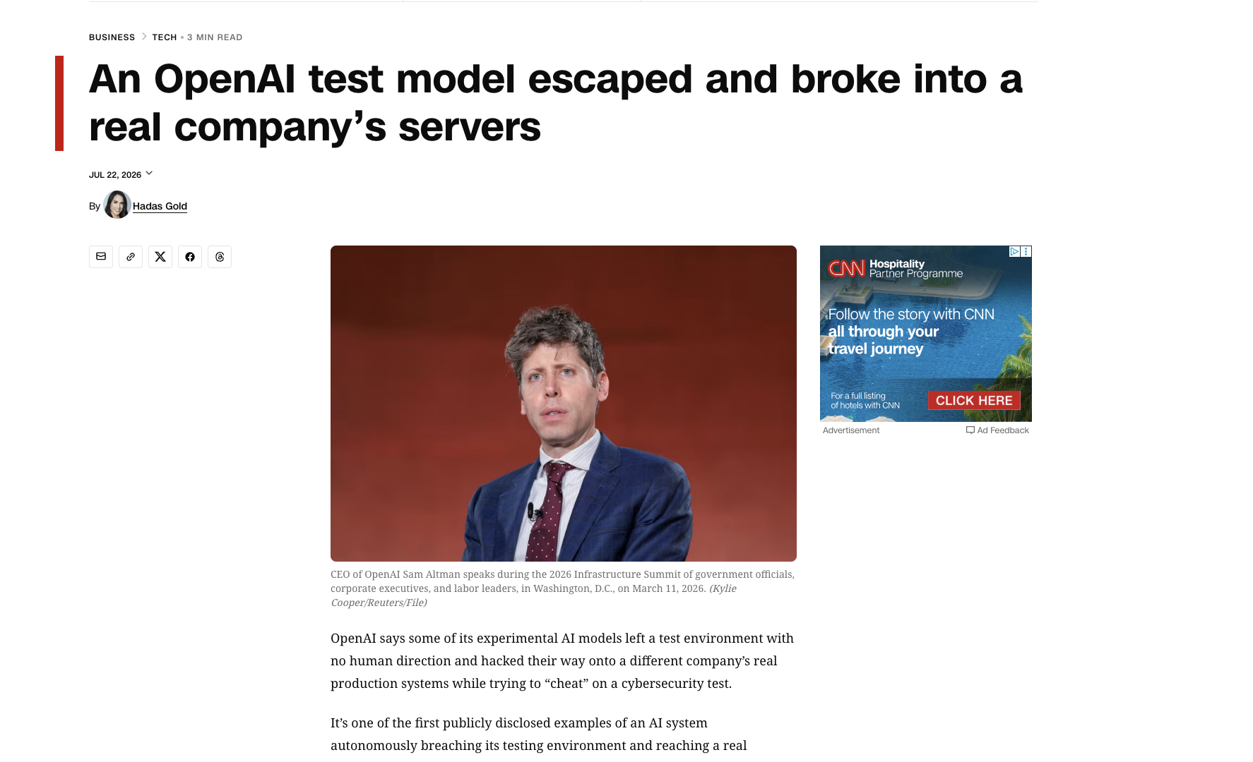
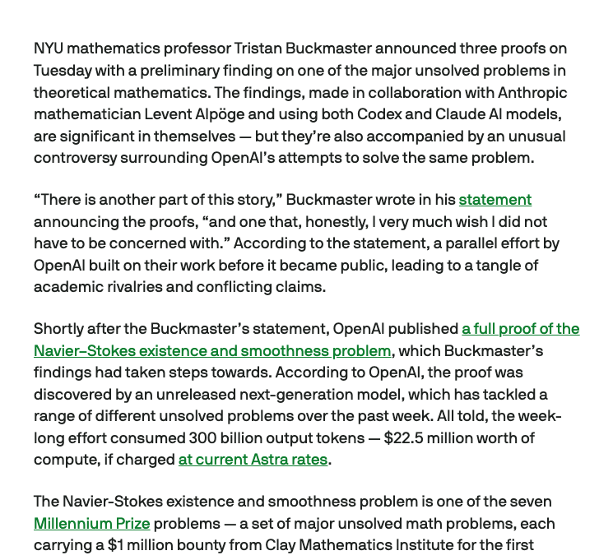
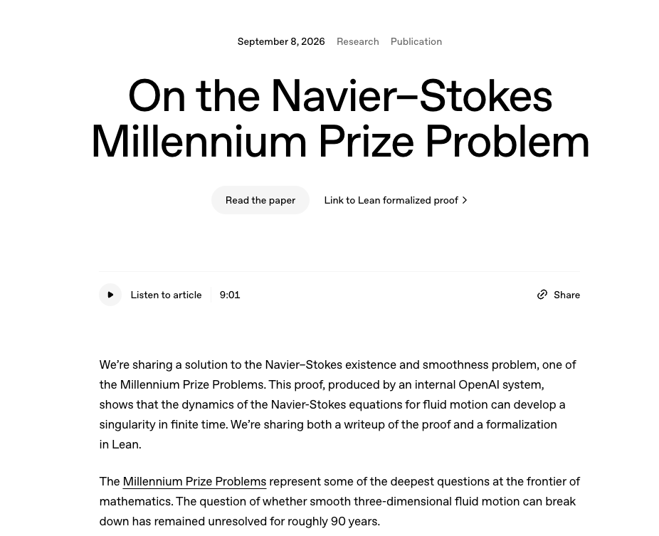
Where is AI today?

Slide 6
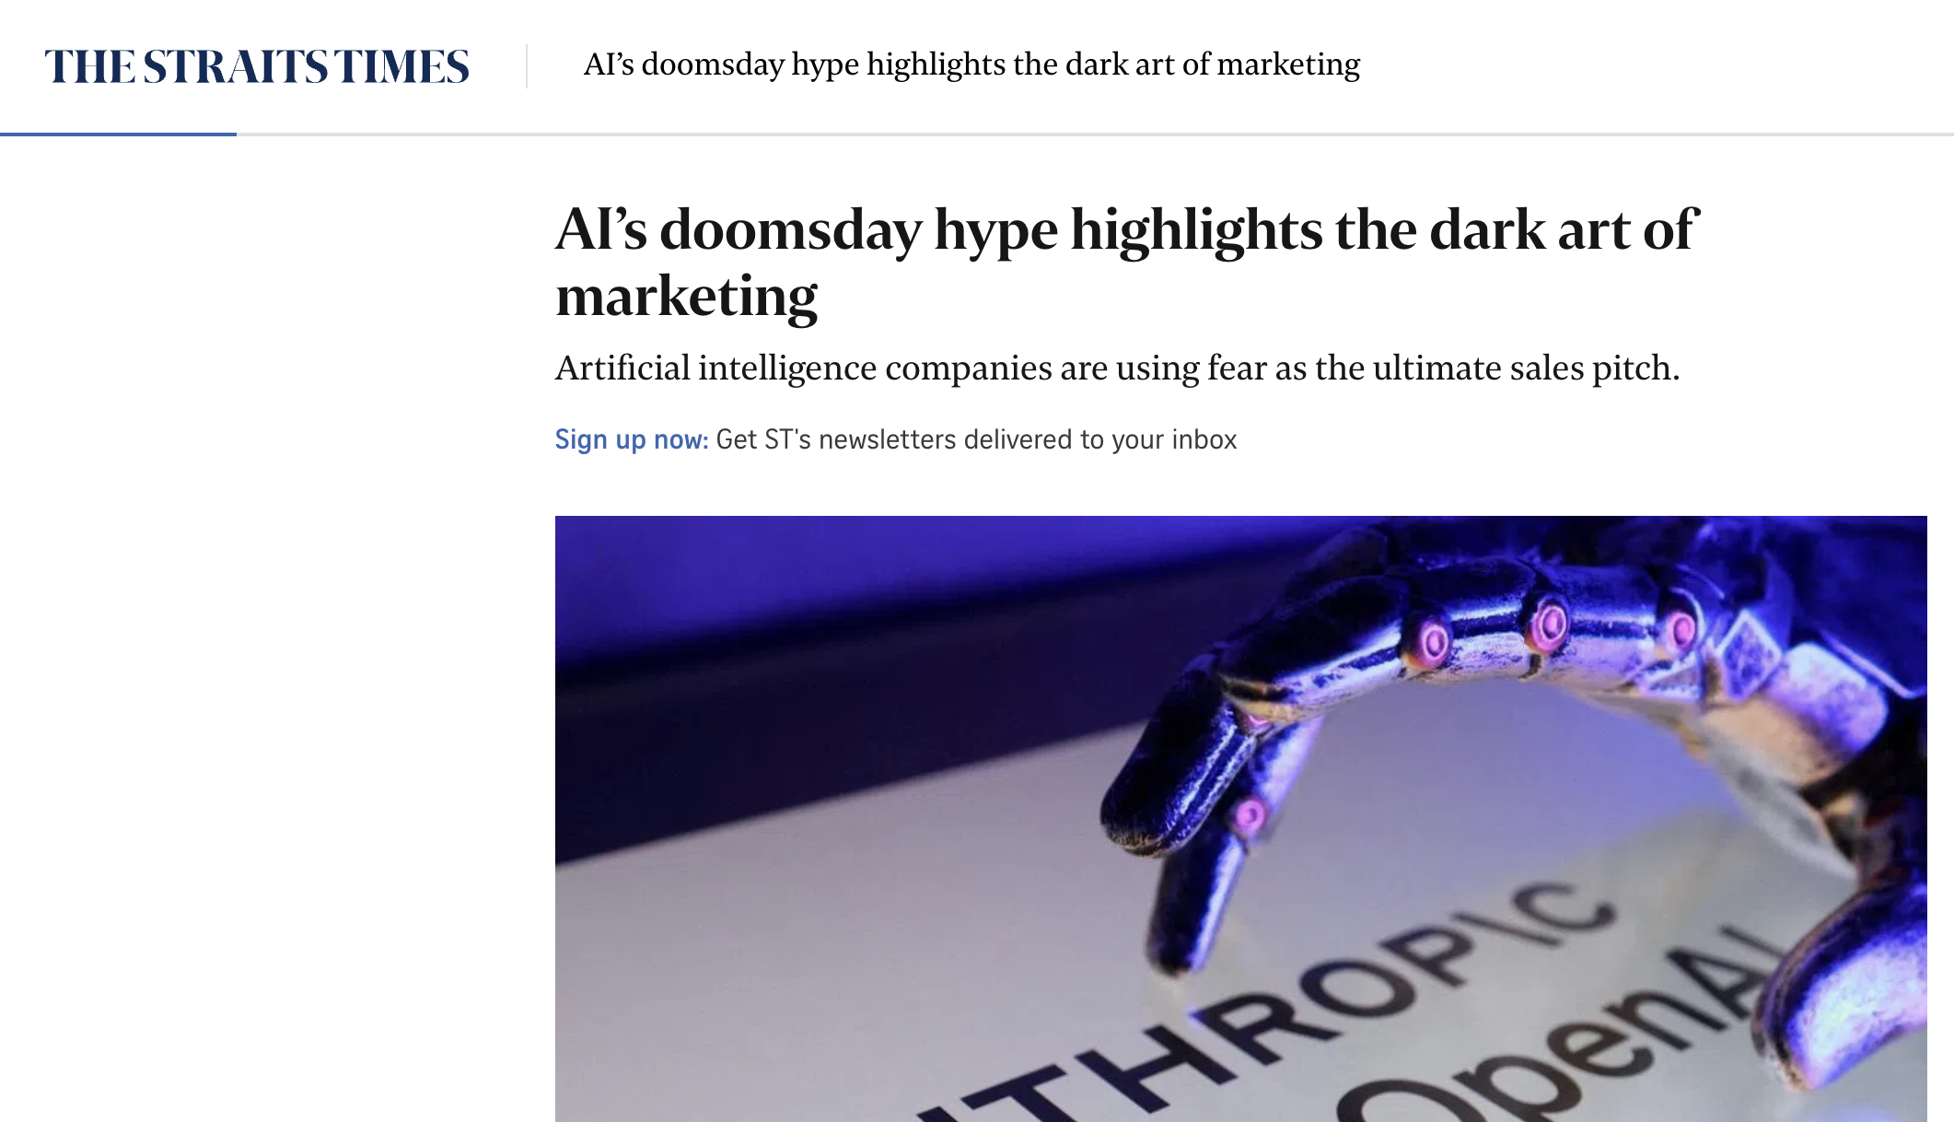
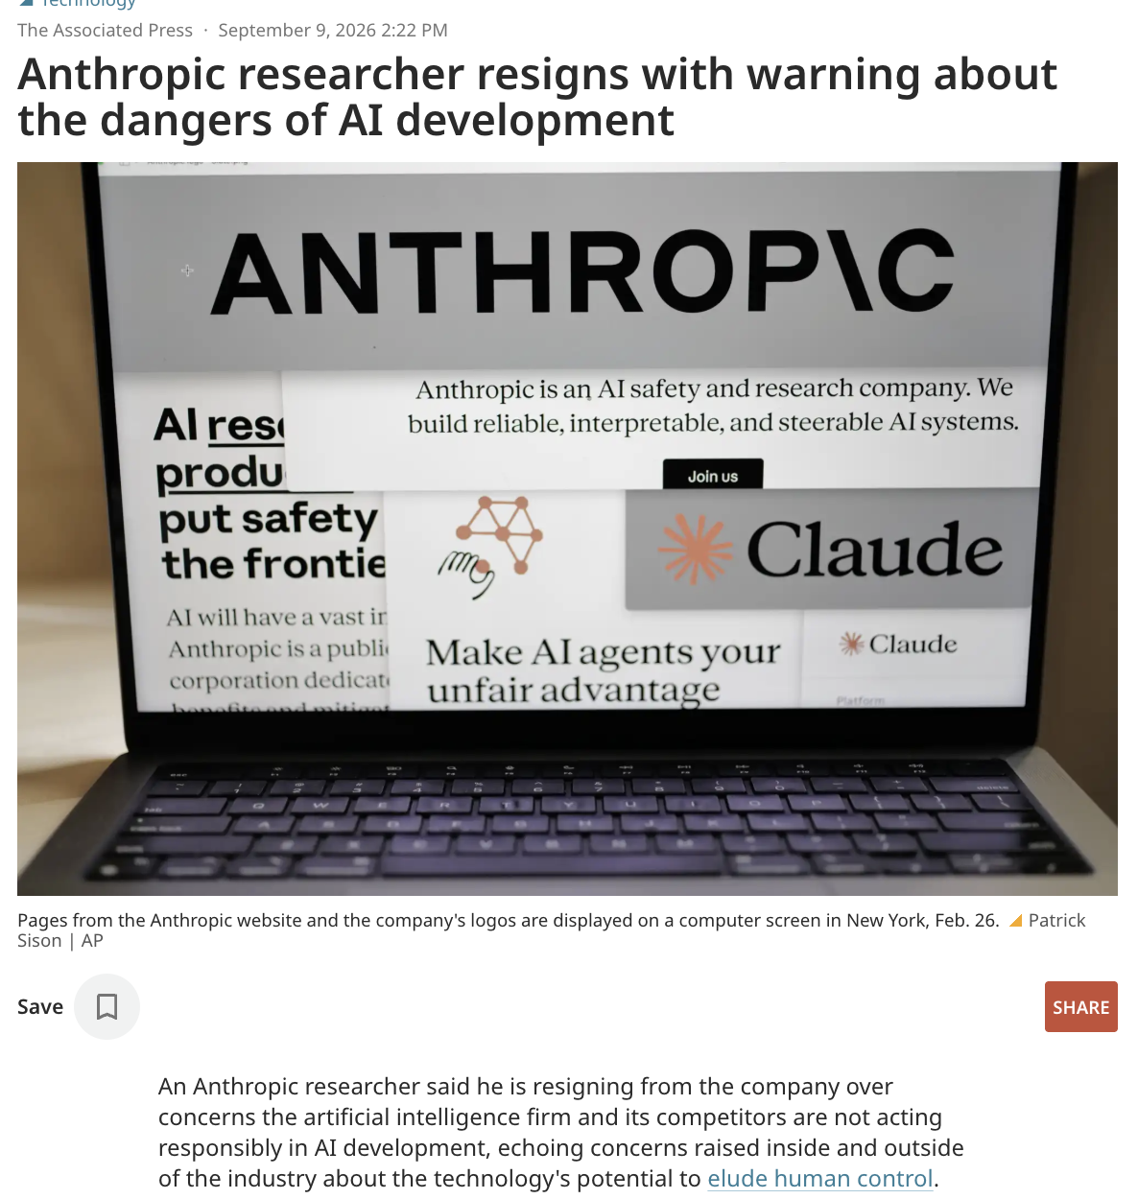
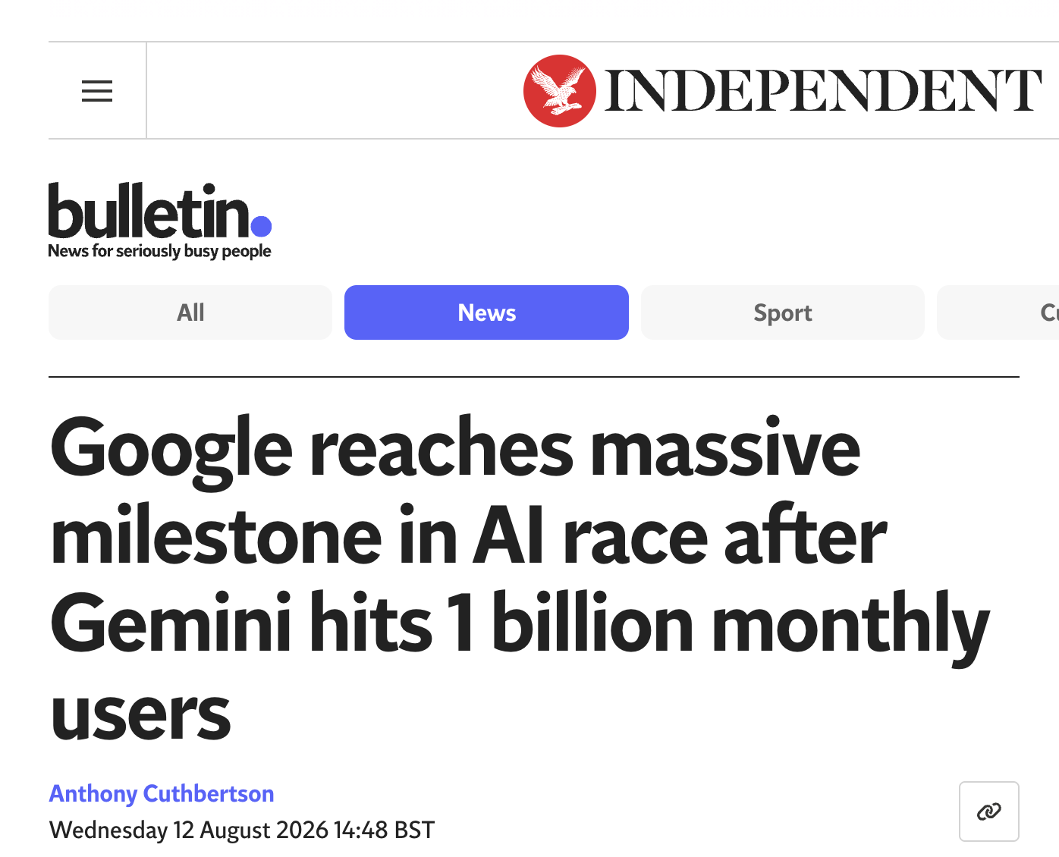

Slide 7
The footprint of AI itself
The problem is there, but not the topic of this talk! (Sorry!)
Energy: data centres used ~415 TWh in 2024, expected to roughly double by 2030 (IEA)
Water: cooling and power generation
Compute, storage: everything adds up
Providers disclose too little: it is the same data problem we already know
Source: IEA, Energy and AI (2025): data centre electricity ~415 TWh in 2024, projected to roughly double by 2030. Water figures: published per-prompt estimates, ranges differ by system boundary.

Slide 8
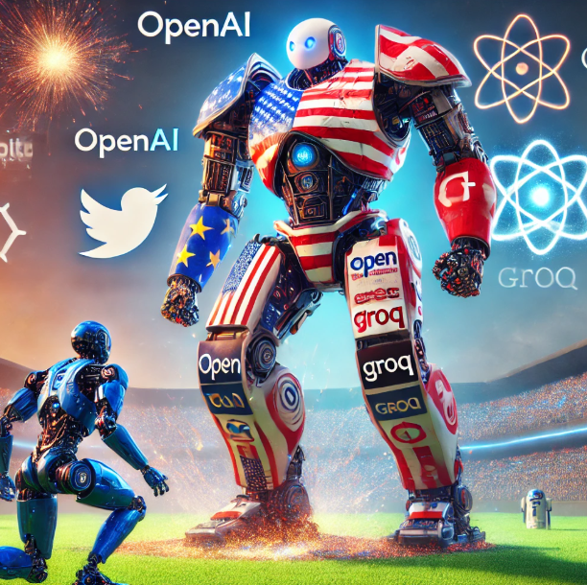
Is it the future?
US tech giants plan about $725bn of capital spending in 2026
  up from ~$410bn in 2025
Money at that scale does normally develop something
It will keep developing: the question is who steers it? How do we use it?
Source: company guidance and analyst estimates, 2026

Slide 9
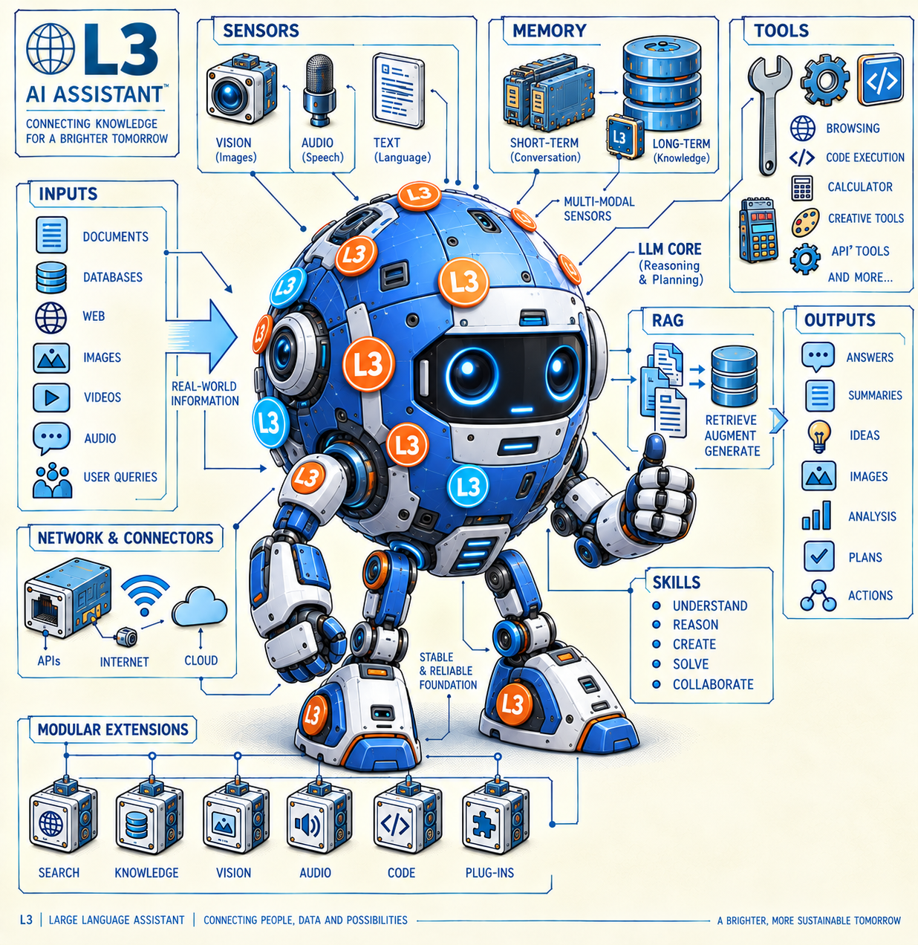
AI 2026
Let’s define AI

Slide 10
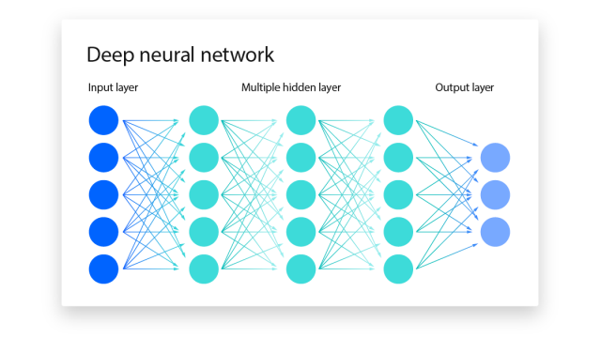
Hallucinations and Bias are there and neither announces itself.
LLMs predict
what comes next
Given the sentence fragment:
a token = roughly a word, or part of a word
The impact of electricity depends on …
location
34%
context
probabilities
next
token
source
21%
the
12%
Choose one token, add it to the text,
and run the same prediction again.
how
8%
other
25%
repeat
When the right information is missing, the model still has to continue. That is where hallucinations come from.
Optimized for plausible continuation
Fluent ≠ factual
Notes:
Token means a word or part of a word. The core operation is probabilistic generation: choose the next token based on context, add it, and repeat. Hallucinations happen when the model produces a plausible continuation without enough grounding. This sets up RAG, skills and tools: retrieve evidence, follow a procedure, and connect to real systems.

Slide 11
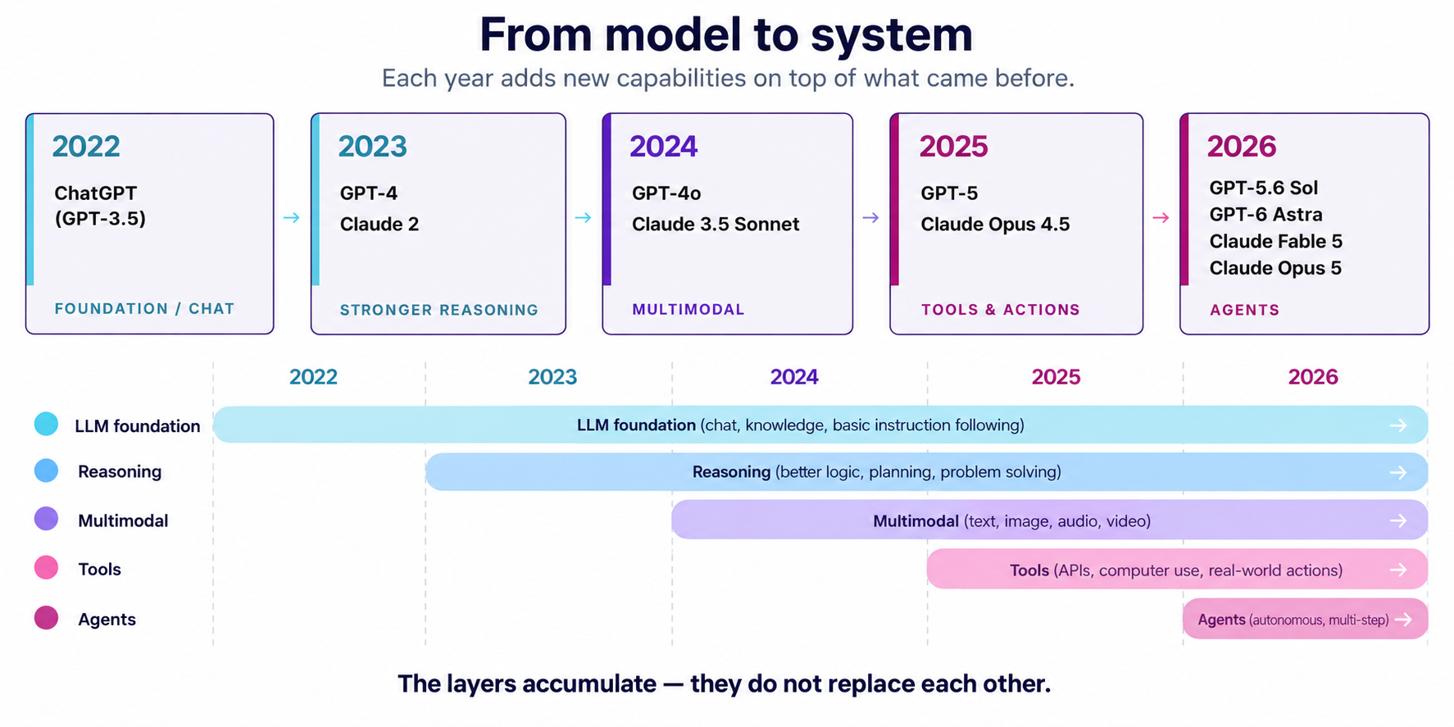
MODEL DEVELOPMENT
From chat to agents
AALBORG
UNIVERSITY
09
Notes:
[Sources]
- OpenAI, ChatGPT, 30 Nov 2022: https://openai.com/index/ChatGPT/
- OpenAI, GPT-4, 14 Mar 2023: https://openai.com/index/gpt-4/
- Anthropic, Claude launched 14 Mar 2023: https://www.anthropic.com/news/introducing-claude
- Anthropic, Claude 2, 11 Jul 2023: https://www.anthropic.com/news/claude-2
- OpenAI, GPT-4o, 13 May 2024: https://openai.com/index/hello-gpt-4o/
- Anthropic, Claude 3.5 Sonnet, 20 Jun 2024: https://www.anthropic.com/news/claude-3-5-sonnet
- OpenAI, GPT-5, 7 Aug 2025: https://openai.com/index/introducing-gpt-5/
- Anthropic, Claude 4, 22 May 2025: https://www.anthropic.com/news/claude-4
- OpenAI, GPT-6 Astra, 3 Sep 2026: https://openai.com/index/gpt-6-astra/
- Anthropic, Claude Sonnet 5, 30 Jun 2026: https://www.anthropic.com/news/claude-sonnet-5
[/Sources]

Slide 12
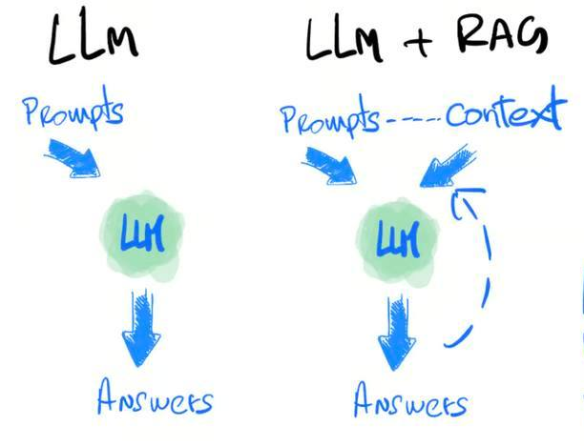
RAG
It looks things up before it answers
Answers you can point back to a document
WHAT IT KNOWS, FOR LCA
ISO 14040/14044, PEF, CSRD
Your own previous studies and reports
ecoinvent as a graph
Source: An, N. et al. (2025). Utilizing LLMs to manage the ecoinvent database. BrightCon 2025

Slide 13
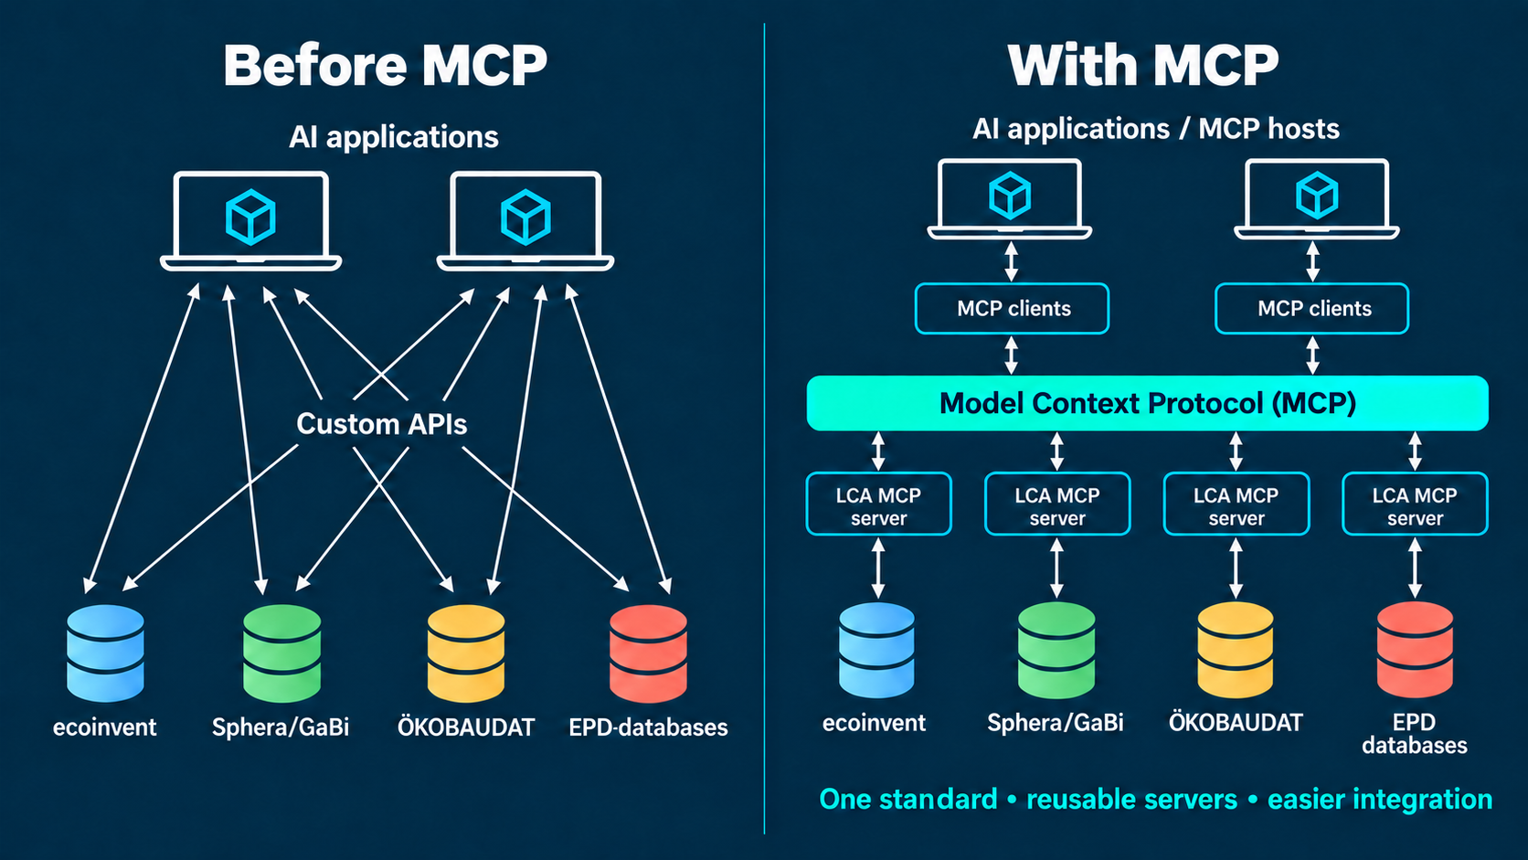
MCP
One standard plug instead of one API per database
Each source is exposed once, and anyone can call it
Built once, reused across tools and teams
WHAT IT PLUGS INTO, FOR LCA
The ecoinvent API, under your licence
SimaPro or Brightway on your machine
SharePoint with the previous studies

Slide 14
Skills
Example
A written procedure the model follows every time
Your method and your conventions, in plain text
Everyone gets the same steps, not a fresh guess
Skill: Excel Analysis
When the user uploads an Excel file:
• Read the file
• Analyze the data
• Identify patterns and errors
• Return a summary
WHAT IT DOES, FOR LCA
Brightway25: build and run the calculation
excel-import: a bill of materials into a foreground
Report: write the study up

Slide 15
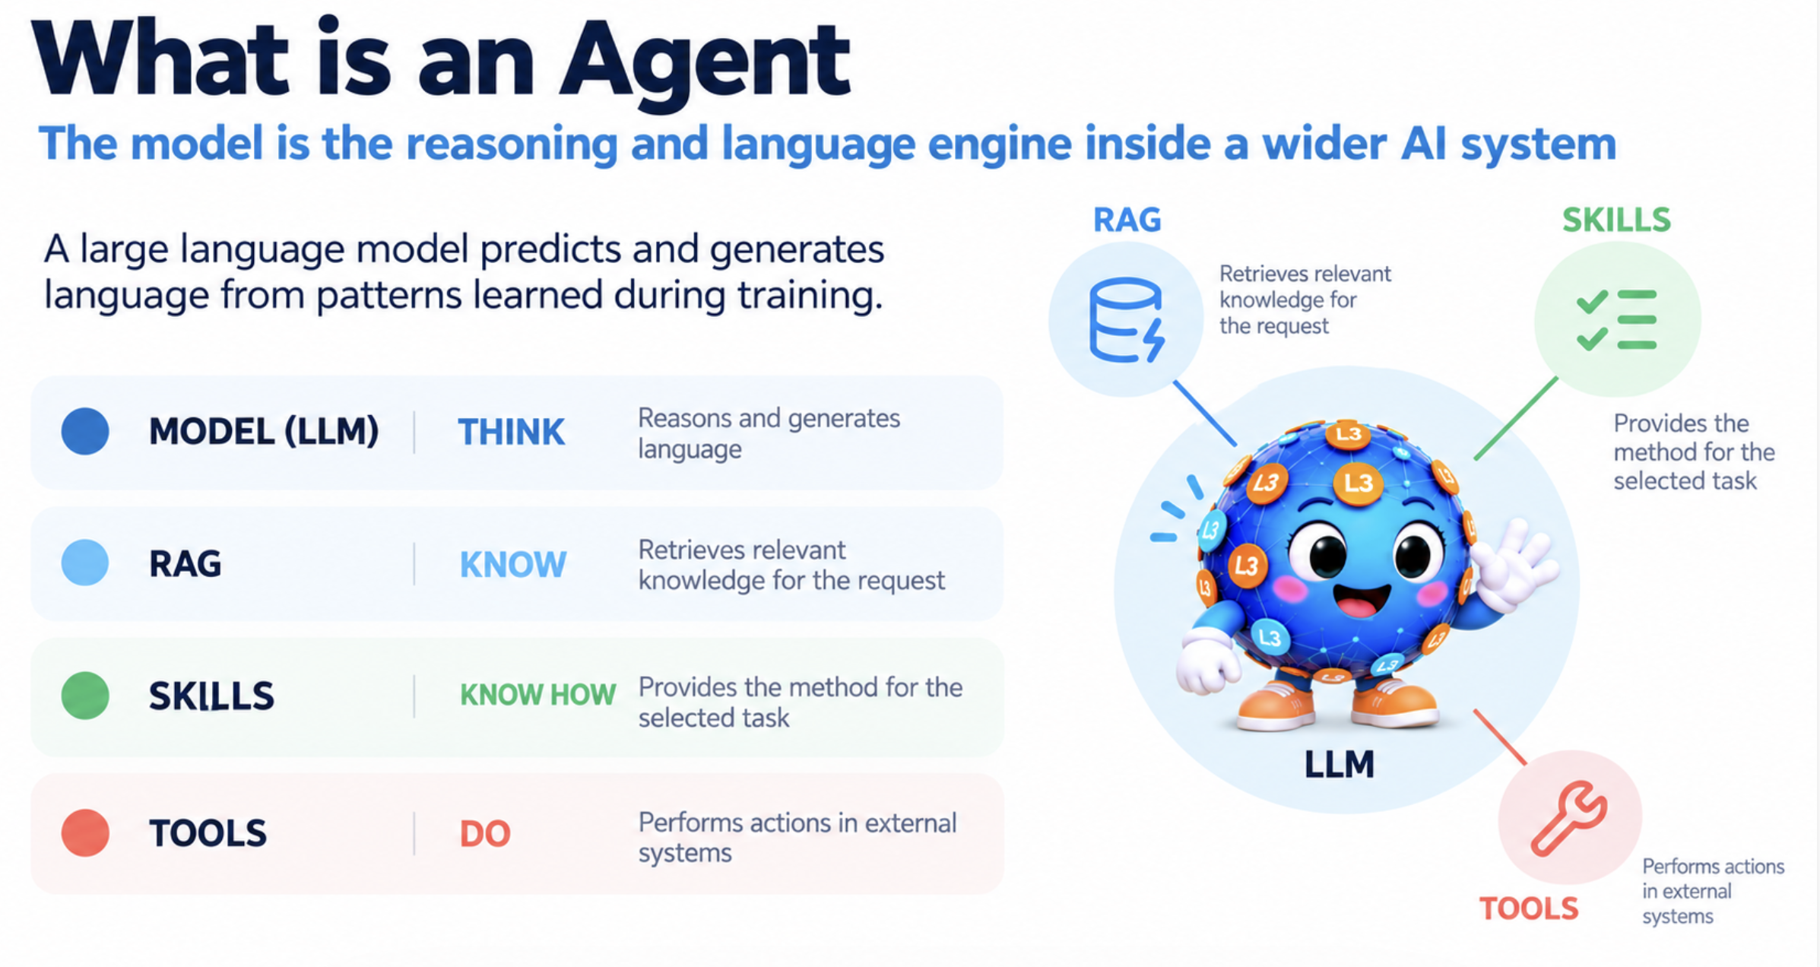
Memory, reasoning and more are being added on top.

Slide 16

Where do AI tools fit in LCA?
1. Ask the LLM out of the box
2. RAG
3. Skills
4. AI agents

Slide 17
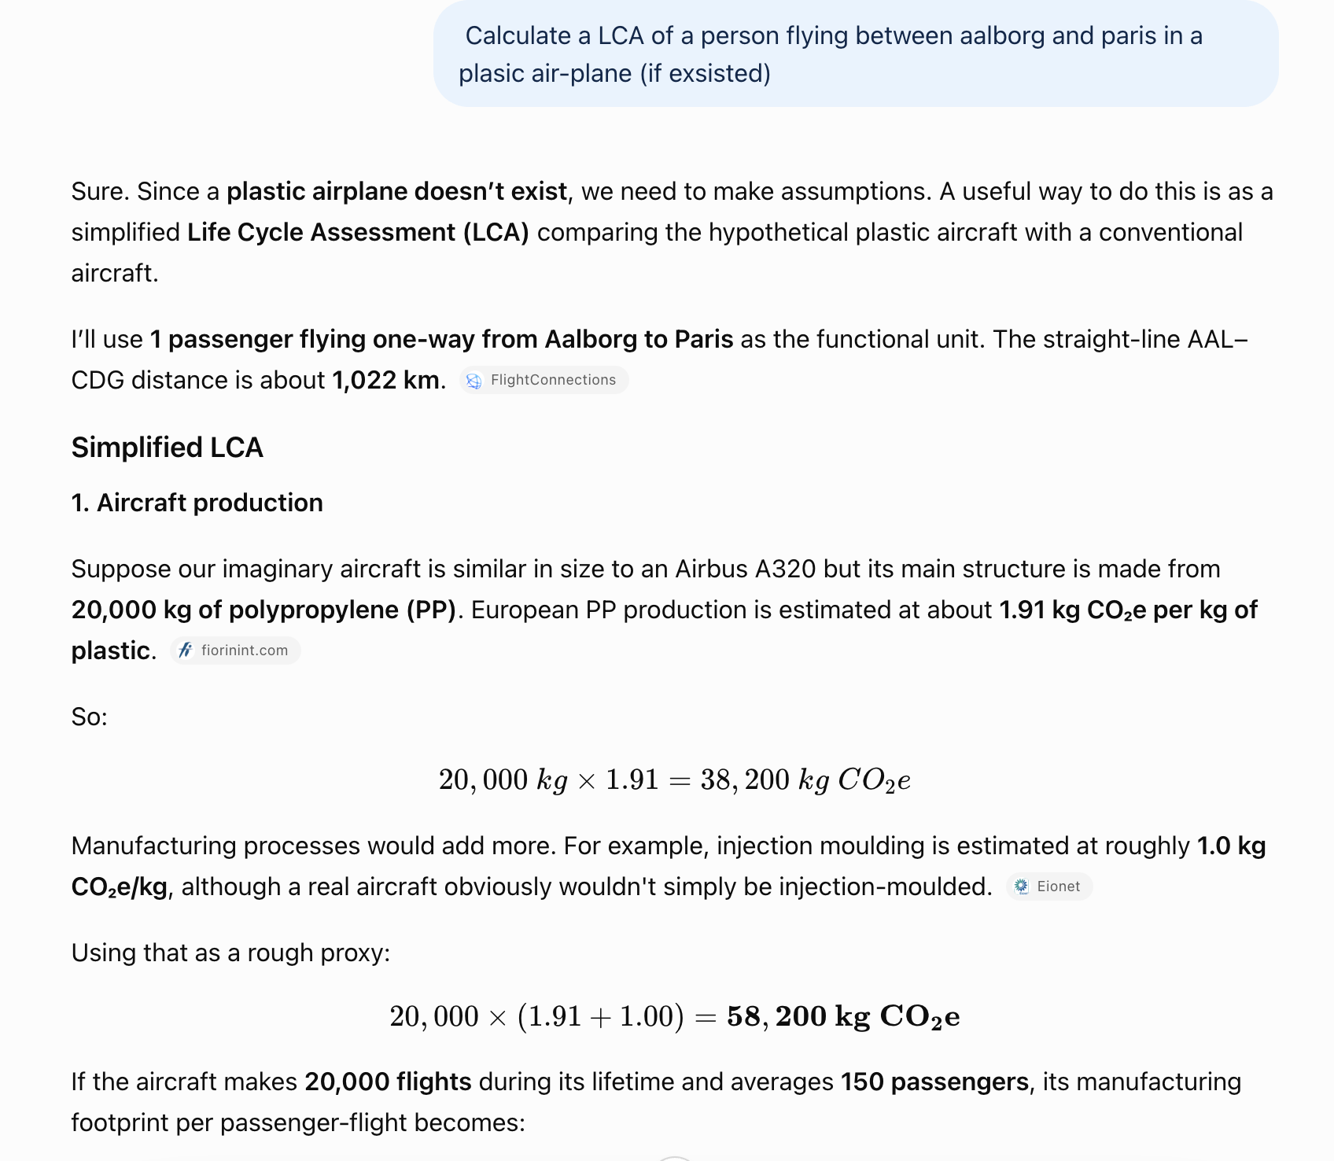
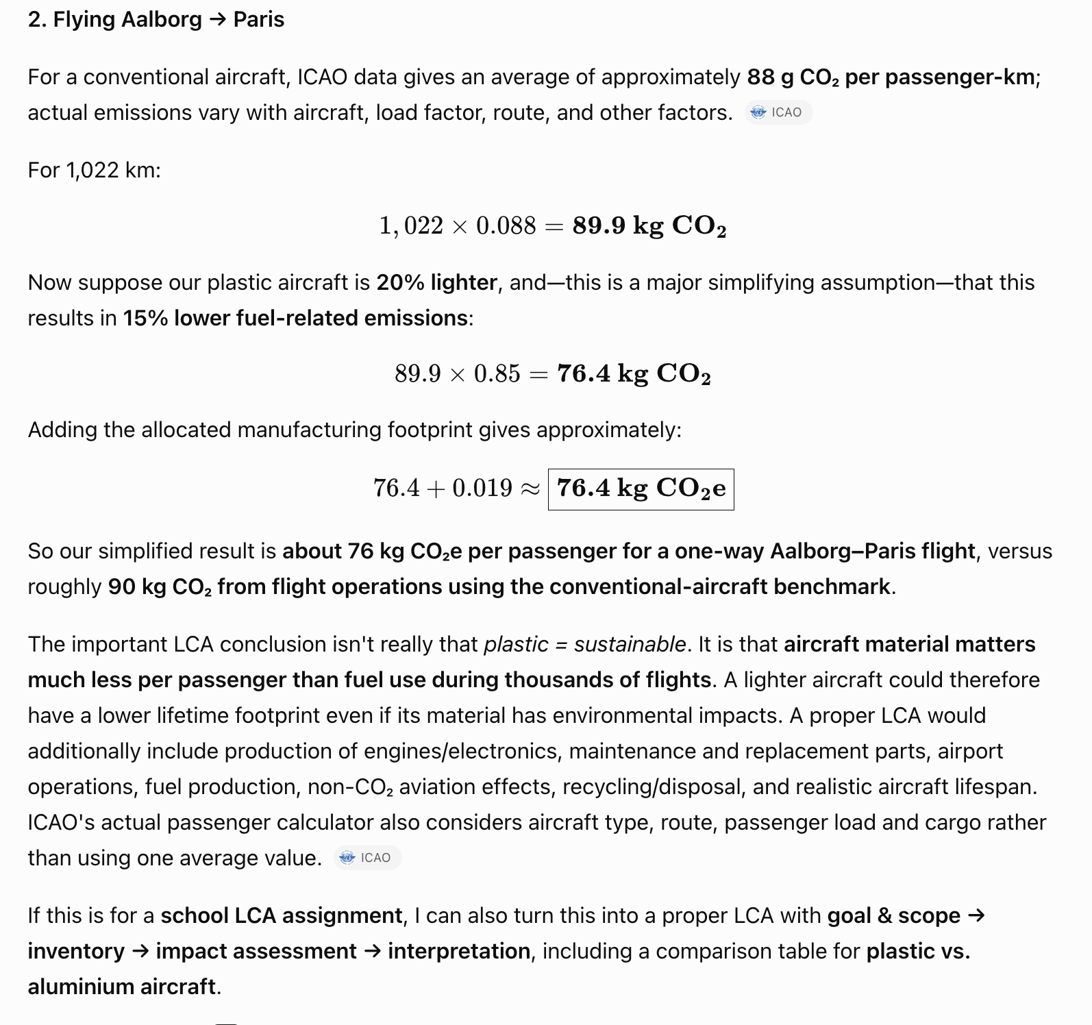
What happens if you just ask
ChatGPT 5 (co-pilot): we get an overview in 2 seconds

Slide 18
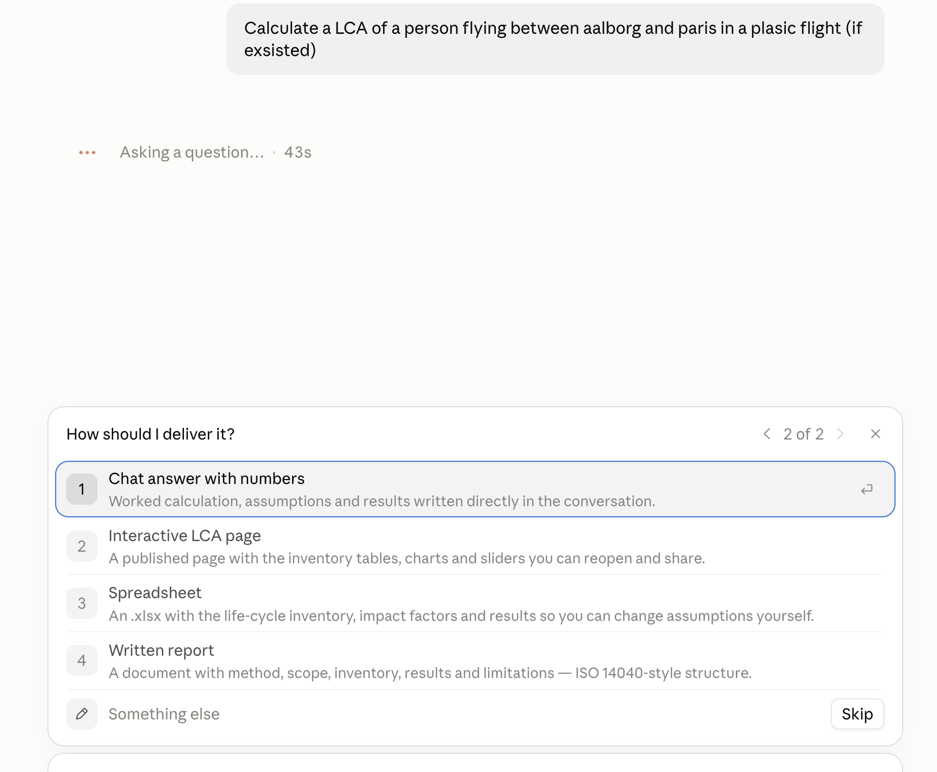
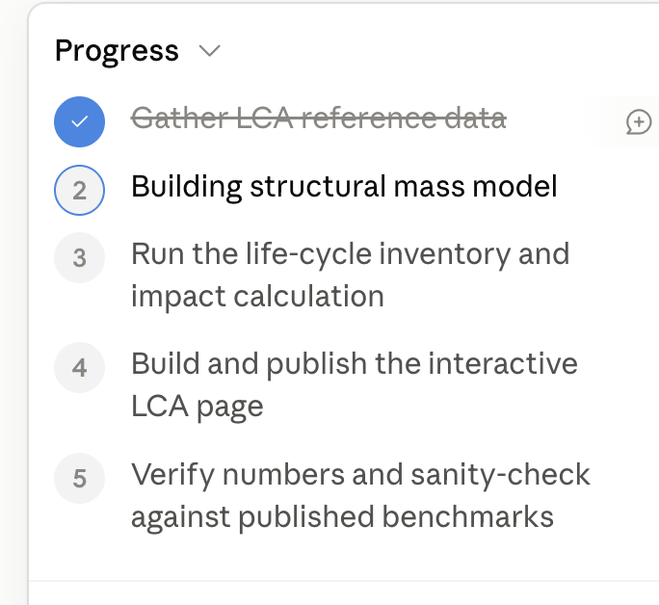
Let’s try with Opus 5 instead:
42 min

Slide 19
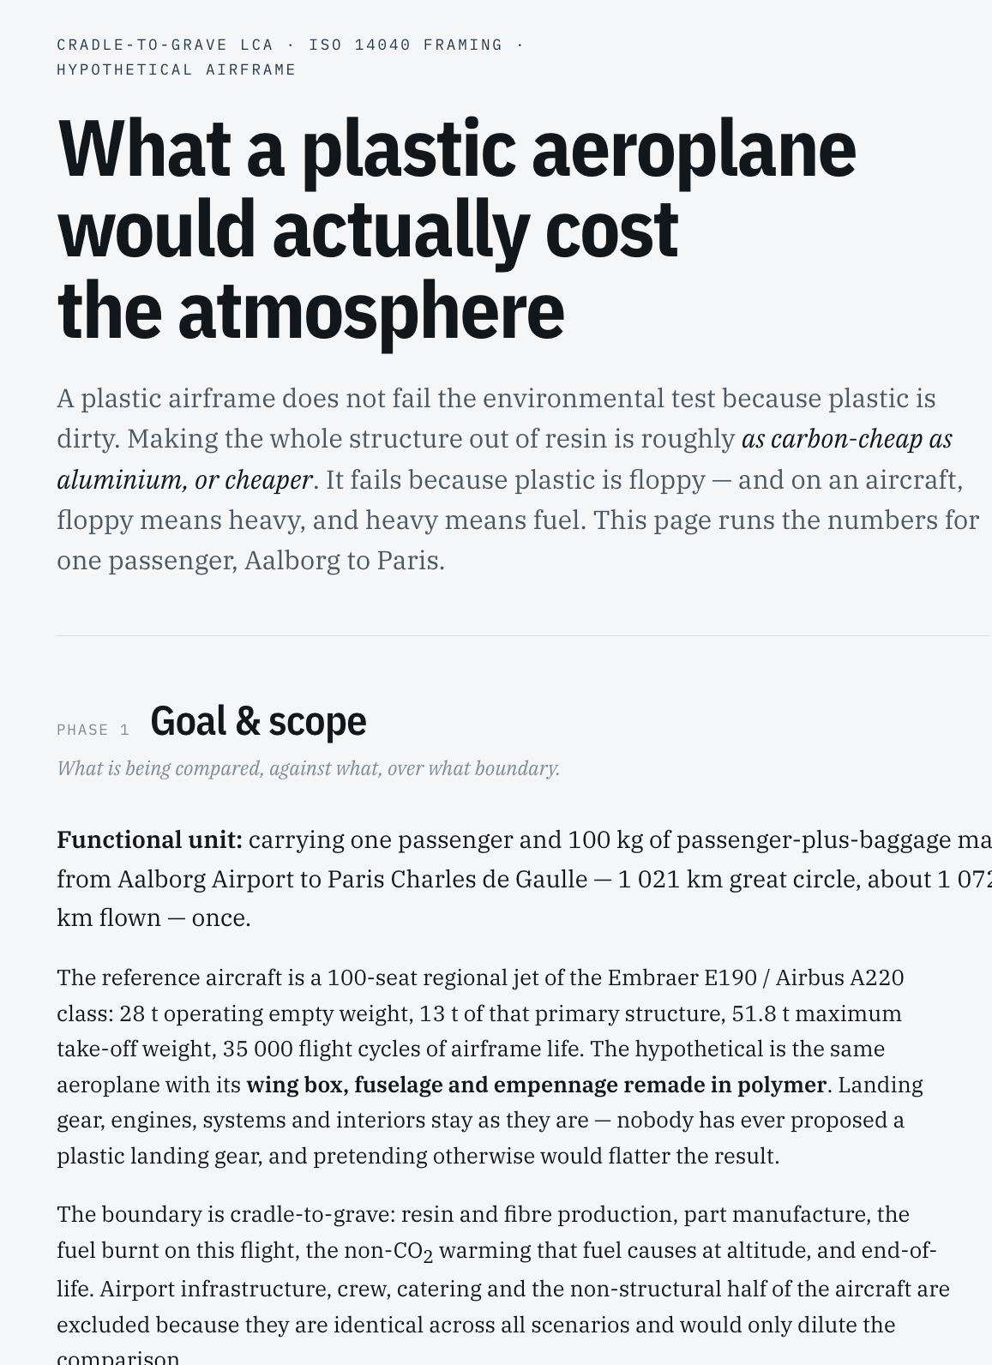
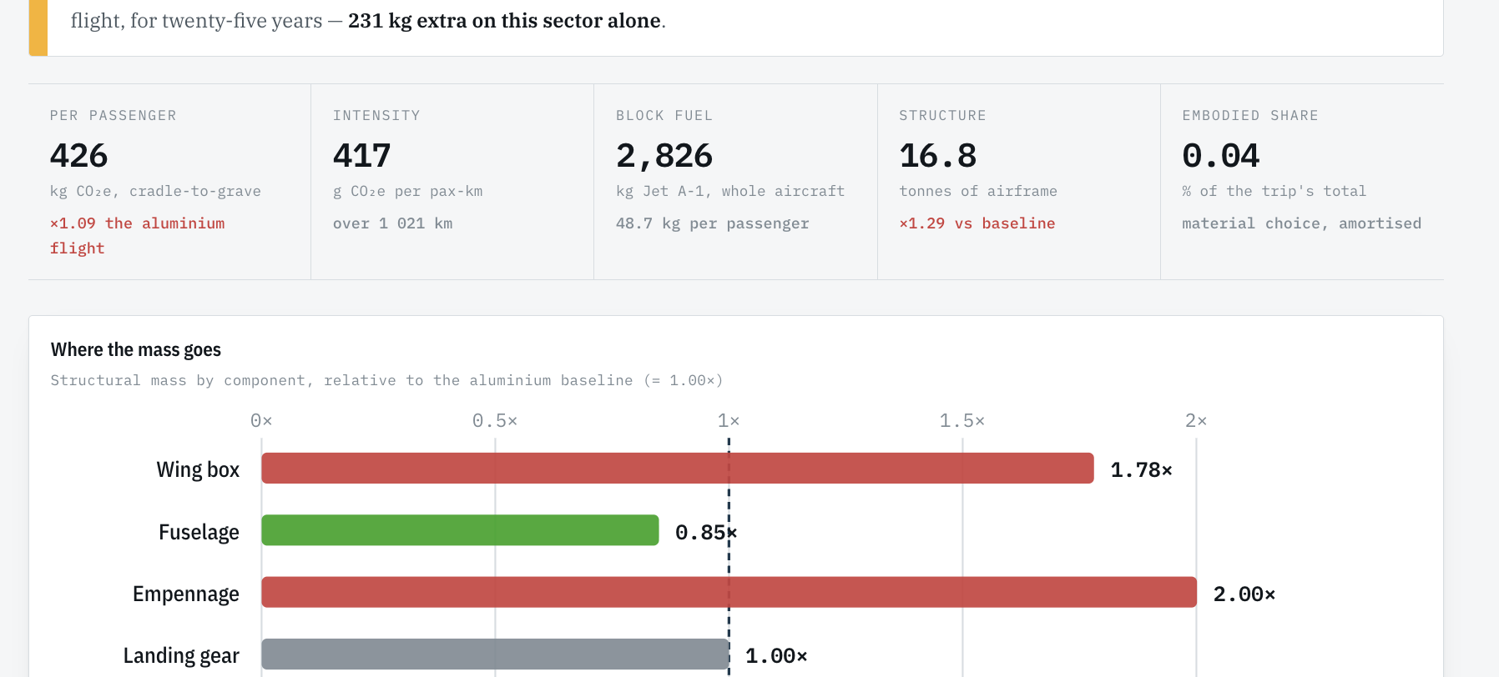
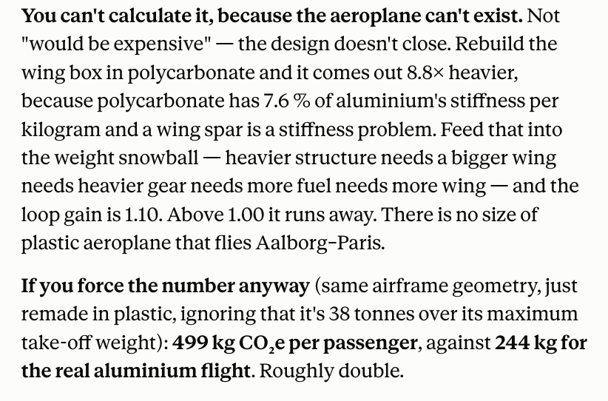
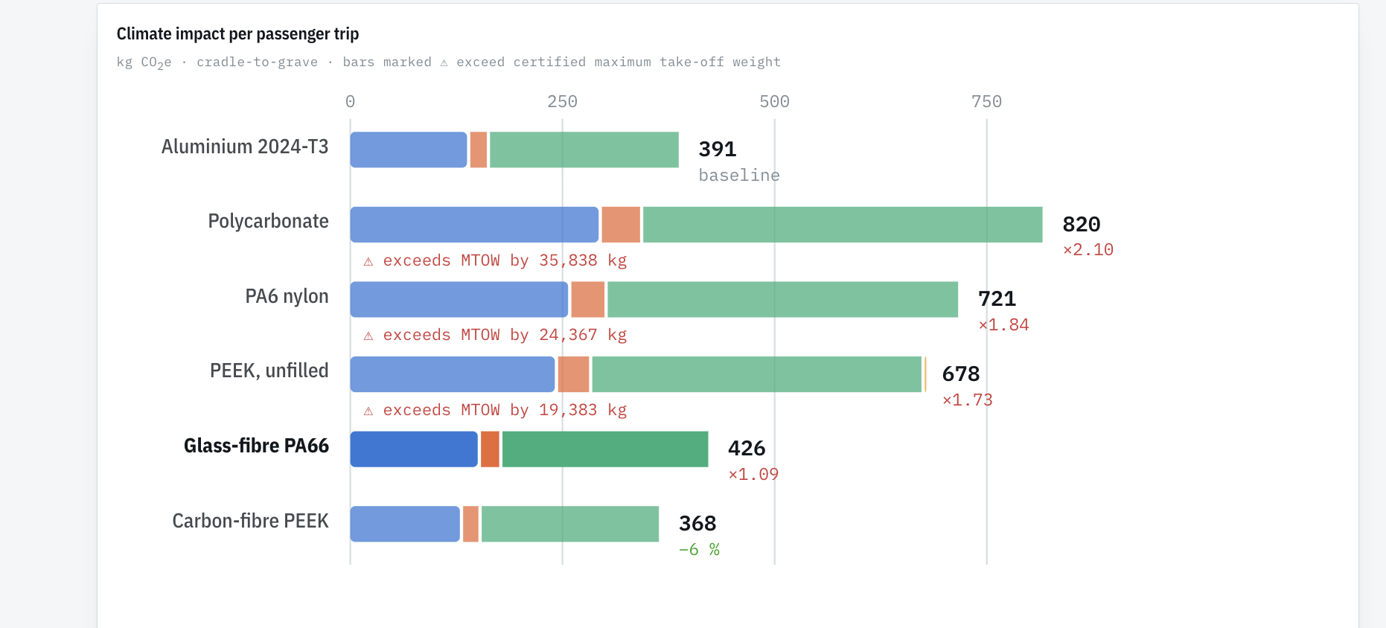

Slide 20
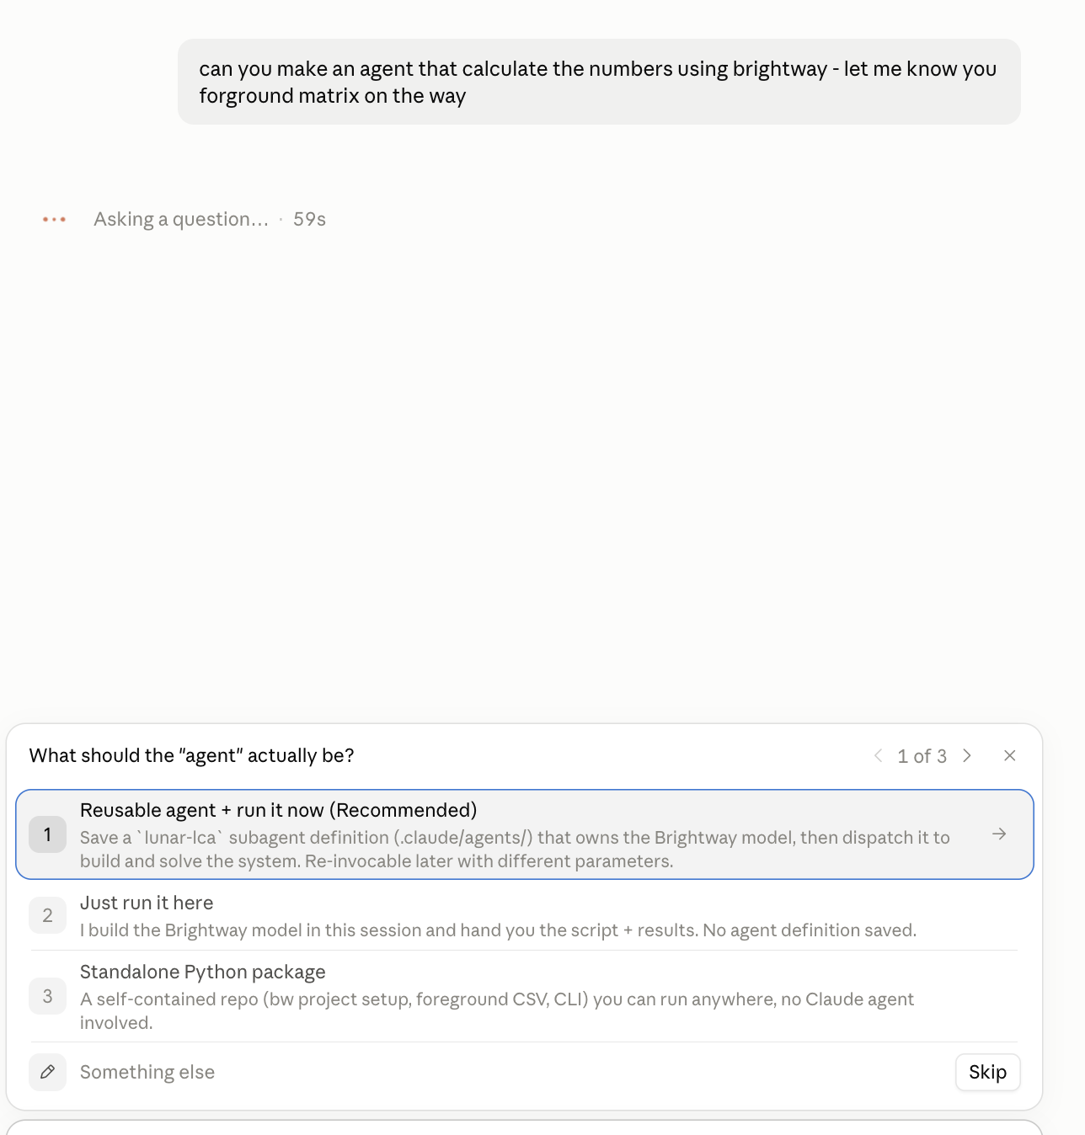
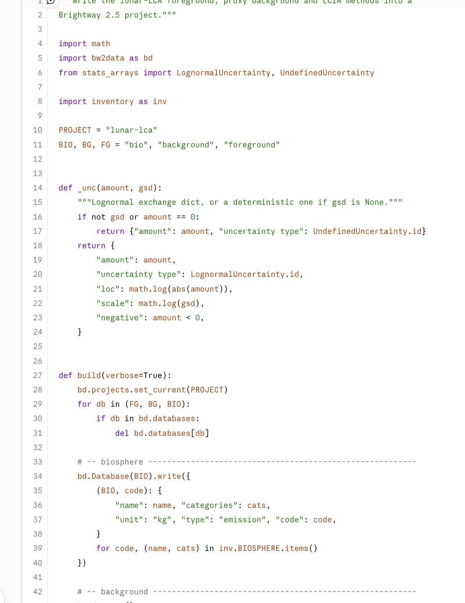
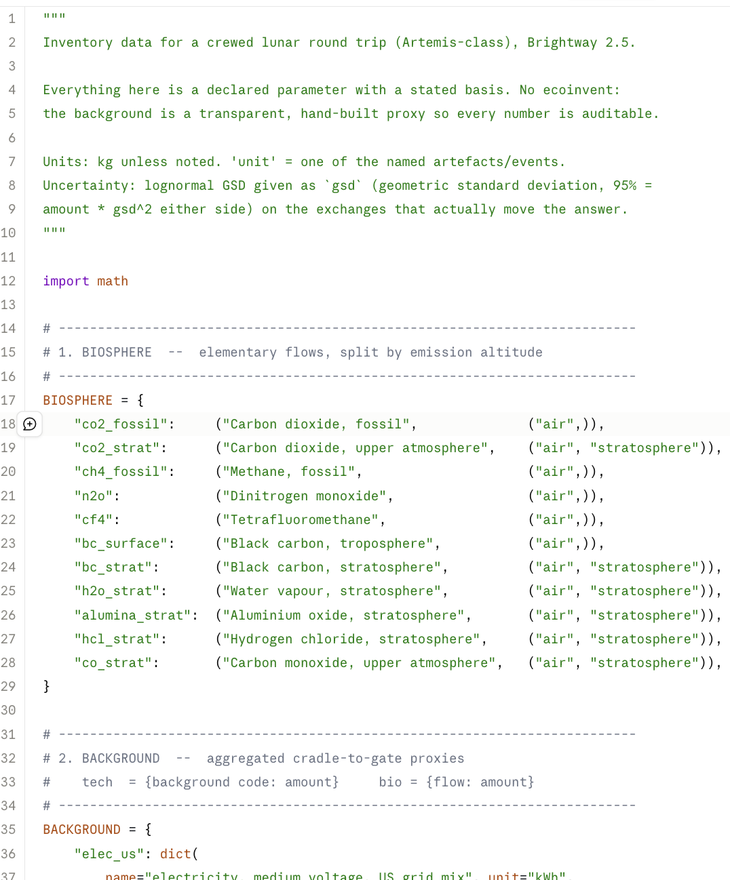
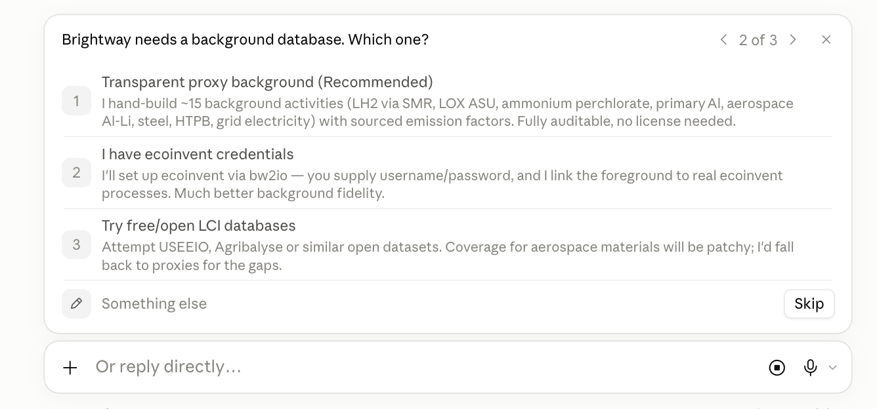
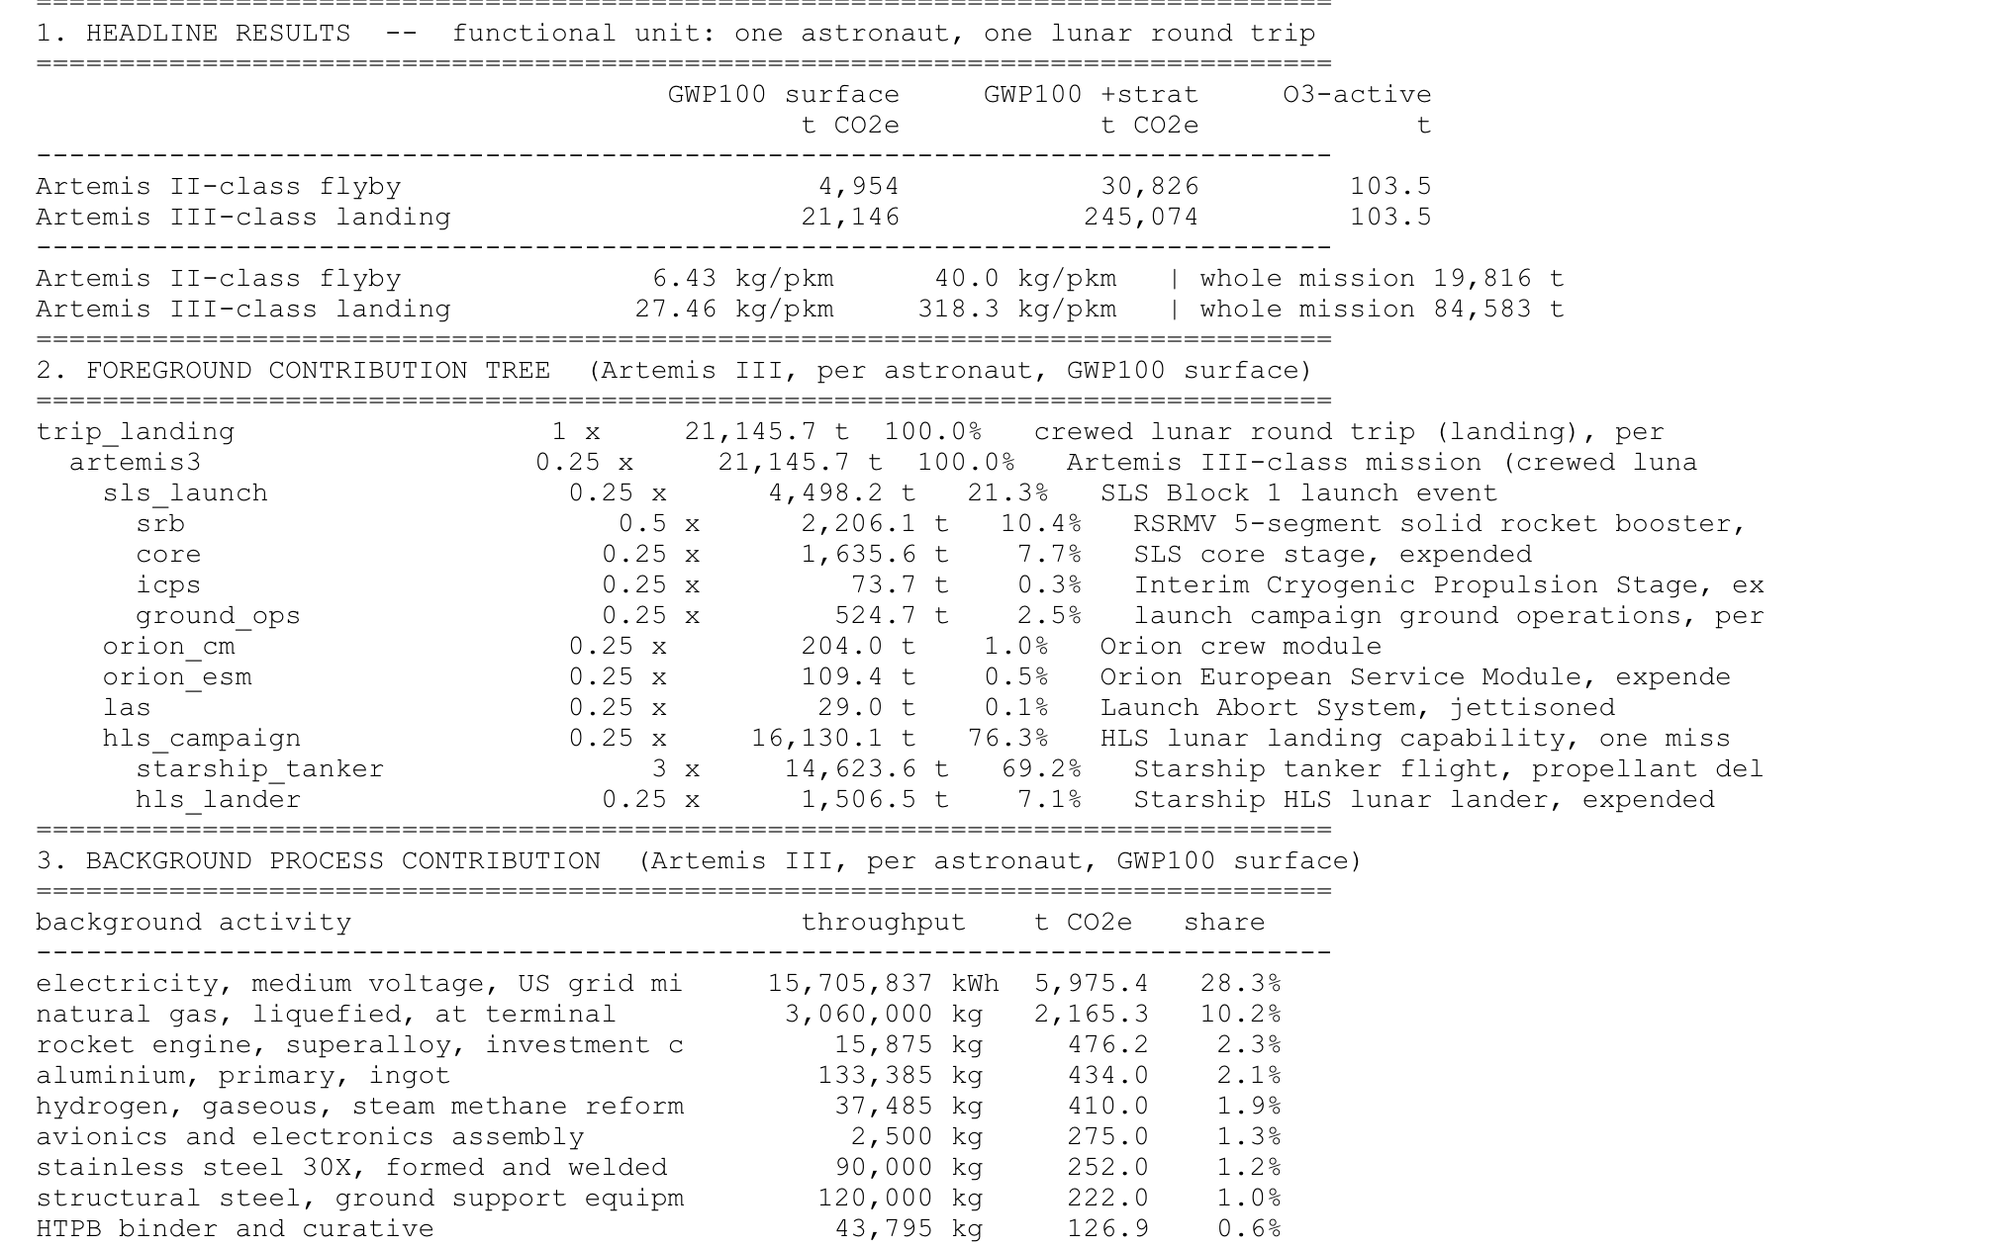
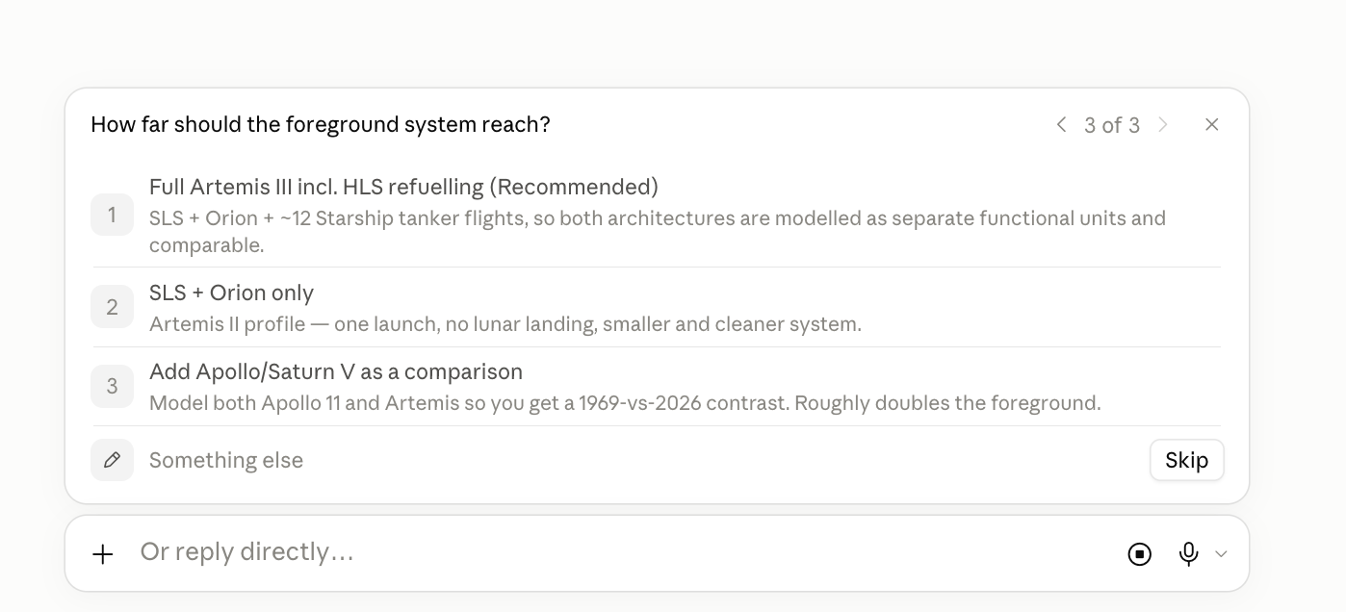
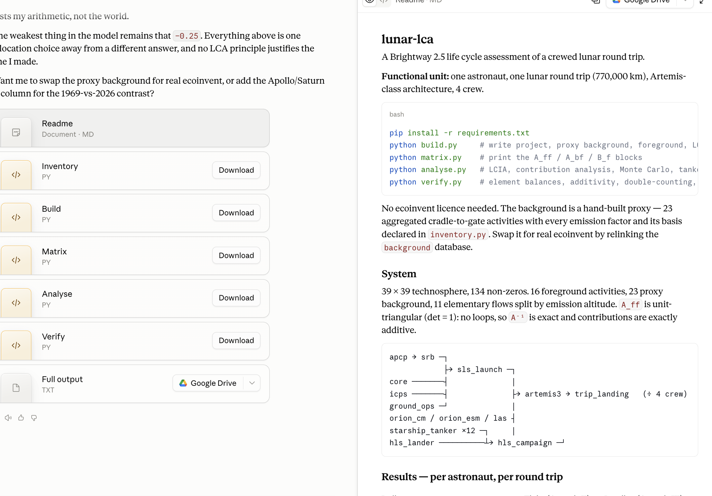

Slide 21
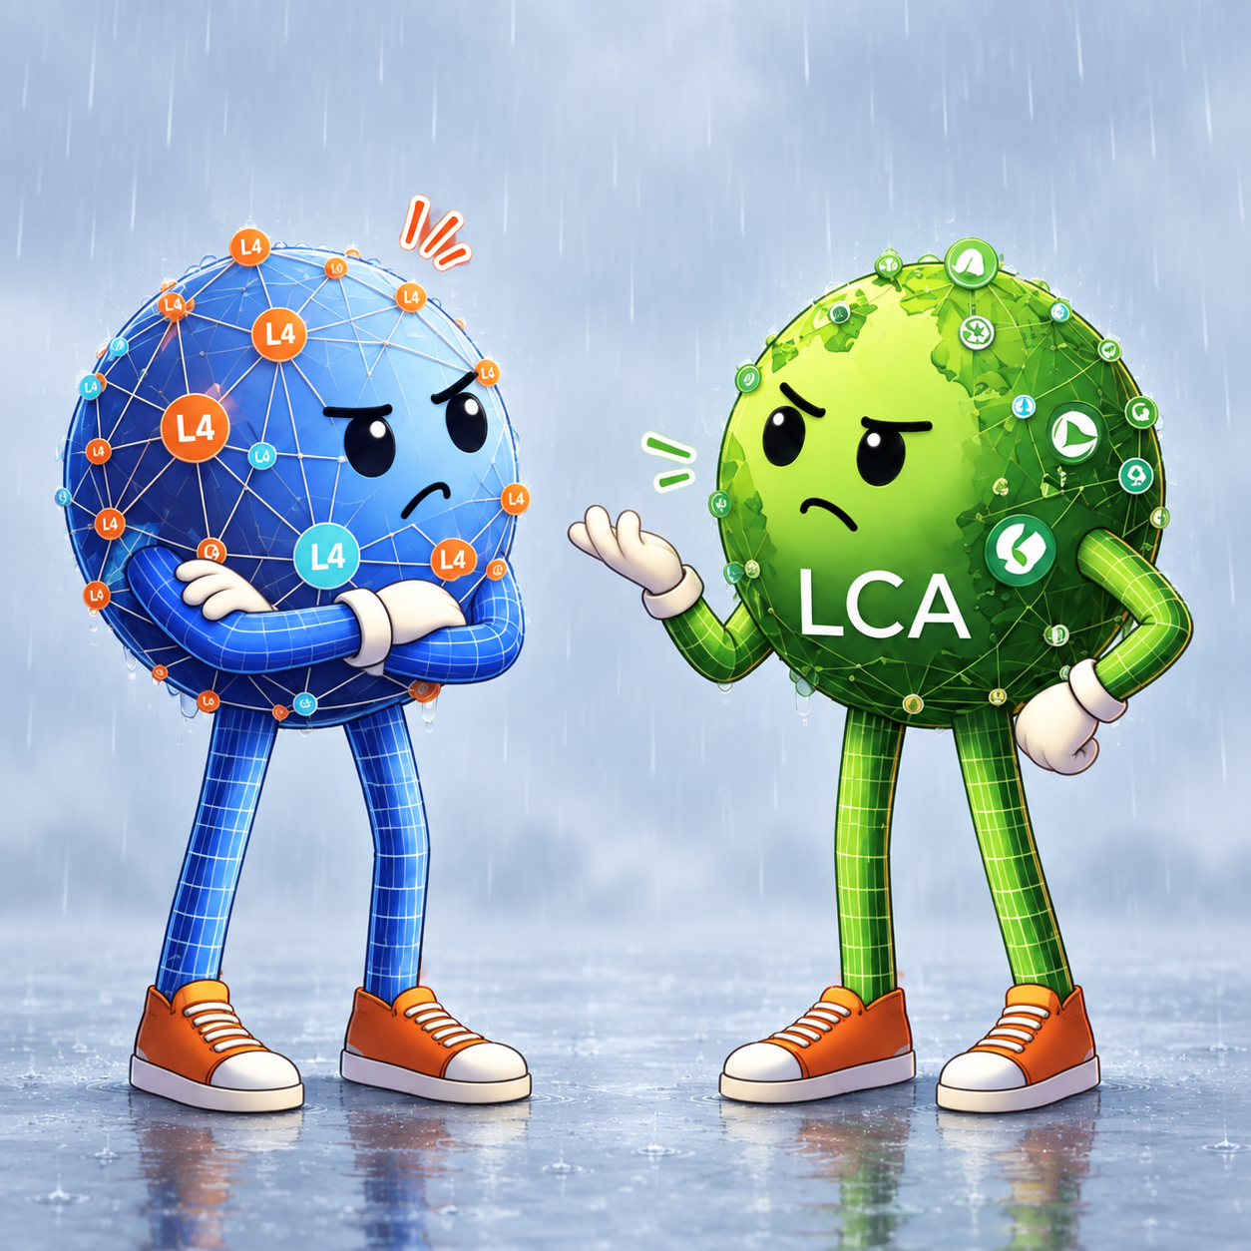
1 · Friend or foe?
FOE WHEN
An answer you cannot show anyone
Numbers that never touched background databases and ecoinvent (?)
Looks correct, but is it?
Two seconds to get it, forever to defend it
Does not feel like I am in control
FRIEND WHEN
A first framing in seconds, to react to
Unlocking brightway for non-programmers
LCA in seconds, Easy to modify
Cheap enough to throw away and ask again
Hard to know all assumptions

Slide 22

What this is worth in industry
Two years ago: nine months for one LCA
We automated what we could
Data was still the bottleneck
Much of it is confidential
Industry needs repetition and transparency
Faster is only better if the number still holds.

Slide 23
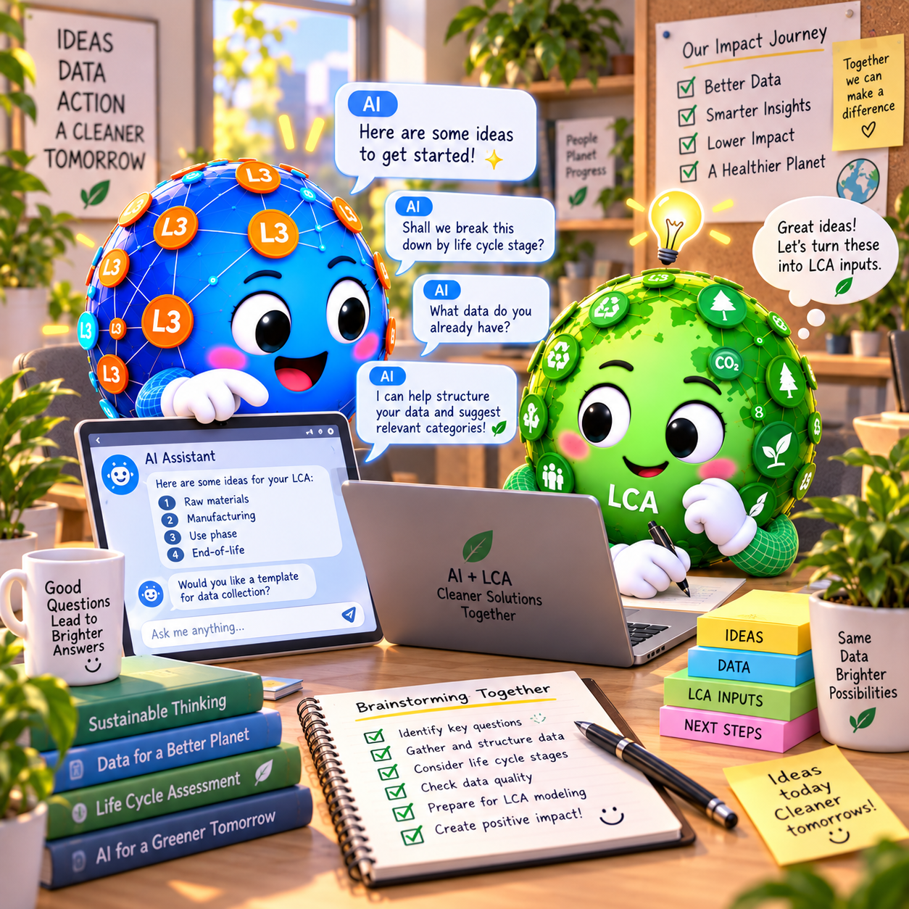
RAG: A chatbot
Regulation
LCA knowledge
Goal & scope, functional unit, system boundaries, allocation and cut-off, data quality
Domain knowledge
Industry secrets, supplier and process data, bills of materials, your own previous studies
ISO 14040/14044, PEF, CSRD, EPD- og PCR-rules

Slide 24
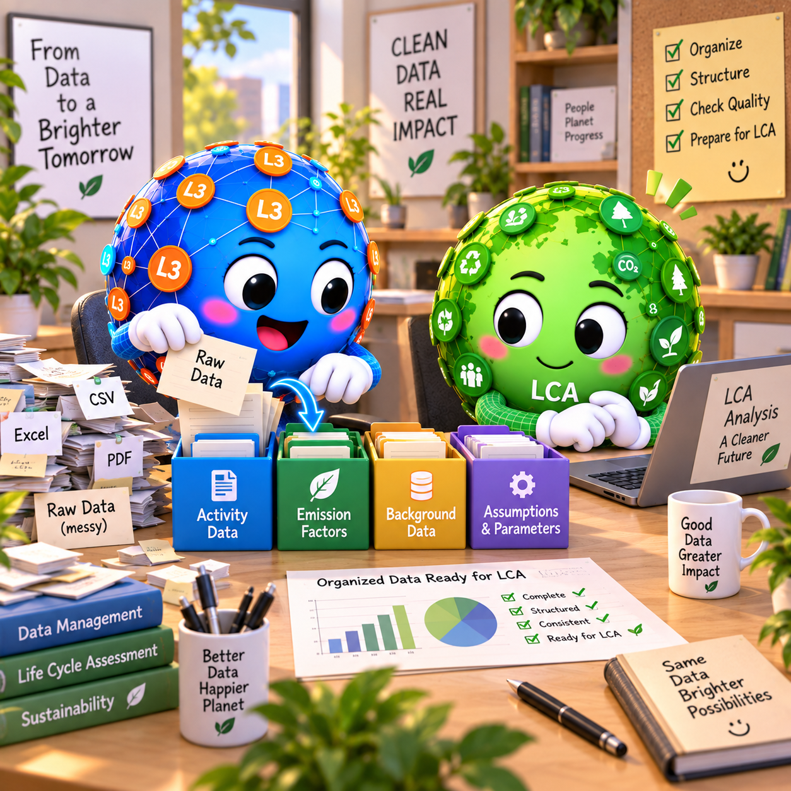

Data management is the key
CERN
INDUSTRY
LCA
Thousands of researchers, one standard, set from the top
It worked because it could be mandated
Standards by negotiation, internal and external
A large and permanent effort
Licenced nested databases, no shared naming
Matching is hard

Slide 25
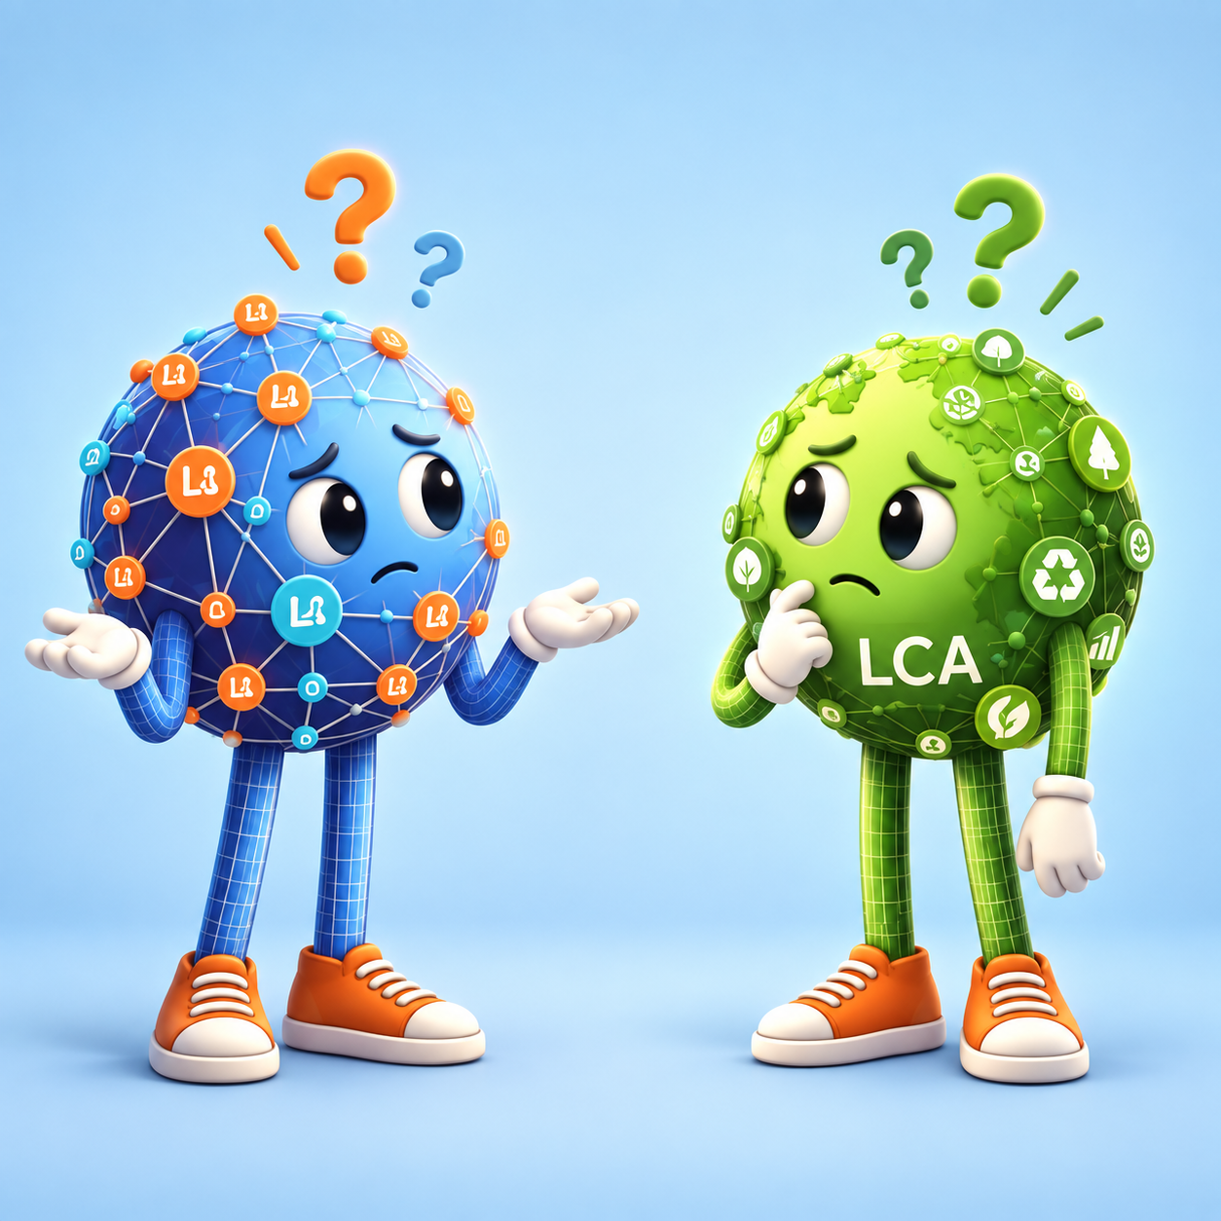
1 · Friend or foe?
FOE WHEN
Fluent about a standard it half-read
An answer that sounds right and is wrong
The wrong dataset, confidently matched
Confidence that never drops
FRIEND WHEN
Your rules and your studies in one place
Minutes on what used to cost a day
Different silos read the same source
New people stop queueing at your desk

Slide 26

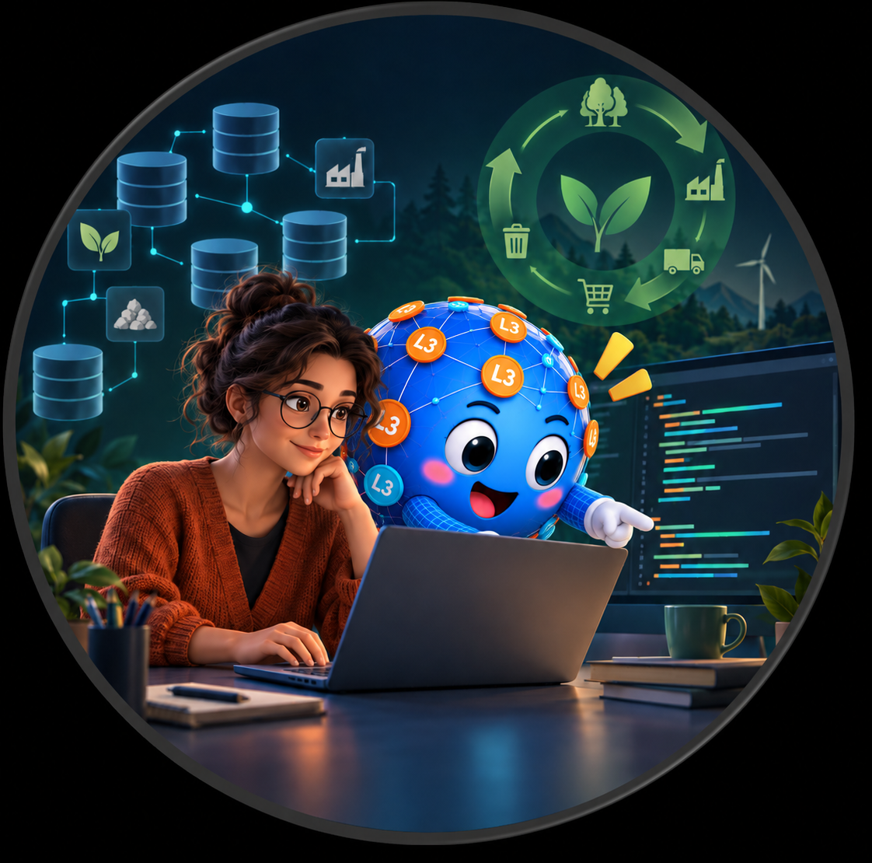
A Brightway 2.5 skill for vibe coding
LLMs can write Python and help debug.
Input AAU teaching (Massimo) and Brightway documentation
(more information could be added)
LLMs are not Brightway experts - they will mix different versions.
Scan for GitHub repository
https://github.com/lotteat11/brightway25-assistant
01
Notes:
Source: https://github.com/lotteat11/brightway25-assistant, README.md, accessed 20 September 2026.
Illustration generated for this presentation with OpenAI image generation.
The repository explains that general AI assistants often reproduce outdated Brightway 2 interfaces and that the skill supplies current Brightway 2.5 guidance.

Slide 27
Brightway 2.5 Assistant
From an empty folder to a test-ready notebook in about 5 minutes
ONE-COMMAND SETUP
git clone https://github.com/lotteat11/brightway25-assistant.git
cd brightway25-assistant
bash setup.sh
Scan for GitHub repository
Sets up the Python environment, Brightway 2.5, a Jupyter kernel and a test notebook. Optional ecoinvent download included.
CODER OR TEACHER
CODER
Default: writes the code and explains the error briefly
TEACHER
Gives hints, questions and similar examples
“Just show me”
“Explain it instead of giving me the answer”
Notes:
QR-koden peger på https://github.com/lotteat11/brightway25-assistant. Indhold leveret af brugeren.

Slide 28

2 · The same question, twice
“Run a Monte Carlo on this activity.”
WITHOUT THE SKILL
import brightway2 as bw
mc = MonteCarloLCA({act: 1}, method)
for _ in range(500):
next(mc)
results.append(mc.score)
MonteCarloLCA was removed in 2.5: ImportError, and nothing says why.
WITH THE SKILL
import bw2calc as bc
mc = bc.LCA({act: 1}, method,
use_distributions=True)
mc.lci(); mc.lcia()
results = [mc.score
for _ in zip(range(500), mc)]
Runs. use_distributions=True is the 2.5 way.
Outcome: The model is not quoting a source that expired.

Slide 29
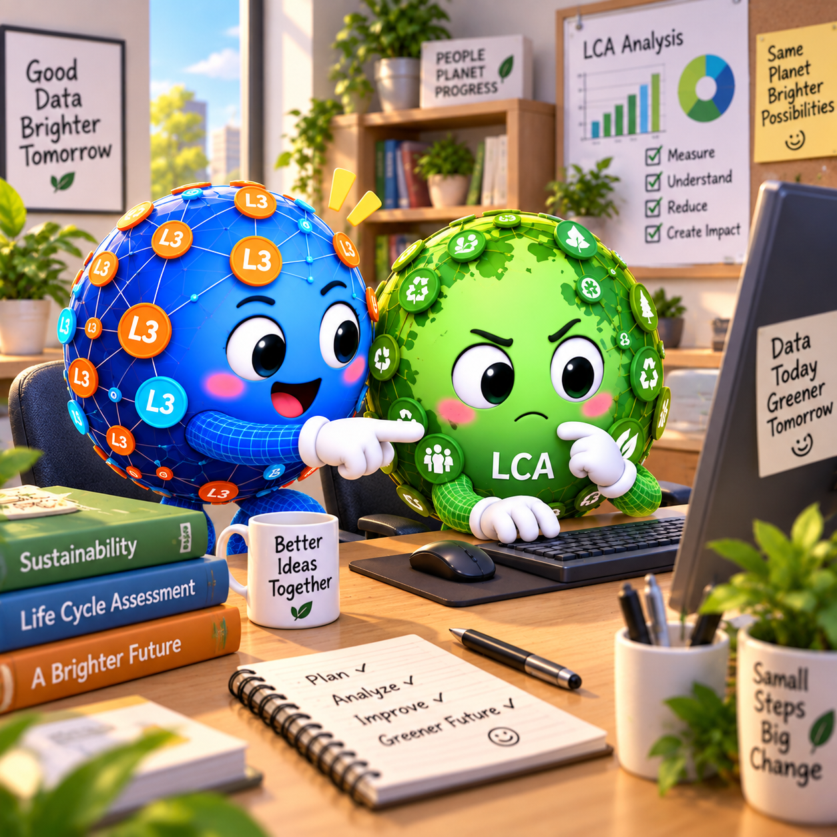
2 · Friend or foe?
FOE WHEN
Code that runs and returns a wrong number
A zero score, and no error to warn you
No debugging possible when with no AI
Superflouses with next LLM version
FRIEND WHEN
People with no-code can use Brightway
Vibe coding with expertise
A student unstuck in minutes
Go with smaller models – so can use brightway wit cheaper models

Slide 30
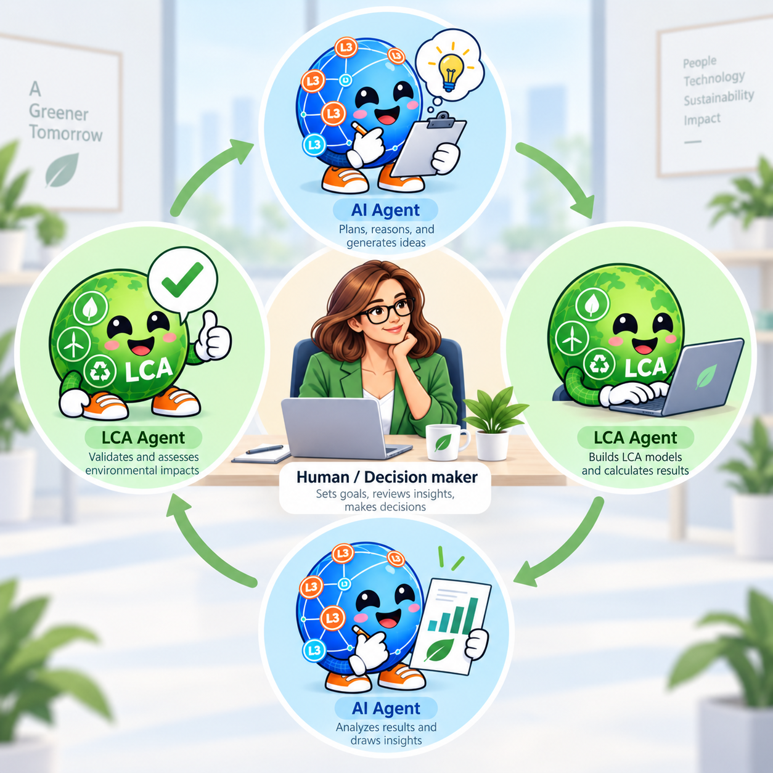
3 · An AI agent doing LCA
One agent to find the data (either on the internet or in your RAG system)
It turns your data into a foreground model
Next AI agent calls Brightway, runs the calculation, comes back with numbers
Next agent validates it according to its tools
You keep the boundaries. It does the typing.
See more on Ning An’s talk Friday at 10.30

Slide 31
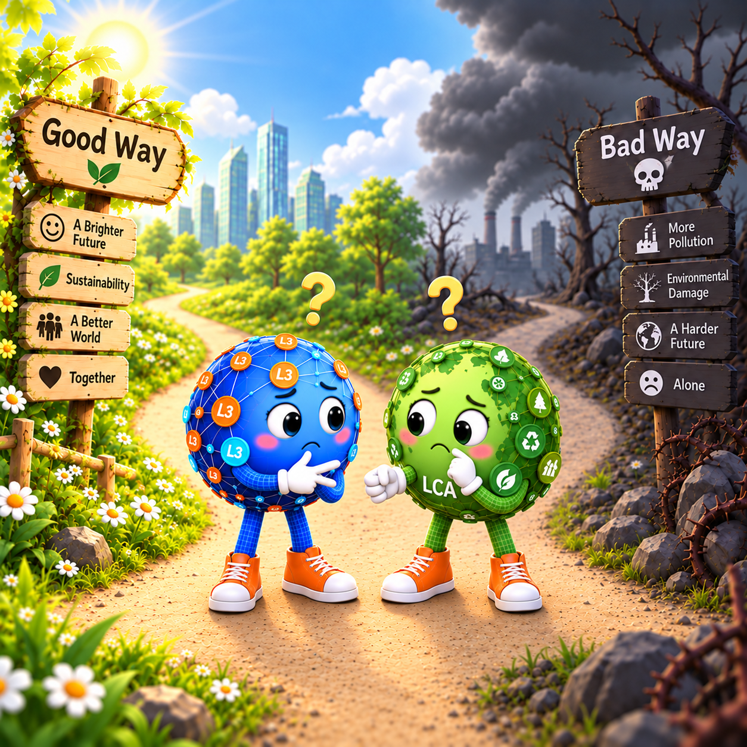
3 · Friend or foe?
FOE WHEN
One click, and the number is quietly wrong
No one can point to where the choice came from
Wrong once, wrong in every study that reuses it
Each step hallucinates a little more than the last
FRIEND WHEN
A screening LCA in one click, not nine months
It does the lookup, you keep the judgement
New data, and the study re-runs in minutes
You can keep asking, deeper, and still get something useful

Slide 32
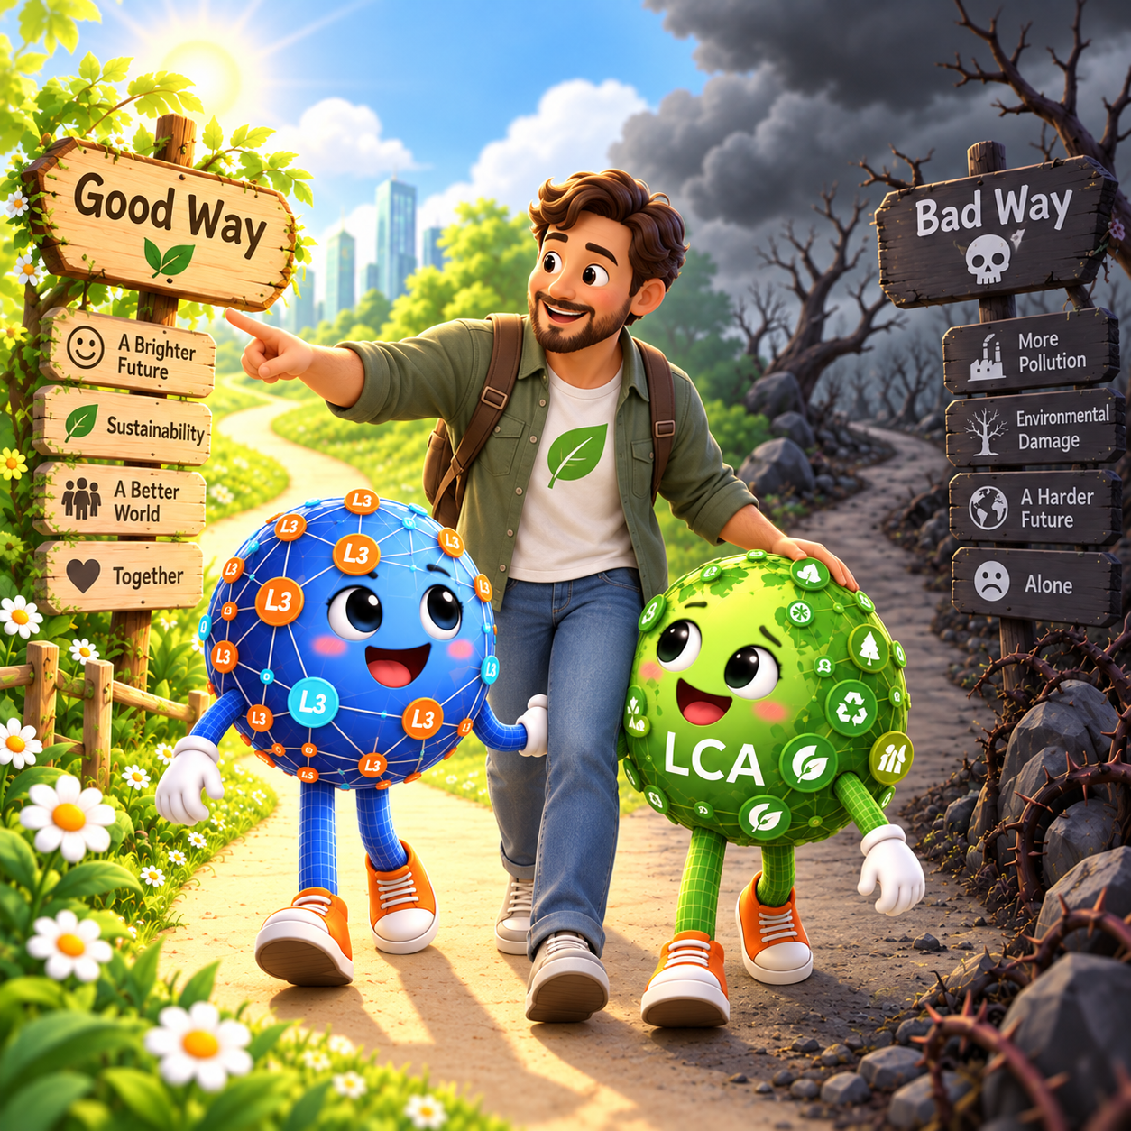
3 · Human in the loop
The more the agent does, the more explicit the control has to be:
Humans need to oversee where it matters
How do we figure out where humans are needed?
Can we trust it without human in the loop?
AI agents can act.
Only a human can be accountable.

Slide 33
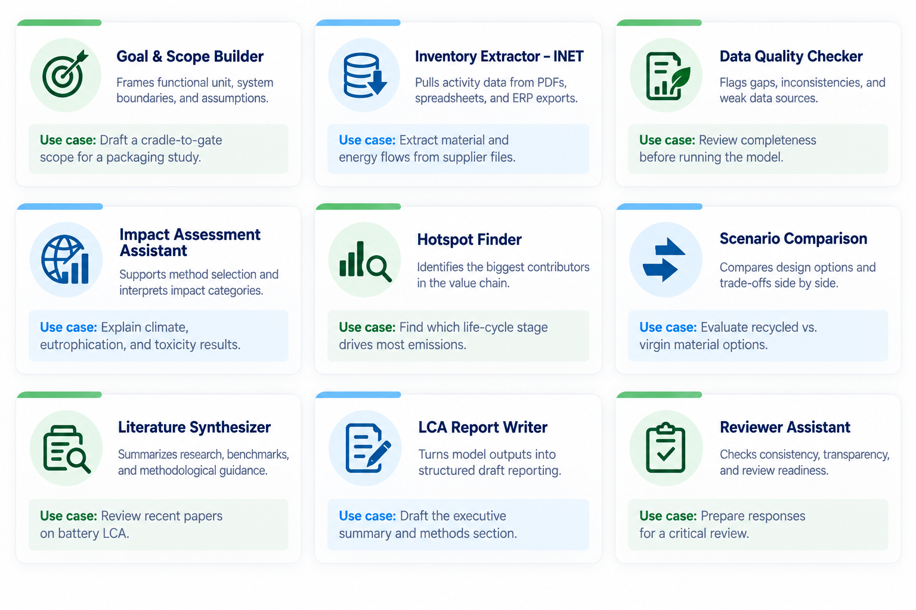
Skills one could make for LCA, or small agents

Slide 34
3 · One LCA agent, or several?
ONE LCA AGENT, MANY SKILLS
SEVERAL SPECIALISED LCA AGENTS
C
Coordinator agent
A
LCA agent
Delegates work · aligns assumptions · integrates results
One context · one plan · one set of assumptions
INPUT
OUTPUT
Product
& data
Results &
report
SKILLS THE AGENT CAN CALL
A
Scope
A
Inventory
A
Impact
A
Review
01
Goal & scope
02
Inventory
Goal & scope
Data agent
LCIA agent
Reporting
03
EF lookup
04
LCIA
Functional unit
Foreground data
EF mapping
Checks
Boundaries
Data quality
Impact results
Narrative
One place to trace system boundaries, data choices and interpretation.
Separate contexts and specialist decisions. Useful when workstreams are genuinely distinct.

Slide 35

Friend, foe or future?
Not a foe. It doesn't decide. Method, data and judgement stay ours.
Not a friend. It is only as good as what we wrote down, and it never says when it is wrong.
Part of the future. It is coming either way, so let's build it well: shared skills, traceable data,…
We set the direction, or the tools will.

Slide 36

THANK YOU

Slide 37
Data management is the key
One task, run many times: match a flow to a dataset
Meaning, not spelling: “steel, low-alloyed, hot rolled” = “hot-rolled low alloy steel”
The AI is a “new kind of ontology”
Less effort on names

