Slide 1



Feedback machine
A brightway-based package for environmental feedback modeling
Pierre Jouannais, ITAP-ELSA, INRAE, Montpellier, France
Brightcon, September 2026
Aalborg
BIOCaP-LCA project
ANR-25-PEBB-0001
Notes:
I am here to present you the work I have been conducting on environmental feedabck modeling which will soon be published in a python package called « Feedback Machine » (the ename changed since the abstract I sent). My objective for today is to give you the main conceptual and mathematical ideas and make you interested in staying tuned for when the package and paper are published for the commhnity. To make you feel the capabilities of the approach

Slide 2
Environmental feedback definition

Slide 3
Unidirectional lca
T
The entire Technosphere
The impacted part of the Ecosphere
1
Decision
t
e
Impact
2
The activated part of the Technosphere (LCI)
3
LCIA result
E
The entire Ecosphere and its current status

Slide 4
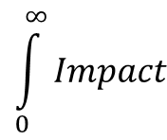
bidirectional lca
T
The entire Technosphere
The impacted part of the Ecosphere
1
t
e
$$\int_{0}^{∞}{Impact}$$
Decision
∞
Impact
2
The activated part of the Technosphere (LCI)
3
LCIA result
LCIA result
What is the feedback-aware impact of 1 truck?
What is the feedback-aware impact of 1 kg CO₂?
E
The entire Ecosphere and its current status

Slide 5
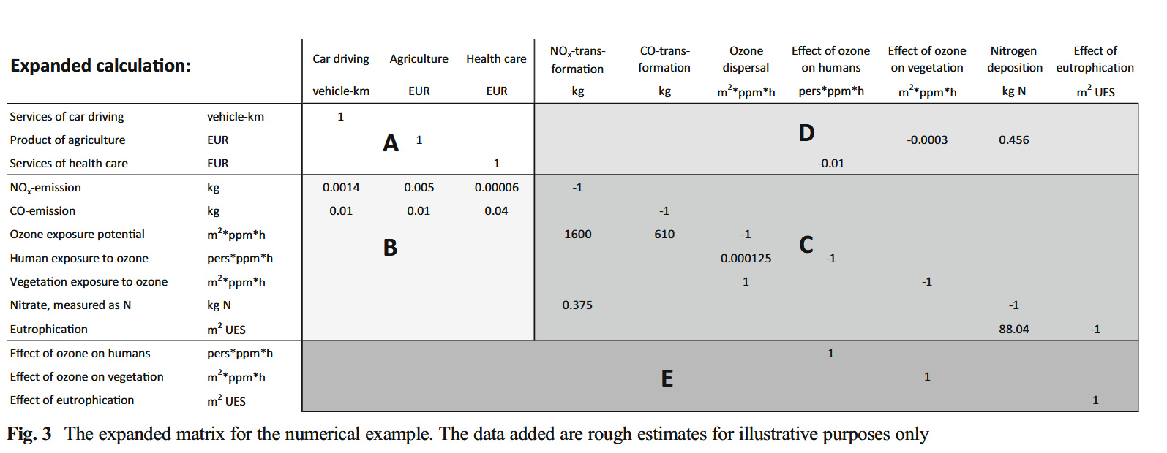
A first matrix-based proposal for bidirectional lca
?
?
?
Weidema, B. P., Schmidt, J., Fantke, P., & Pauliuk, S. (2018). On the boundary between economy and environment in life cycle assessment. The International Journal of Life Cycle Assessment, 23(9), 1839‑1846. https://doi.org/10.1007/s11367-017-1398-4
A breakthrough… and yet Feedback-aware LCA is not here yet.
Notes:
But in this paper, they propose a theoretical view, which Is correct, and to my appreciation ,a breakthrough, but we have to
Quite Brillant paper honestly.
One of the reasons is that they do not explain how to find right numbers to put here, the numbers that feed back into to the technosphere. I think it not only a matter of lack of data, but more crucially a problem of lack of a conceptual and mathematical feamework to find these values. In particular I believe it’s impissible to find these values without thinking prospectively.

Slide 6
bidirectional lca
T
The entire Technosphere
?
The impacted part of the Ecosphere
1
t
e
$$\int_{0}^{∞}{Impact}$$
Decision
∞
Impact
2
The activated part of the Technosphere (LCI)
3
LCIA result
LCIA result
E
The entire Ecosphere and its current status

Slide 7
Environmental feedback modeling
Notes:
SO here comes my p^roposal.

Slide 8
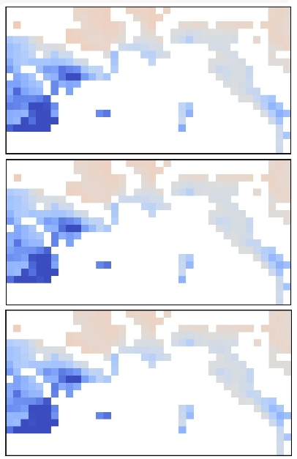
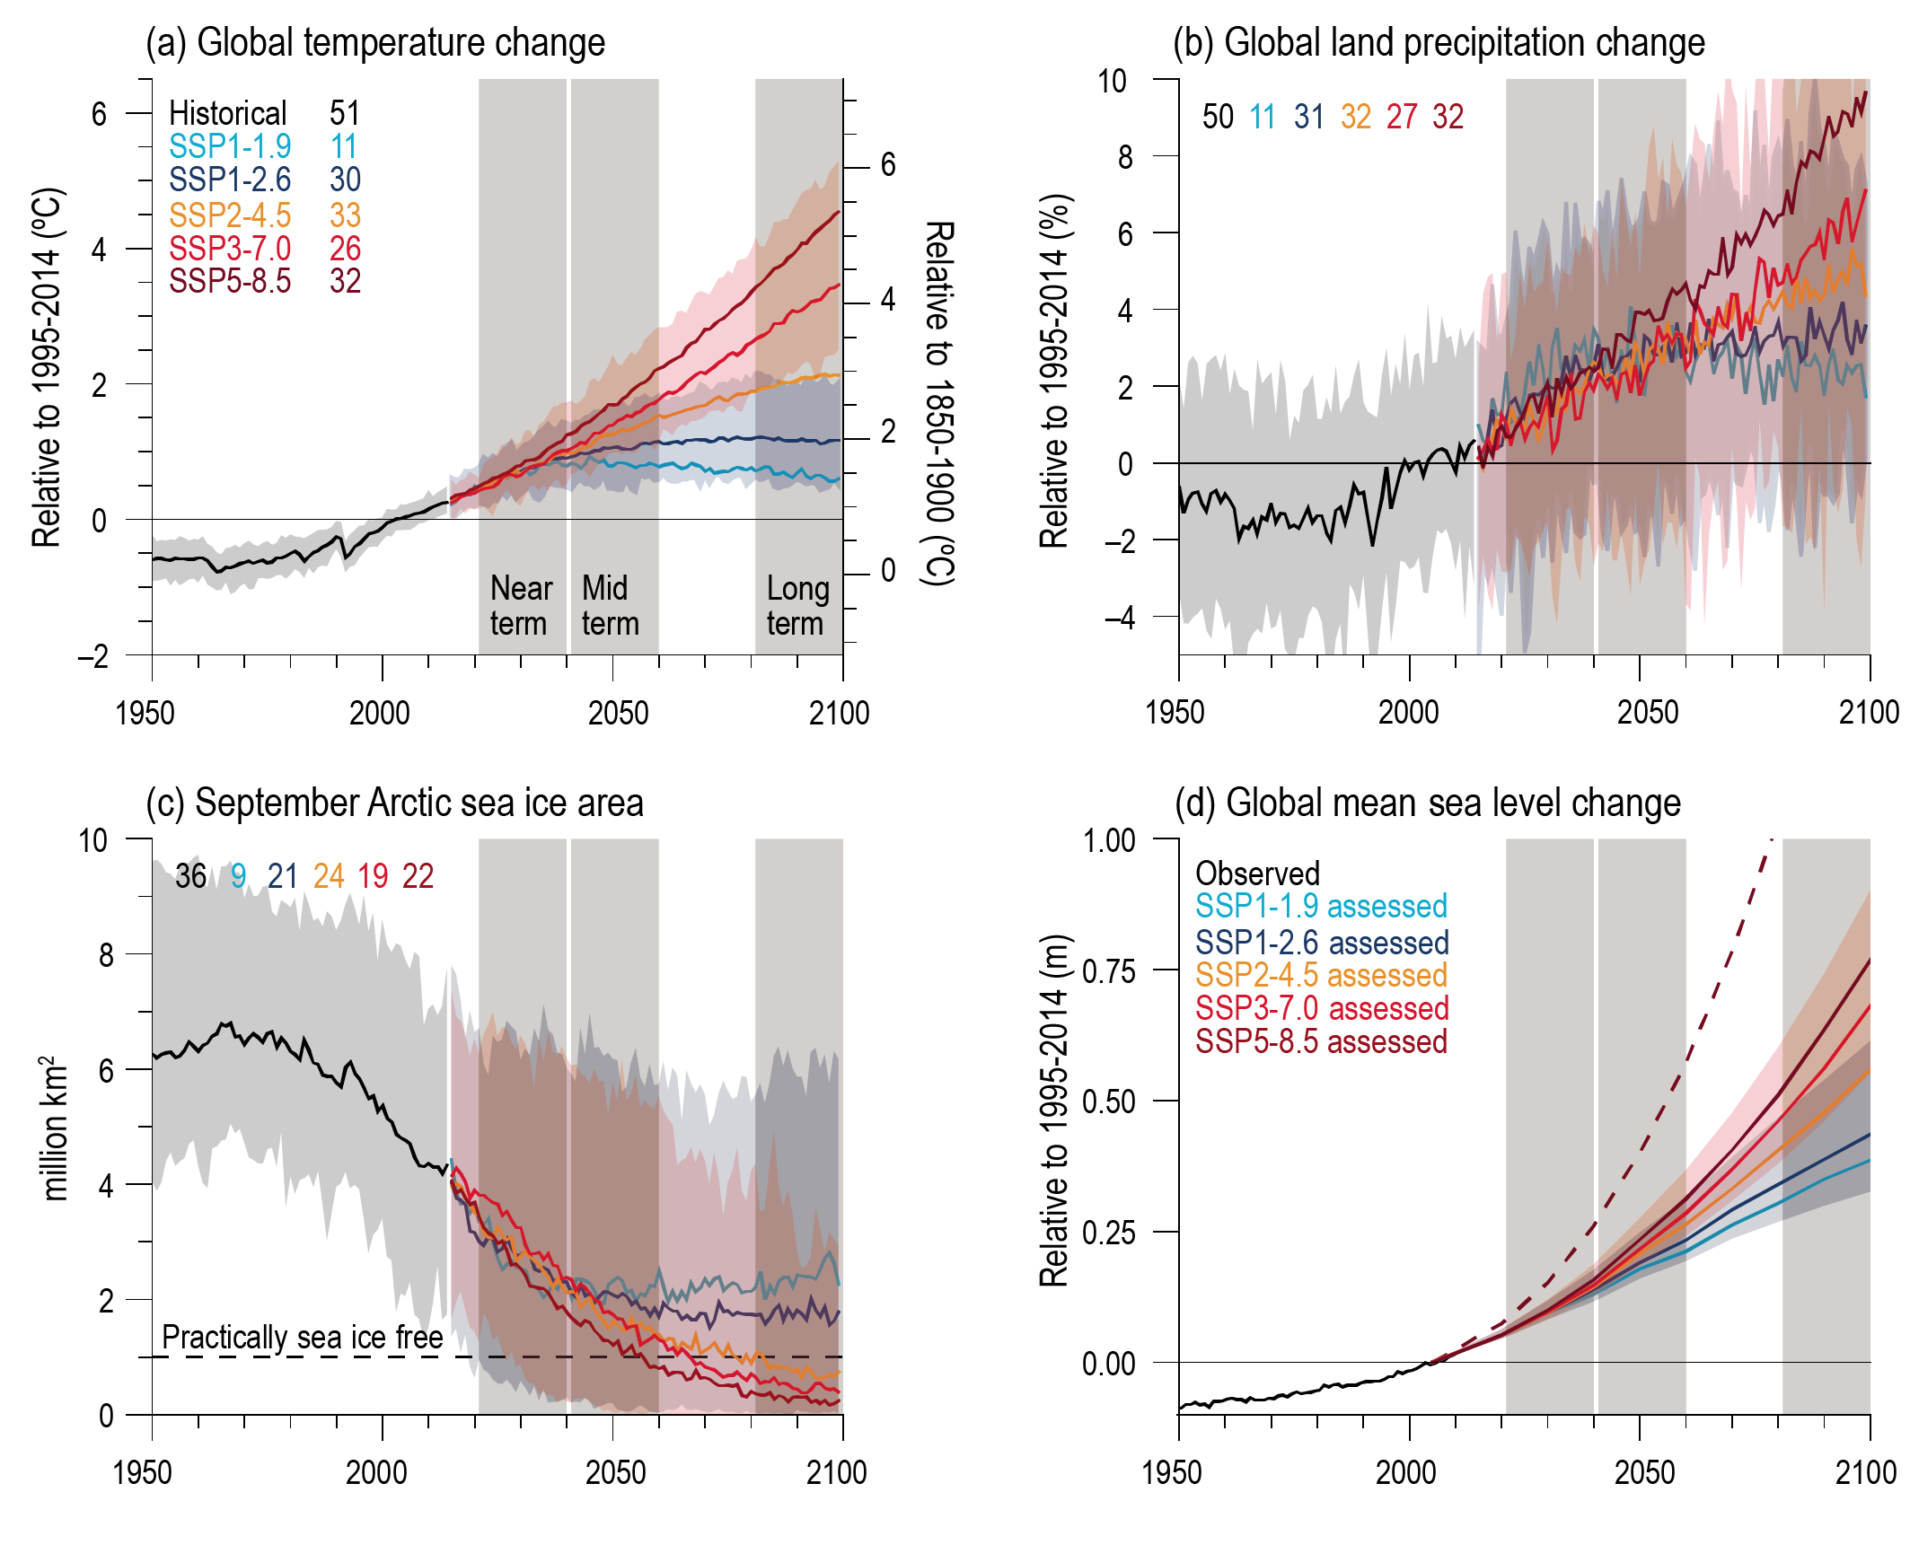
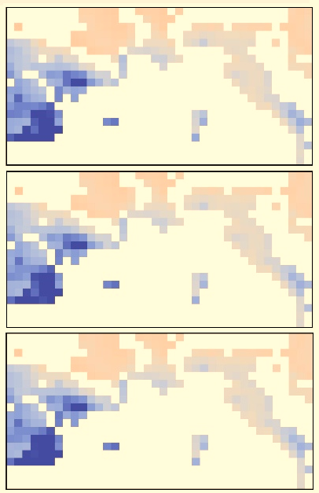
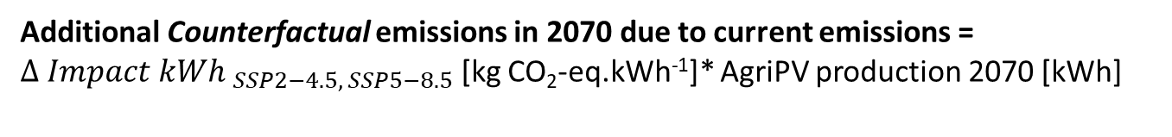

the hidden causality in prospective lca
Impact AgriPV 2070
Consequences of current decisions
$$∆ {Impact kWh }_{SSP2−4.5, SSP5−8.5}$$
Additional Counterfactual emissions in 2070 due to current emissions = $∆ {Impact kWh }_{SSP2−4.5, SSP5−8.5}$ [kg CO₂-eq.kWh⁻¹]* AgriPV production 2070 [kWh]
Temperature change due to studied decisions
e
t
T
Demand forecast
Notes:
It draws inspiration nform what we do in prospective LCA

Slide 9
bidirectional lca
T
The entire Technosphere
?
The impacted part of the Ecosphere
1
t
e
$$\int_{0}^{∞}{Impact}$$
Decision
∞
Impact
2
The activated part of the Technosphere (LCI)
3
LCIA result
LCIA result
E
The entire Ecosphere and its current status

Slide 10
bidirectional lca
T
T
The entire Technosphere
The impacted part of the Ecosphere
1
t
e
$$\int_{0}^{∞}{Impact}$$
Decision
∞
Impact
2
The activated part of the Technosphere (LCI)
3
LCIA result
LCIA result
E
The entire Ecosphere and its current status

Slide 11
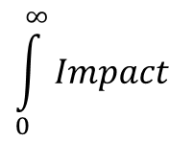
bidirectional lca
T
T
The entire Technosphere
The impacted part of the Ecosphere
1
4
t
e
$$\int_{0}^{∞}{Impact}$$
Decision
Product system
∞
Feedback driver
Impact
2
2
AGTP (°C)
3
GWP (kg CO₂-eq)
The activated part of the Technosphere (LCI)
LCIA result
E
The entire Ecosphere and its current status
Notes:
Symetricaly, the entire technosphere will affect the feedback flow

Slide 12
Counterfactual reasoning
Propagating a feedback: Isolating what it due to the feedback initiated with our decision (e.g., emitting 1 kg of CO₂) (ENDOGENOUS) from what is due to the rest of the World (EXOGENOUS)
ENDOGENOUS
EXOGENOUS
(pale color)
(solid color)
e
E
t
T
Notes:
I will use this color labeling for the rest of the prsentation

Slide 13
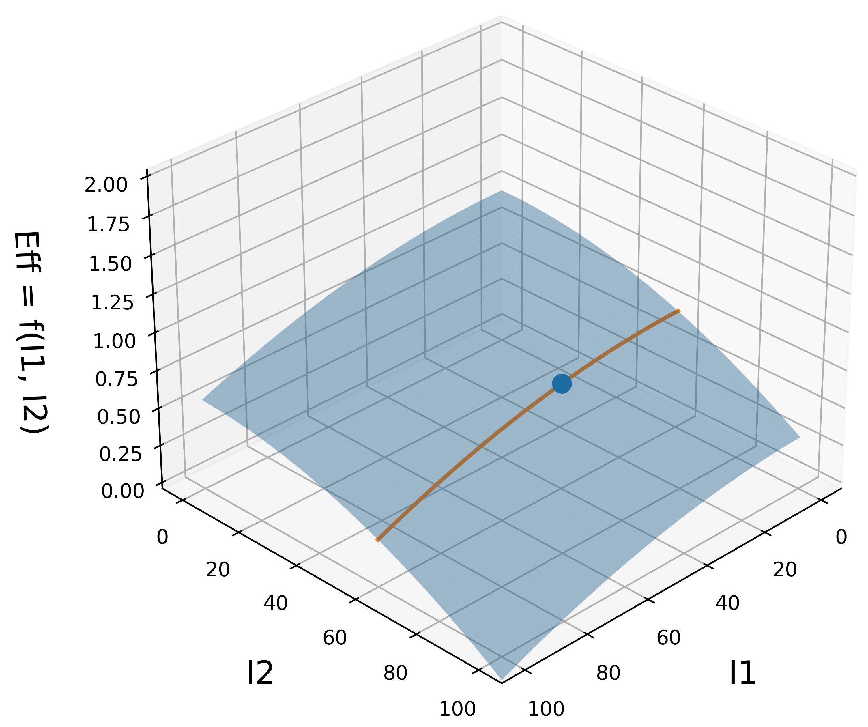

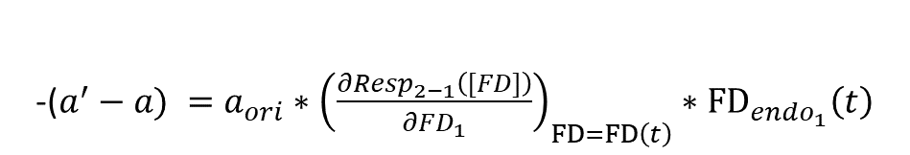

Feedback technosphere matrix
 | Act_1 | Act_2 | Act_3
Act_1 | 1 | b=f₂(FD) | -
Act_2 | a = f₁(FD) | 1 | -
Act_3 | x | c= f₃(FD) | 1
T
E
FD’
T
E
 | Act_1 | Act_2 | Act_3
Act_1 | 1 | b’=f₂(FD’) | -
Act_2 | a’ = f₁(FD’) | 1 | -
Act_3 | x | c’= f₃(FD’) | 1
FD
t₀
t
e
t₁
t
 | Feedback(t₁) | Act_1_exo | Act_2_exo | Act_3_exo | Act_1 | Act_2 | Act_3
Feedback(t₁) | 1 | - | - | - | - | - | -
Act_1_exo | -ExoDemand_{Act1} | 1 | - | - | - | - | -
Act_2_exo | -ExoDemand_{Act2} | - | 1 | - | - | - | -
Act_3_exo | - | - | - | 1 | - | - | -
Act_1 | - | - | -(b’-b) | - | 1 | b’ | 0
Act_2 | - | -(a’-a) | - | - | a’ | 1 | 0
Act_3 | - | - | -(c’-c) | - | x | c’ | 1
$${\left(\frac{∂Resp_{2−1}\left([FD]\right)}{∂FD_{1}}\right)}_{FD=FD\left(t\right)}$$
$$M_{cu_{FB1}}$$
FD₂
FD₁
-EndoDemand_{Act1}
-($a^{′}−a) =a_{ori}∗{\left(\frac{∂Resp_{2−1}\left([FD]\right)}{∂FD_{1}}\right)}_{FD=FD\left(t\right)}∗{FD}_{endo_{1}}\left(t\right)$
Notes:
Imagine we are sometime in the future and we wonder what would have been the emissions of the whole productive system if I had not emitted 1 kg of Flow A 20 years before?
F’ « prime »
For t1 we can build a feedback technosphere matrix wich will use these differences to compute the emissions that would not have not occured if we had not emiited something at t0.

Slide 14



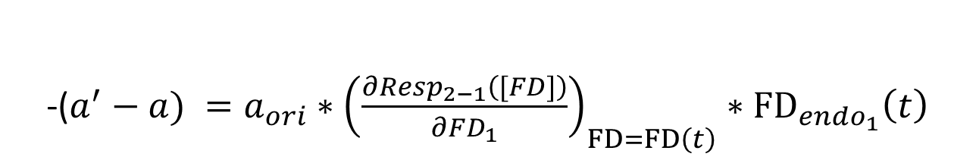

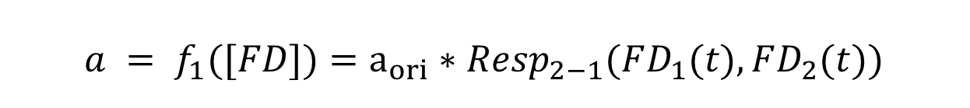

Isolating the effect of a Feedback
 | Feedback(t₁) | Act_1_exo | Act_2_exo | ...
Feedback(t₁) | 1 | - | -
Act_1_exo | -ExoDemand_{Act1} | 1 | -
Act_2_exo | -ExoDemand_{Act2} | - | 1
Act_3_exo | - | - | -
Act_1 | - | - | -(b’-b)
Act_2 | - | -(a’-a) | -
Act_3 | - | - | -(c’-c)
$${\left(\frac{∂Resp_{2−1}\left([FD]\right)}{∂FD_{1}}\right)}_{FD=FD\left(t\right)}$$
Resp_{y}
$$M_{cu_{FB1}}$$
-EndoDemand_{Act1}
FD₂
FD₁
$$FD\left(t\right)=$$
$$a = f_{1}([FD])=a_{ori}∗Resp_{2−1}(FD_{1}(t),FD_{2}(t))$$
$${FD}_{endo_{1}}\left(t\right)$$
+
$${FD}_{{exo}_{1}}\left(t\right)$$
-($a^{′}−a) =a_{ori}∗{\left(\frac{∂Resp_{2−1}\left([FD]\right)}{∂FD_{1}}\right)}_{FD=FD\left(t\right)}∗{FD}_{endo_{1}}\left(t\right)$
Notes:
Imagine we are sometime in the future and we wonder what would have been the emissions of the whole productive system if I had not emitted 1 kg of Flow A 20 years before?

Slide 15
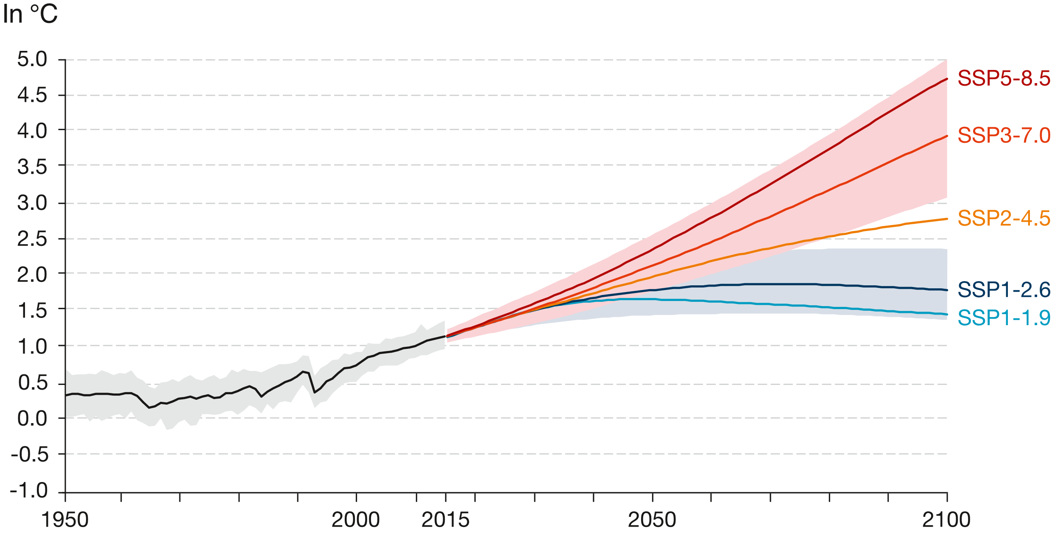
Feedback propagation
+ 1kg emission

Slide 16
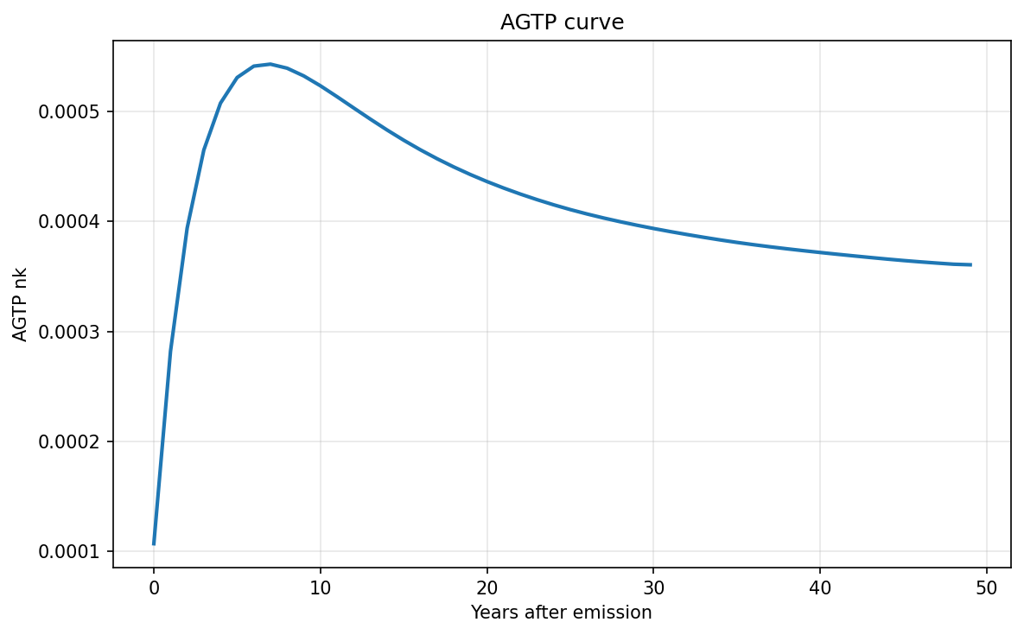
Feedback propagation
T (°C)
Feedback Driver Pattern
+ 1kg Flow
t

Slide 17

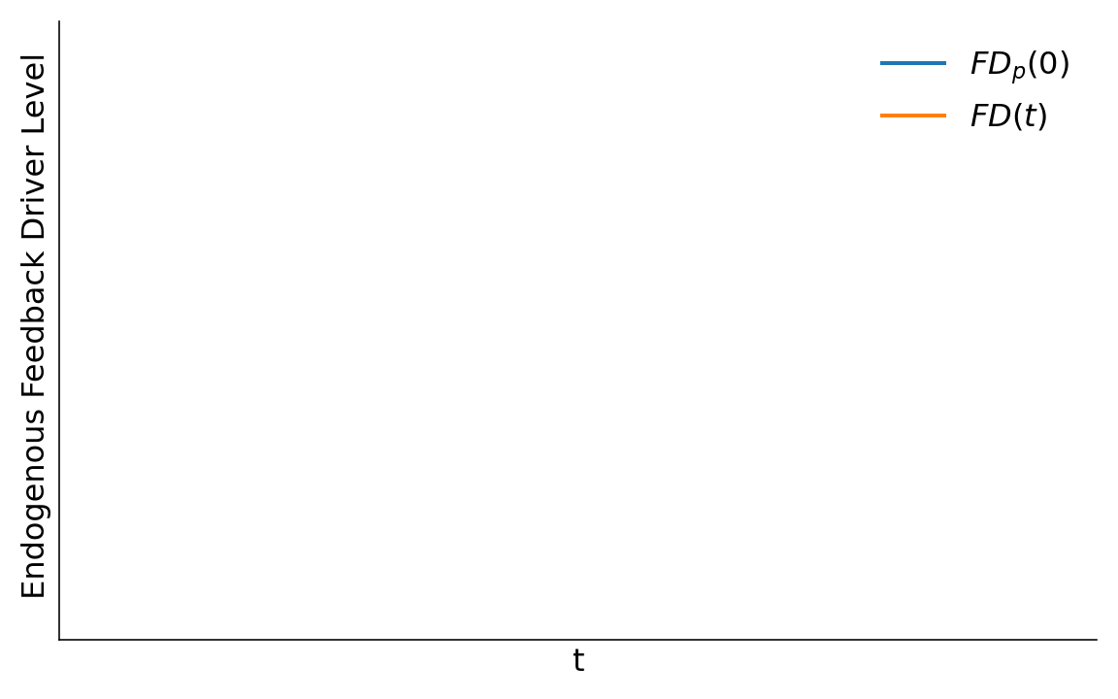
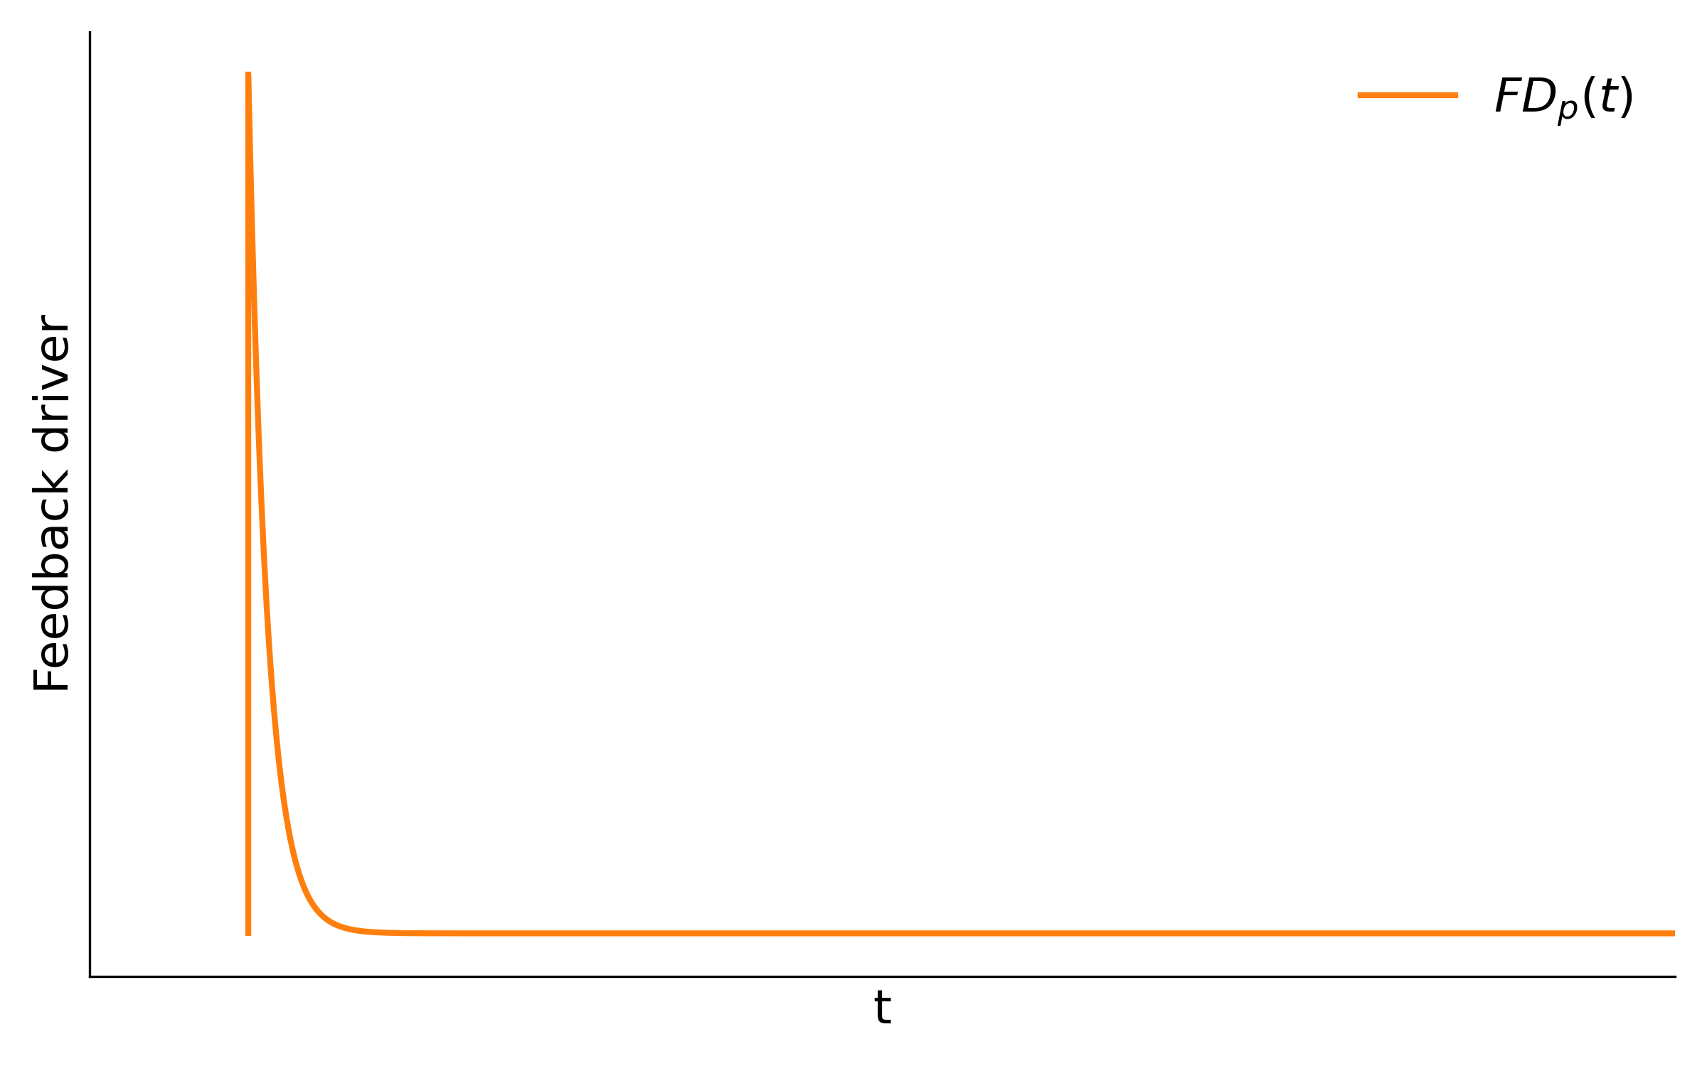
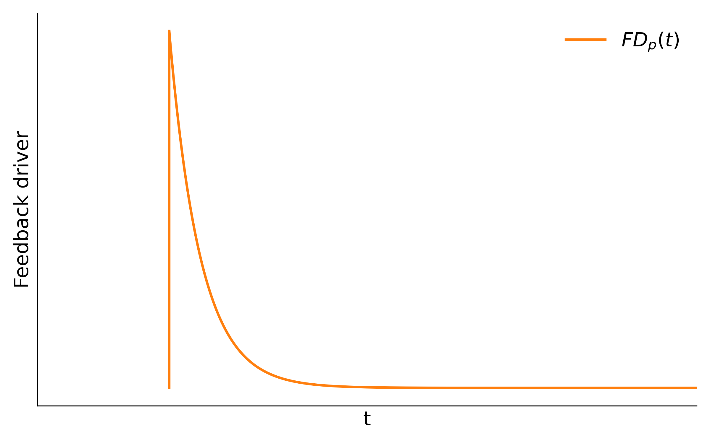

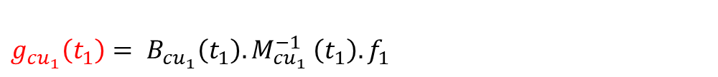
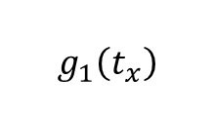






Feedback propagation
$g_{cu_{1}}\left(t_{1}\right)= B_{cu_{1}}\left(t_{1}\right).M_{{cu}_{1}}^{−1}$ $\left(t_{1}\right).f_{1}$
$M_{cu_{FB1}}$(FD(t₁) ,t₁)
T
$$g_{1}\left(t_{1}\right)= g_{{cu}_{1}}\left(t_{1}\right)+g_{{cu}_{1}}\left(t_{1}\right)\left[Bf_{1}\right]∗\frac{g_{in_{1}}\left(t_{1}\right)}{1−g_{in_{1}}\left(t_{1}\right)\left[Bf_{1}\right]}$$
$B_{cu_{FB1}}$ (FD (t₁) ,t₁)
$M_{in_{FB1}}$(FDp(t1),t₁)
$B_{in_{FB1}}$ (FDp(t₁) ,t₁)
x
$M_{cu_{FB1}}$(FD(t_{x}) ,t_{x})
$$g_{1}\left(t_{x}\right)$$
…
Instantaneous effect
$B_{cu_{FB1}}$ (FD(t_{x}) ,t_{x})
=f([FD(t)])
Cumulated effect
x
e
E
Emissions
Initial emission
≈ prospective CFs
Notes:
Centrer sur le feedback driver
Seulement à la fin , dire mais on peut aussi avori une demane directe, pour ça demand pattern , qui lui mêm peut être modulé par les niveaux de feedback

Slide 18


Generalization to interacting feedbacks
Interannual and instantaneous interactions
Multi-dependent partial derivatives
g_{cu1}(t)= B_{cu1}(t) . M_{cu1}(t)⁻¹. f₁
g_{cu2}(t)= B_{cu2}(t) . M_{cu2}(t)⁻¹. f₁
$${\left(\frac{∂Resp_{2−1}\left([FD]\right)}{∂FD_{1}}\right)}_{FD=FD\left(t\right)}$$
∞
Resp_{y}
(I-R_{t})⁻¹
g_{tot1}(t)
g_{tot2}(t)
FD₂
FD₁
$$R_{in}\left(t\right)={\left(g_{in_{1}}\left(t\right) g_{in_{2}}\left(t\right)⋯g_{in_{n}}\left(t\right)\right)}_{n∗n}$$
$$g_{tot}\left(t\right){{=\left(I−R_{in}\left(t\right)\right)}^{−1}∙g}_{{cu}_{tot}}\left(t\right)$$

Slide 19
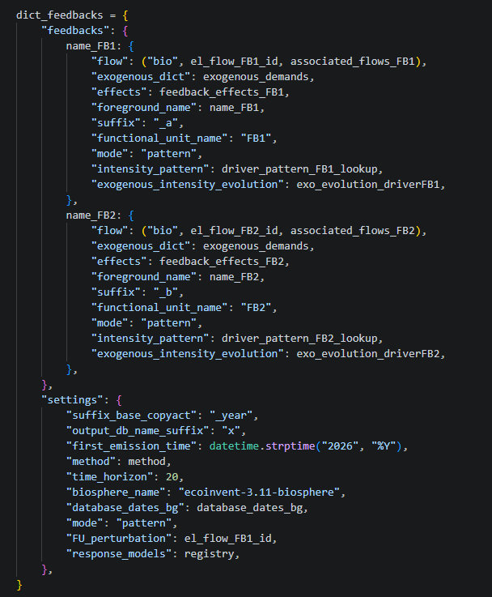
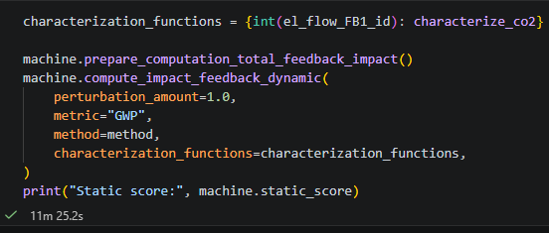


Simple workflow
Compute total impact with propagation
Collect all inputs in a dictionary
FB 1
FB 2
Common propagation settings including response functions
Create Feedback Machine Instance, and propagate

Slide 20
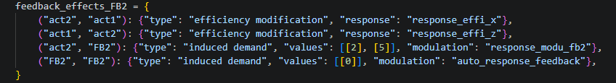
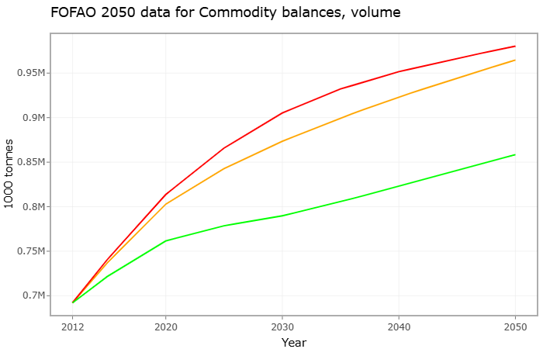
Feedback inputs
An exogenous driver evolution
An effect dictionary (maps reponse functions in the LCA matrices):
    X modifications efficiences
    Y demand change patterns
A set of necessary exogenous demand levels
An initialisation LCA database
A set of biosphere flows
A FB driver
  Global Temperature (°C)
A FB driver pattern (multi-dependent lookup table)
  AGTP(t) (°C)
Common propagation settings
First emission time Background databases
Time horizon
Efficiency response models

Slide 21
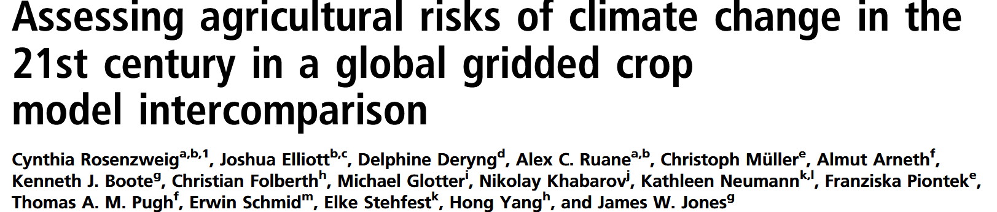
Feedback inputs
Common propagation settings including response functions
Common propagation settings
First emission time Background databases
Time horizon
Efficiency response models

Slide 22
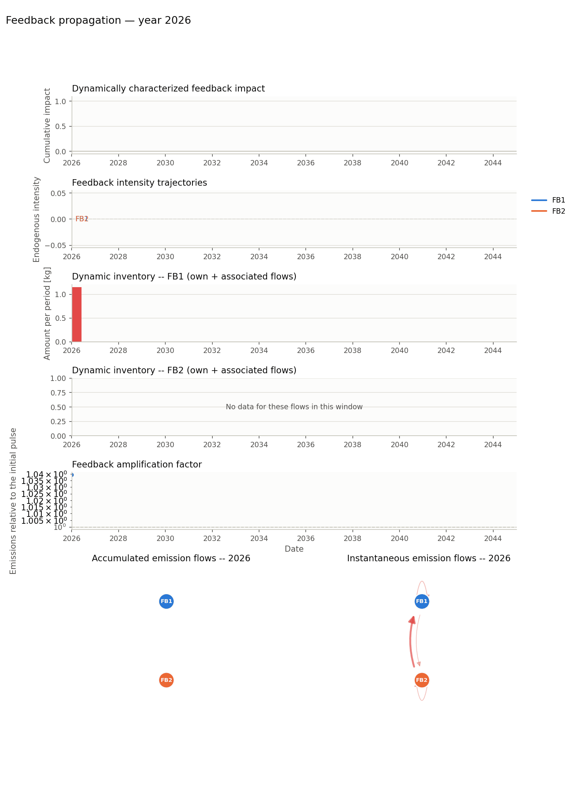
Following feedback propagation

Slide 23
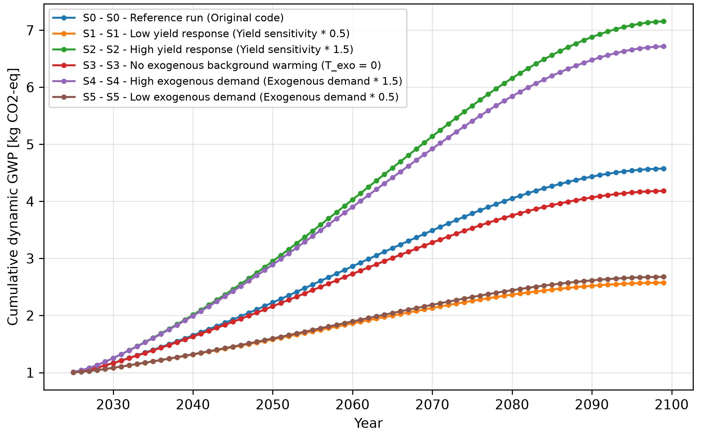
First results
Feedback-aware GWP impact of 1 kg CO2 emitted in 2026
+ 1 kg CO₂
Climate Change
∞
Global Crop Yields
Internship Aysenur Oner

Slide 24
perspectives

Slide 25
A consistent mathematical, algorithmic, and python-implemented solution for the brightway ecosystem and the LCA research community
To be released soon on pip and conda
Seminal article on the way
Hoping to kickstart a new research branch for the community to move LCA from unidirectional to bidirectional modeling
Making LCA fit for the systemic challenges or our time
BIOCaP-LCA project
ANR-25-PEBB-0001

Slide 26
THANK you for your attention
pierre.jouannais@inrae.fr

