Slide 1



BrightCon - September 24th, 2026
Titre de la présentation sur
2 lignes de texte maximum
mescal
A Python package for coupling Life-Cycle Assessment with Energy System Models
Matthieu Souttre, Guillaume Majeau-Bettez, François Maréchal, Manuele Margni
Sous-titre ou nom de la personne

Slide 2



Table of contents
Basics about Energy System Models (ESMs)
Purpose and goals of mescal
Main input data and methods of mescal
Hands-on

Slide 3










Typical structure of a technology-rich and optimization-based ESM
Infrastructures
Technology
Technology
Technology
Resources (imports)
Technology
Cost & emissions
Yearly availability
Technology
Technology
Optimization
Energy strategy
Technologies
Minimize
subject to:
- mass & energy balance
- storage
Technology sizing and operation
Centralized vs decentralized heat supply
Public vs private mobility
Freight vs road
Fossils and renewables
Investment and O&M cost
Efficiencies, emissions
Storage
Optimization variables
Energy demand
Typically, ESMs are limited to direct CO₂ emissions
→ Overlooking indirect emissions and other environmental issues
→ Coupling with LCA to fill these gaps

Slide 4

Purpose and goals of mescal

Slide 5
Purpose and goals of mescal
Couple (⬅➔) Energy System Models (ESMs) with LCA
➔ Endogenously integrate LCA metrics in ESMs
Why? For LCA metrics to play an active role in the generation of energy transition scenarios.
⬅ Feed the ESMs results back in the LCI database (ecoinvent/premise)
Why? To connect the new energy transition scenarios with the rest of the supply chain.
Systematic and easy-to-apply methodology
Applicable to any bottom-up (technology-rich) ESM and with any set of LCIA methods
Compatible with other brightway-based tools (e.g., premise, regioinvent, etc.) that enrich the LCI database

Slide 6
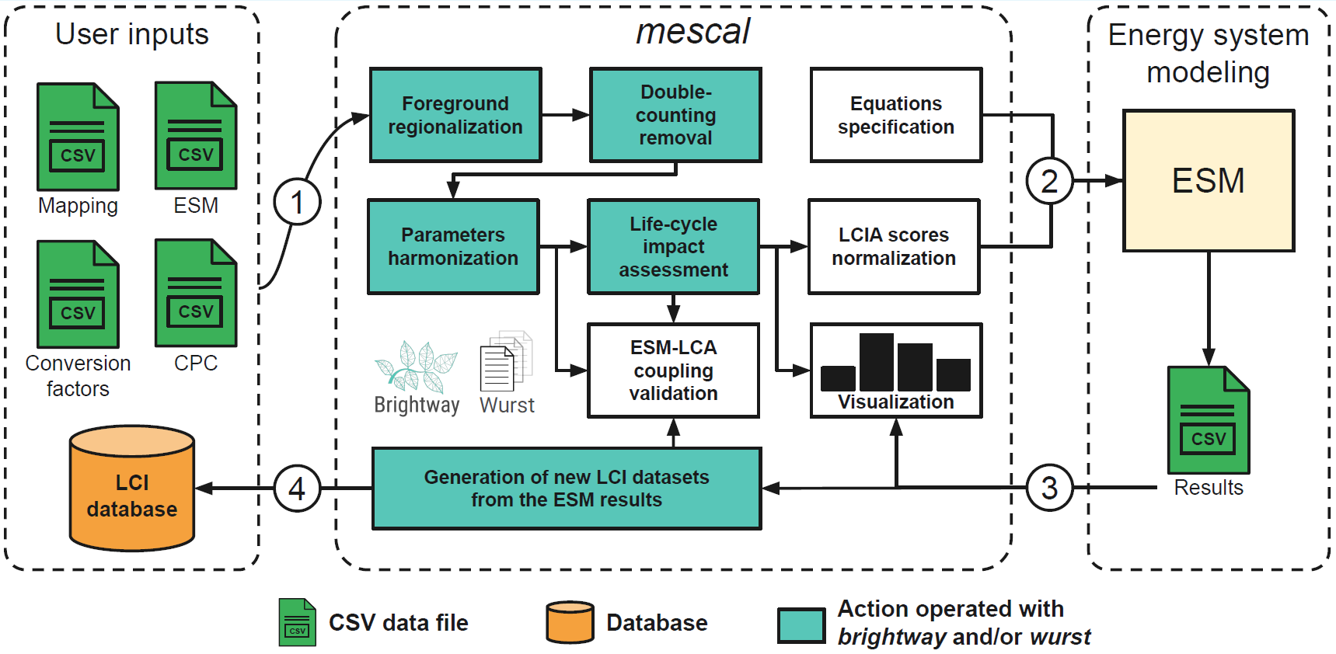
Integrating LCA impact scores in ESMs…
and feed the results back in the database
Notes:
Regionalization = adapt LCI datasets to a given ESM geography
Double-counting = in LCI datasets, remove flows that are both in the ESM and in LCI datasets (e.g., energy flows)
Harmonization = align the technological parameters of technologies in ESM and LCI datasets (e.g., efficiency, lifetime, capacity factors, etc.)

Slide 7

Main input data and methods of mescal

Slide 8
Integrating LCA impact scores in ESMs…
and feed the results back in the database

Slide 9
Mapping between ESM technologies/resources and LCI datasets
ESM
LCA
photovoltaic slanted-roof installation, 1.3 MWp, multi-Si, panel, mounted, on roof (/unit)
Infrastructure LCI dataset
PV
electricity production, photovoltaic, at 1.3 MWp slanted-roof, multi-Si, panel, mounted (/kWh)
Operation LCI dataset
COAL
market for hard coal (/kg)
Resource LCI dataset
ecoinvent / premise / regioinvent
We have done this (painful) step for every technology and resource in our ESM (EnergyScope), feel free to reuse this work!

Slide 10
Integrating LCA impact scores in ESMs…
and feed the results back in the database

Slide 11
Aligning physical units and other assumptions between ESM and LCA
Example with the infrastructure LCI dataset of any kind of car or truck:
BEVs in LCI database → [unit] as a functional unit (i.e., 1 car, 1 truck)
BEVs in ESM → [Mpkm/h] or [Mtkm/h] for installed capacities
In this case, we need the following assumptions from the LCI dataset :
Number of people per car (p) or load factor (t)
Annual distance (km/year)
8760 * capacity factor (hours/year)
Other technological parameters aligned by mescal:
lifetime, energy efficiency

Slide 12
Aligning the energy efficiency
Problem: in case energy efficiencies are not aligned, inconsistencies might arise between fuel consumption (ESM) and direct emissions (LCA).
Natural gas
Boiler
Heat
ESM
2 kWh
1 kWh
Natural gas
Efficiency = 1 / 2 = 50%
3 kWh
Life-cycle inventory database
Lubricating oil
Boiler
1 kWh
Heat
Manufacturing
If the efficiency in the LCI dataset is 33%, direct emissions are multiplied by 33/50
Direct emissions
x 33/50

Slide 13
Integrating LCA impact scores in ESMs…
and feed the results back in the database

Slide 14
Solving the double-counting problem
Problem: flows represented in the ESM are also represented in LCI datasets, therefore their impact is double-counted.
Double-counting
Natural gas
Boiler
Heat
ESM
Correspond in the CPC mapping
Natural gas
Life-cycle inventory database
Lubricating oil
Boiler
Heat
Manufacturing
Direct emissions
Complementary inputs and emissions coming from LCA embodied in metrics to be integrated in the ESM

Slide 15
Integrating LCA impact scores in ESMs…
and feed the results back in the database

Slide 16
Create new datasets based on ESM results
Method: considering production results, mescal builds new markets for all commodities represented in the ESM and connects them to the rest of the database. Example with electricity:
ESM results
New LCI dataset
Activity: market for electricity, high voltage
Reference product: electricity, high voltage (1 kWh)
Location: ESM location
Exchanges:
Electricity production, nuclear (0.5 kWh)
Electricity production, solar photovoltaic (0.3 kWh)
Electricity production, onshore wind (0.2 kWh)
500 TWh/year
200 TWh/year
300 TWh/year
Taken from the mapping file

Slide 17
Integrating LCA impact scores in ESMs…
and feed the results back in the database

Slide 18
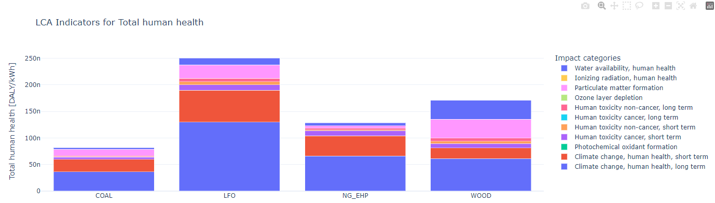
Visualize your results
Basic bar plots to visualize LCA impact scores and system-level LCA results
Example : human health impact scores for a few energy resources

Slide 19
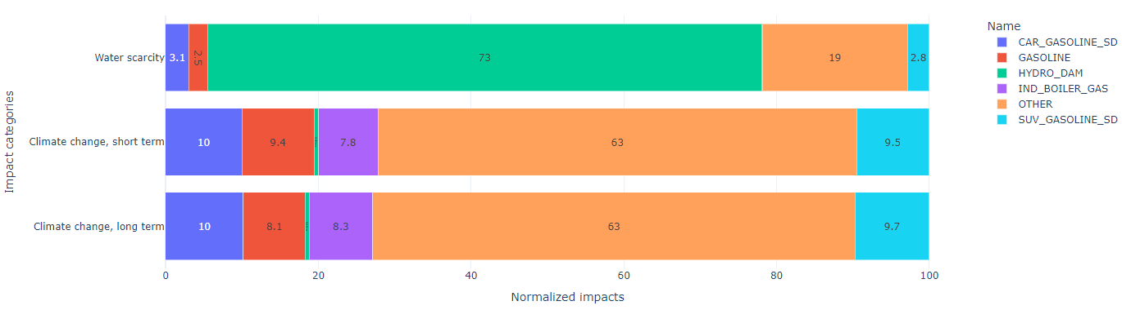
Visualize your results
Basic bar plots to visualize LCA impact scores and system-level LCA results
Example : top 5 contributors in the system
More of mescal’s plots here

Slide 20
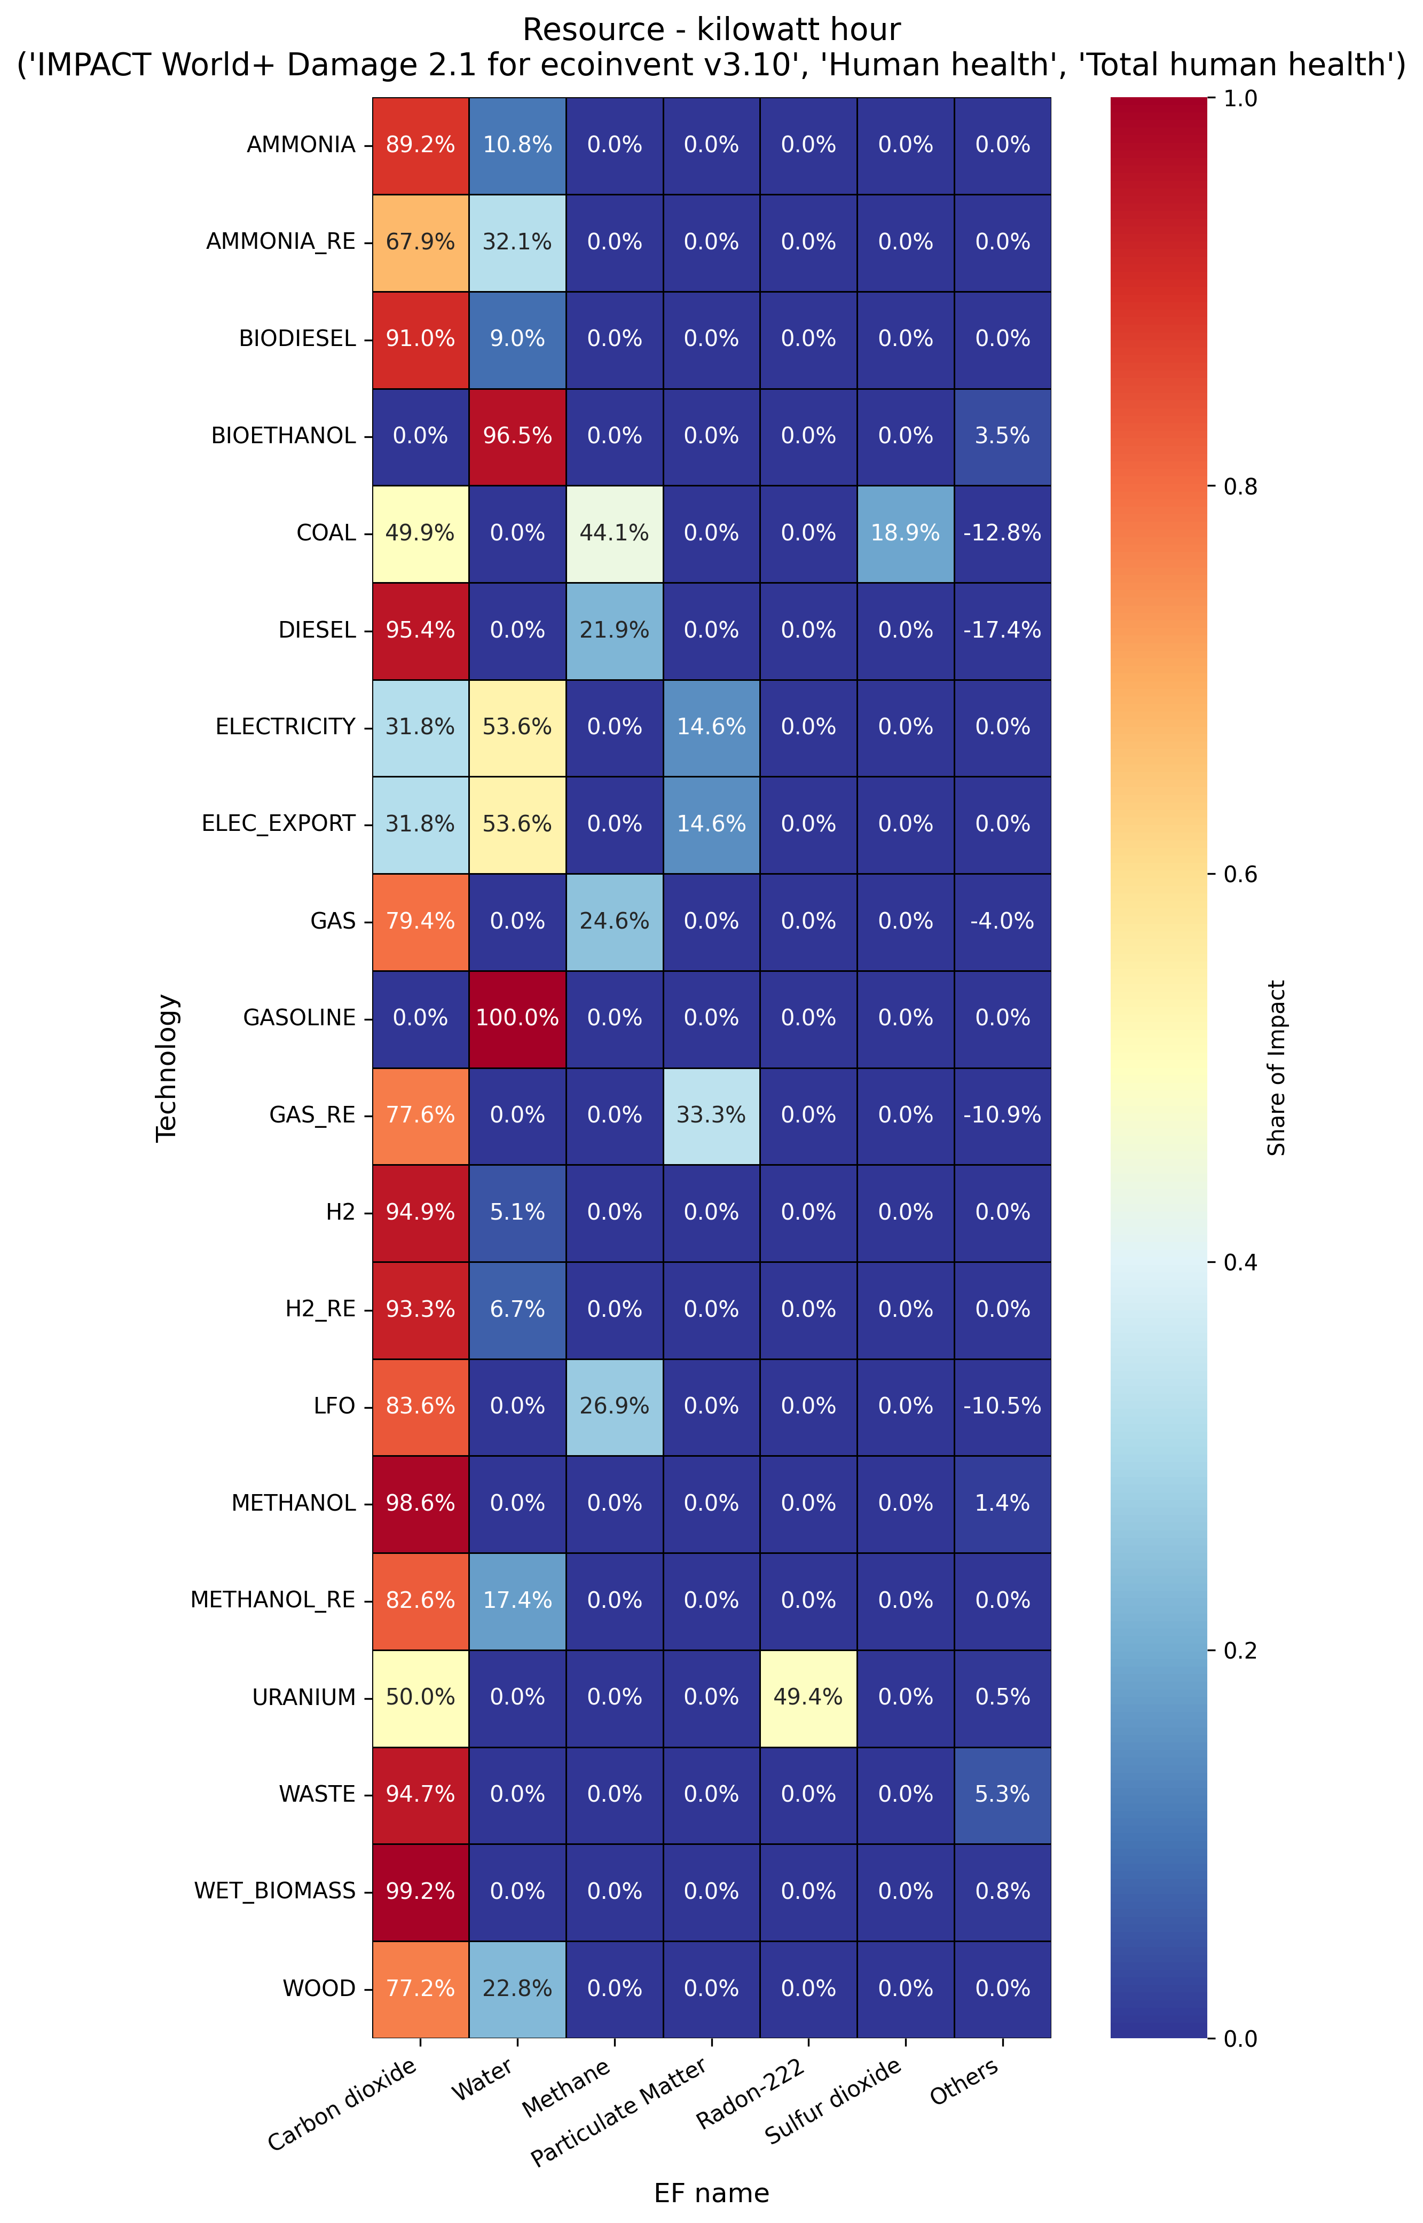
Visualize your results
Advanced app for contribution analyses (processes and elementary flows)
Example: contribution analysis of elementary flows among energy resources for the category “total human health”
Streamlit app

Slide 21

More details and how to cite
For more details and a funny case study, have a look at our publication:

Slide 22
Installation and documentation
pip install mescal
https://pypi.org/project/mescal/
Github
https://github.com/matthieu-str/mescal
ReadTheDocs
https://mescal.readthedocs.io/en/latest/

Slide 23

Merci!
Questions?
Matthieu Souttre
Ph.D. student
Montréal - Canada
matthieu.souttre@polymtl.ca
ciraig.org

Slide 24
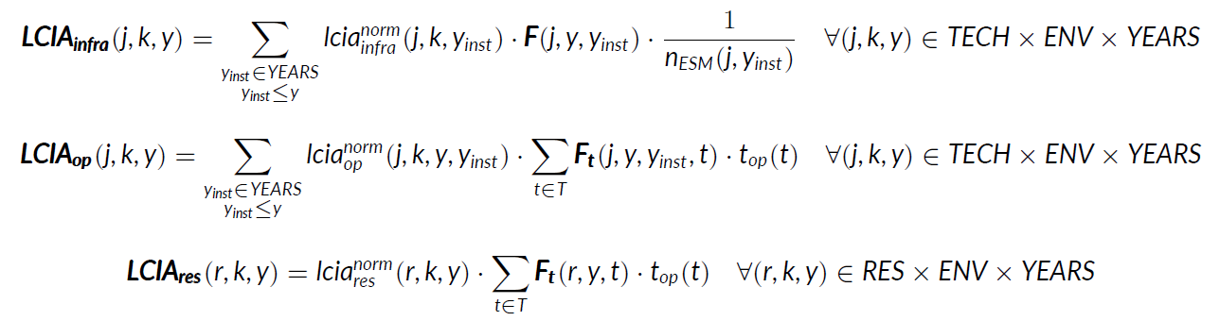
Equations
Notes:
Time dimension → we allocate (1 / lifetime) of the impact of energy infrastructures being installed to the current year y.

