Slide 1


Scenario-Based Life Cycle Assessment and Techno Economic Analysis of e-Diesel Production for Maritime Decarbonization: A Saudi Arabian Case Study
Ph.D. Student: Monserrat Echegoyen
Environmental Sciences and Engineering
Academic Advisor: Prof. S. Mani Sarathy
Notes:
Hello everyone, my name is Monserrat Echegoyen, PhD student at KAUST. Today I'll present a scenario-based life cycle and techno-economic assessment of e-diesel for maritime decarbonization in Saudi Arabia.

Slide 2
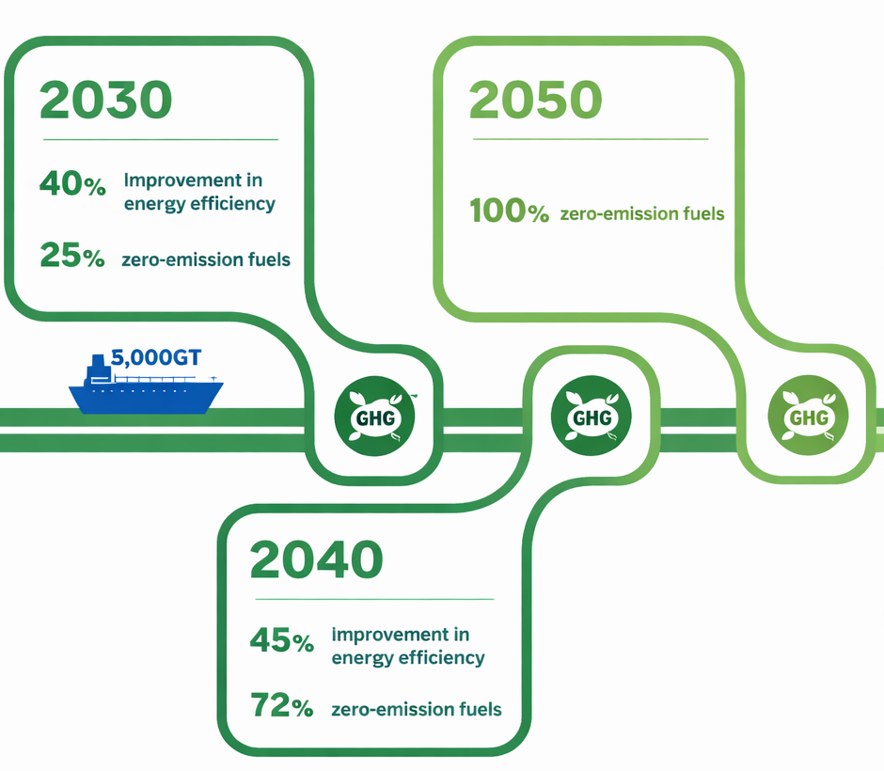

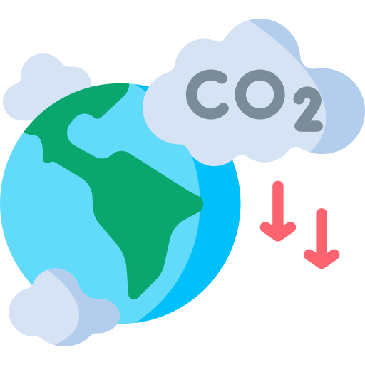
1. E-Diesel: a Decarbonization Strategy in the Maritime Sector
Why Decarbonizing Shipping Matters?
International Maritime Organization Targets
Shipping accounts for ~3% of global CO₂ emissions. (1,056 Mt in 2018)¹.
Vessel lifetimes of 25‑40 years create infrastructure lock‑in².
Notes:
Shipping emits about 3% of global CO₂, over one billion tonnes a year.
Ships stay in service 25 to 40 years, so what we build today locks in emissions for decades.
At the same time, the IMO targets deep cuts by 2030 and 2040, and net zero by 2050.

Slide 3






Why e‑Diesel?
Drop‑in fuel
High energy density
Closed carbon cycle
Ultra clean
Compatible with existing diesel engines and bunkering infrastructure
Critical for long‑distance shipping
The CO₂ used in production is released upon combustion, adding no new fossil carbon
e-Diesel is sulfur‑free, aromatic‑free, high cetane number
3
Notes:
E-diesel is a synthetic fuel made from renewable electricity, water and CO₂.
Its biggest advantage is that it's a drop-in fuel: it works in existing engines and bunkering infrastructure without retrofitting.
It has the high energy density long-distance shipping needs, the CO₂ released when it burns is the same CO₂ captured to make it, and it's sulfur and aromatic free.

Slide 4







Why Saudi Arabia? A Big Opportunity
Energy Advantage
Strategic Location
Mediterranean Sea
Solar: ~2200 kWh/m²
Wind: >200 GW
Adjacent to Suez Canal
(~12% of global trade)
Jubail
Policy Support
Red Sea
Yanbu
$270B investment
Industrial CO2 point sources
Net Zero 2060
Notes:
Saudi Arabia is very well positioned.
The kingdom is already investing in this type of technologies.
It has excellent solar and wind for cheap hydrogen, large industrial CO₂ sources in Yanbu and Jubail, and a location on the Red Sea next to the Suez Canal, which carries about 12% of global trade.
And there's policy support: 270 billion dollars under Vision 2030

Slide 5





Research Question
What combination of hydrogen and CO₂ supply pathways yields the lowest cost of e-diesel for the maritime sector in Saudi Arabia?
S1: e-Diesel Production: Renewable Hydrogen + Point Source CO₂ (Base Case - Yanbu)
S2: e-Diesel Production: Grid Electricity Hydrogen + Point-Source CO₂
Grid H2= $4.54
CO₂ Cost = $69/tonne
LCOH = $2.78/kg H₂
CO2 Cost= $69/tonne
S3: e-Diesel Production (Low-Cost Point-Source CO₂ )
S4: e-Diesel Production Direct Air Capture (DAC) CO₂
H2= same as S1
CO₂ Cost = $30/tonne
H2: same as S1
CO₂ Cost = $400/tonne
Notes:
So our question is: which combination of hydrogen and CO₂ supply gives the lowest cost e-diesel?
We built four scenarios.
S1, the base case, uses renewable hydrogen and point-source CO₂ at 69 dollars per tonne in Yanbu.
S2 uses hydrogen from grid electricity.
S3 keeps the S1 hydrogen but with cheaper CO₂ at 30 dollars per tonne.
And S4 uses CO₂ from direct air capture at 400 dollars per tonne.

Slide 6














Life Cycle Assessment System Boundary
Upstream Inputs
Core PtL Production Process
Outputs
Outside of
System Boundary
Electrolyzer materials (Pt, Ni, Ti, membranes)
Catalysts (Co, Fe)
Hydrogen (H₂) Production
(Downstream – Tank to Wake)
Raw Materials
Electrolysis
Co-Products
(System Expansion)
Fuel Storage
Naphtha
H₂ Compression
Transport and
Distribution
Renewable Electricity
(Solar, Wind)
Grid Electricity
Transmission)
CO₂ + H₂ → CO + H₂O
Jet Fuel
Energy Supply
Reverse Water Gas Shift (RWGS)
Marine Bunkering
Wax
(Gas Cleanup, H₂/CO Adjustment)
Syngas Conditioning
Fuel Combustion
e-Diesel
Functional Unit: 1 kg e-Diesel delivered
Water Extraction & Purification
Hydrocarbon Production
Water Supply
Fischer–Tropsch Synthesis (FT)
Other Exclusions
• Ship & Engine Manufacturing
• Port Infrastructure
• Catalyst Recycling
• R&D, Administration
(Distillation, Hydrocracking, Hydrotreating)
Product Separation and Upgrading
• Industrial Capture
• Direct Air Capture (DAC))
CO₂ Source
GHG
emissions
Additional e-Diesel
Upstream Inputs
Core Processes
Co-Products
Excluded Processes
System Boundary
Notes:
For the LCA, our functional unit is 1 kg of e-diesel. Upstream, we include raw materials, energy, water and the CO₂ source.

Slide 7
Life Cycle Assessment System Boundary
Upstream Inputs
Core PtL Production Process
Outputs
Outside of
System Boundary
Electrolyzer materials (Pt, Ni, Ti, membranes)
Catalysts (Co, Fe)
Hydrogen (H₂) Production
(Downstream – Tank to Wake)
Raw Materials
Electrolysis
Co-Products
(System Expansion)
Fuel Storage
Naphtha
H₂ Compression
Transport and
Distribution
Renewable Electricity
(Solar, Wind)
Grid Electricity
Transmission)
CO₂ + H₂ → CO + H₂O
Jet Fuel
Energy Supply
Reverse Water Gas Shift (RWGS)
Marine Bunkering
Wax
(Gas Cleanup, H₂/CO Adjustment)
Syngas Conditioning
Fuel Combustion
e-Diesel
Functional Unit: 1 kg e-Diesel delivered
Water Extraction & Purification
Hydrocarbon Production
Water Supply
Fischer–Tropsch Synthesis (FT)
Other Exclusions
• Ship & Engine Manufacturing
• Port Infrastructure
• Catalyst Recycling
• R&D, Administration
(Distillation, Hydrocracking, Hydrotreating)
Product Separation and Upgrading
• Industrial Capture
• Direct Air Capture (DAC))
CO₂ Source
GHG
emissions
Additional e-Diesel
Upstream Inputs
Core Processes
Co-Products
Excluded Processes
System Boundary
Notes:
The core process is electrolysis for hydrogen, reverse water gas shift and Fischer-Tropsch synthesis, then separation and upgrading.

Slide 8
Life Cycle Assessment System Boundary
Upstream Inputs
Core PtL Production Process
Outputs
Outside of
System Boundary
Electrolyzer materials (Pt, Ni, Ti, membranes)
Catalysts (Co, Fe)
Hydrogen (H₂) Production
(Downstream – Tank to Wake)
Raw Materials
Electrolysis
Co-Products
(System Expansion)
Fuel Storage
Naphtha
H₂ Compression
Transport and
Distribution
Renewable Electricity
(Solar, Wind)
Grid Electricity
Transmission)
CO₂ + H₂ → CO + H₂O
Jet Fuel
Energy Supply
Reverse Water Gas Shift (RWGS)
Marine Bunkering
Wax
(Gas Cleanup, H₂/CO Adjustment)
Syngas Conditioning
Fuel Combustion
e-Diesel
Functional Unit: 1 kg e-Diesel delivered
Water Extraction & Purification
Hydrocarbon Production
Water Supply
Fischer–Tropsch Synthesis (FT)
Other Exclusions
• Ship & Engine Manufacturing
• Port Infrastructure
• Catalyst Recycling
• R&D, Administration
(Distillation, Hydrocracking, Hydrotreating)
Product Separation and Upgrading
• Industrial Capture
• Direct Air Capture (DAC))
CO₂ Source
GHG
emissions
Additional e-Diesel
Upstream Inputs
Core Processes
Co-Products
Excluded Processes
System Boundary
Notes:
Co-products like naphtha, jet fuel and wax are handled with system expansion.

Slide 9
Life Cycle Assessment System Boundary
Upstream Inputs
Core PtL Production Process
Outputs
Outside of
System Boundary
Electrolyzer materials (Pt, Ni, Ti, membranes)
Catalysts (Co, Fe)
Hydrogen (H₂) Production
(Downstream – Tank to Wake)
Raw Materials
Electrolysis
Co-Products
(System Expansion)
Fuel Storage
Naphtha
H₂ Compression
Transport and
Distribution
Renewable Electricity
(Solar, Wind)
Grid Electricity
Transmission)
CO₂ + H₂ → CO + H₂O
Jet Fuel
Energy Supply
Reverse Water Gas Shift (RWGS)
Marine Bunkering
Wax
(Gas Cleanup, H₂/CO Adjustment)
Syngas Conditioning
Fuel Combustion
e-Diesel
Functional Unit: 1 kg e-Diesel delivered
Water Extraction & Purification
Hydrocarbon Production
Water Supply
Fischer–Tropsch Synthesis (FT)
Other Exclusions
• Ship & Engine Manufacturing
• Port Infrastructure
• Catalyst Recycling
• R&D, Administration
(Distillation, Hydrocracking, Hydrotreating)
Product Separation and Upgrading
• Industrial Capture
• Direct Air Capture (DAC))
CO₂ Source
GHG
emissions
Additional e-Diesel
Upstream Inputs
Core Processes
Co-Products
Excluded Processes
System Boundary
Notes:
Transport, bunkering and combustion are outside the boundary, because they're the same in all scenarios and don't change the comparison.

Slide 10

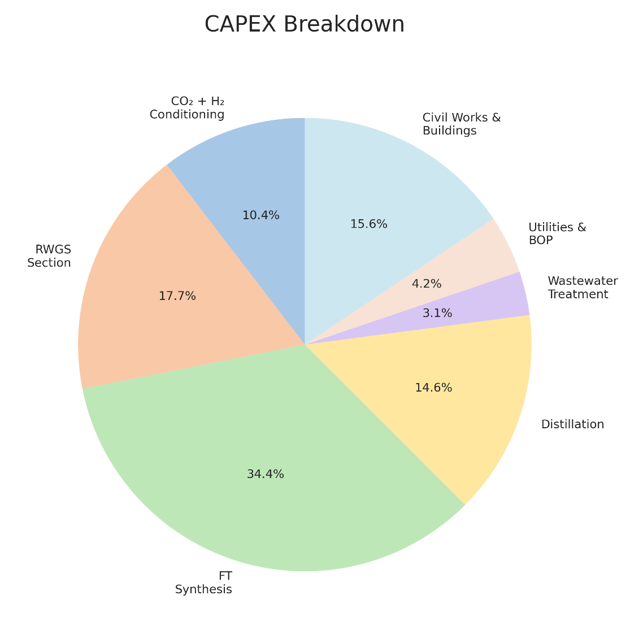
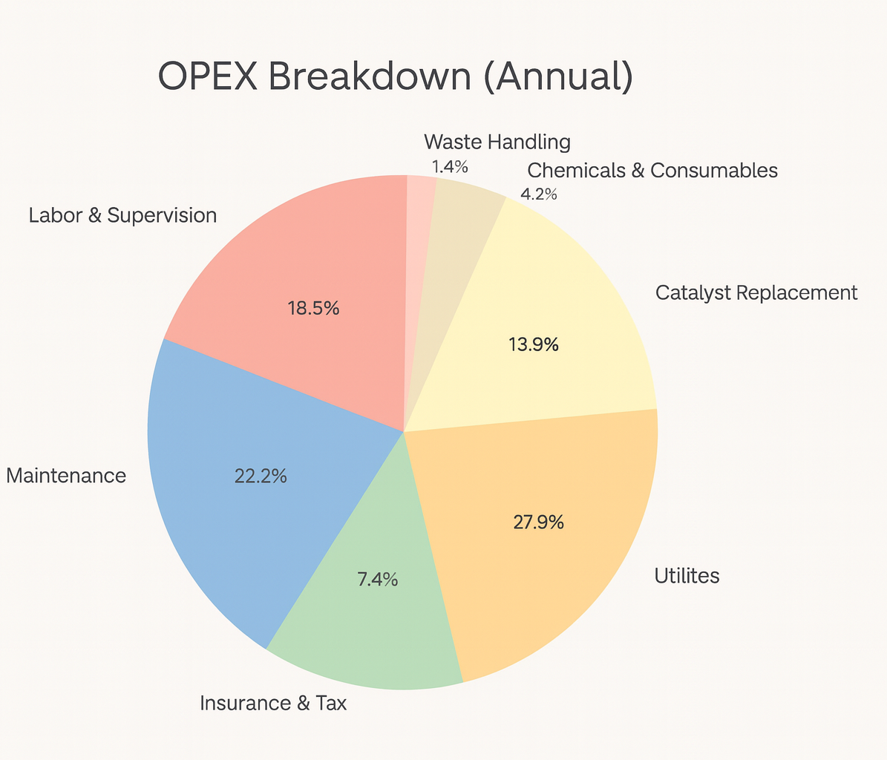
Plant Cost Breakdown: CAPEX vs OPEX
CAPEX Breakdown
OPEX Breakdown (annual)
52.3 million USD
7.2 million USD
Notes:
Regarding the techno economic analysis
For the commercial plant, the capital cost is about 52 million dollars. Fischer-Tropsch is the biggest share, about a third, followed by the RWGS reactor, distillation and civil works.
Operating costs are about 7.2 million dollars a year, mainly utilities, maintenance and labor.

Slide 11
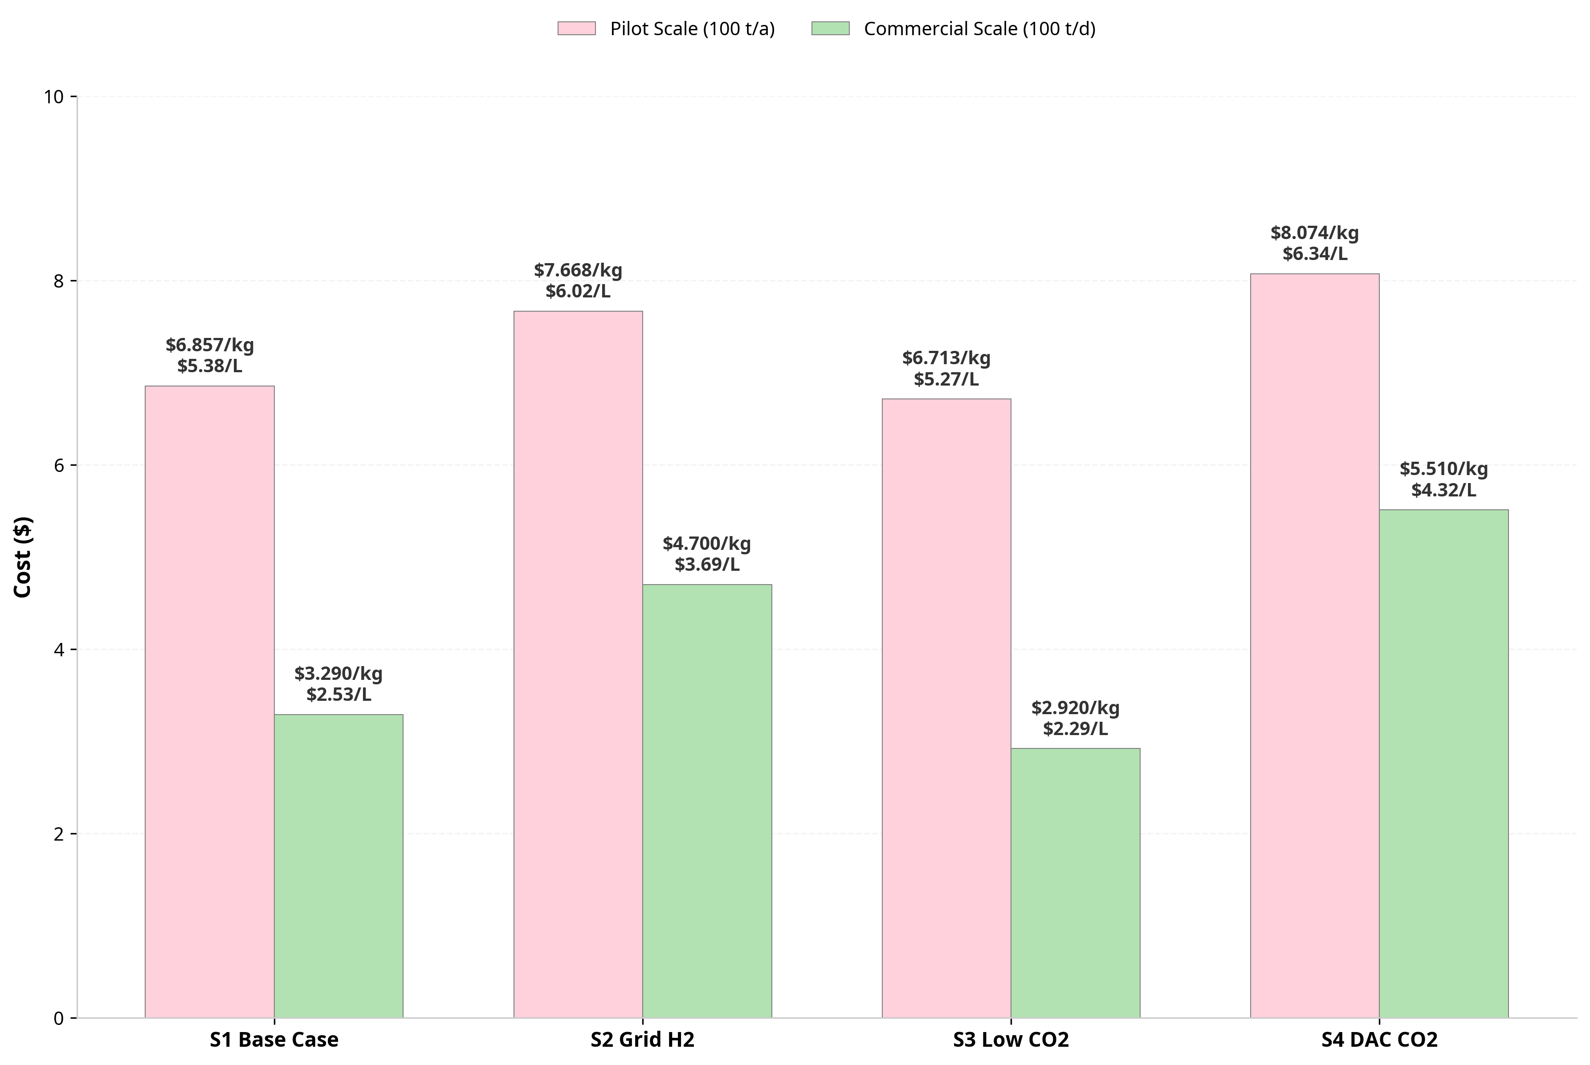
Scenario Results
Compared to our previous model of pilot scale
Scenario (100t/day)​ | LCOD (USD/L)​ | Description
S1​ | $2.53​ | Renewable H₂ + point‑source CO₂​
S2​ | $3.69​ | Grid H₂ + point‑source CO₂ (cost penalty)​
S3​ | $2.29​ | Renewable H₂ + low‑cost CO₂ (best)​
S4​ | $4.32​ | Renewable H₂ + DAC (most expensive)​
Notes:
Here are the results.
The base case, S1, gives 2.53 dollars per liter. S2, with grid hydrogen, goes up to 3.69. S3 is the cheapest at 2.29.
The 30 dollar CO₂ price is realistic here: many industries vent low-purity CO₂ with almost no value, and placing the plant next to the source avoids transport and storage costs.
S4 with DAC is the most expensive at 4.32. On the right, compared with our pilot-scale model of 100 tonnes a year, scaling up will cut the costs by roughly 40 to 60%

Slide 12
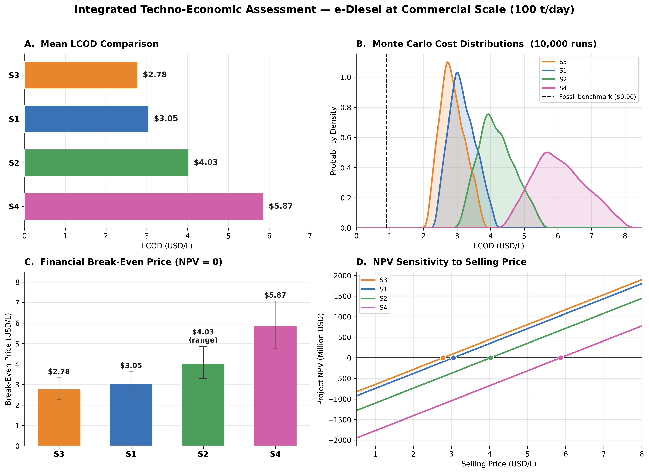
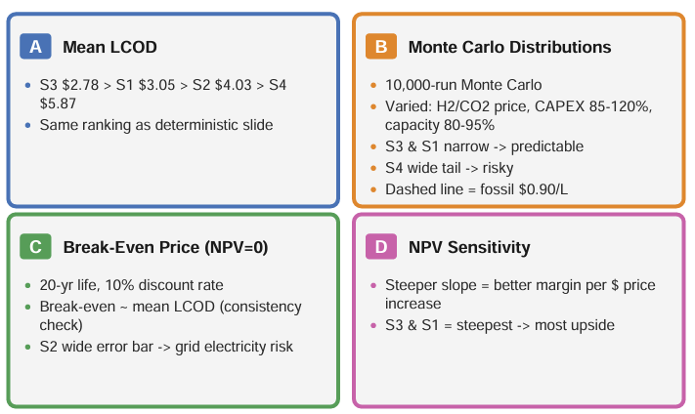
Integrated Techno-Economic Assessment
Notes:
We then tested uncertainty with a 10,000-run Monte Carlo, varying hydrogen price, CO₂ price, CAPEX and capacity factor.
The mean costs go up a bit, but the ranking stays the same: S3, then S1, S2 and S4.
S3 and S1 have narrow distributions, so their costs are predictable. S4 has a long right tail, which is a real investment risk.

Slide 13
Integrated Techno-Economic Assessment
Notes:
The break-even selling price, over 20 years at a 10% discount rate, matches those mean costs, from about 2.78 for S3 to 5.87 for S4.
And NPV grows fastest with selling price for S3 and S1. So the ranking is robust: S3 is both the cheapest and the most investable option.

Slide 14
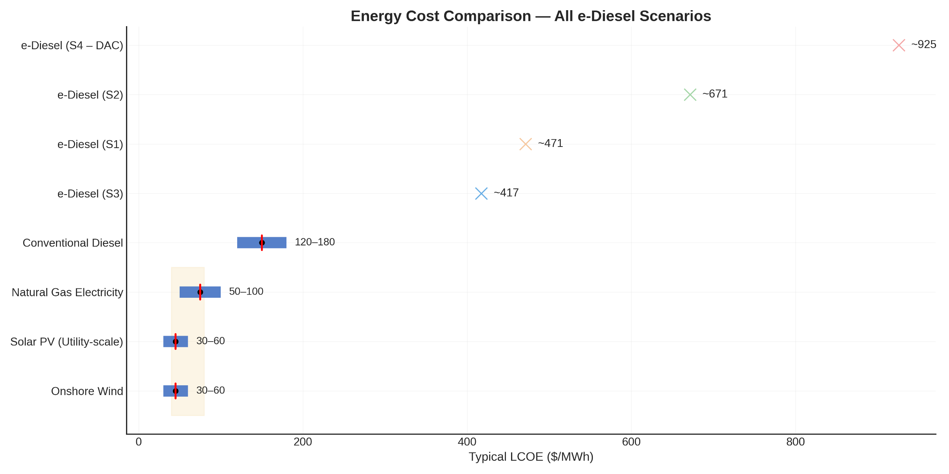
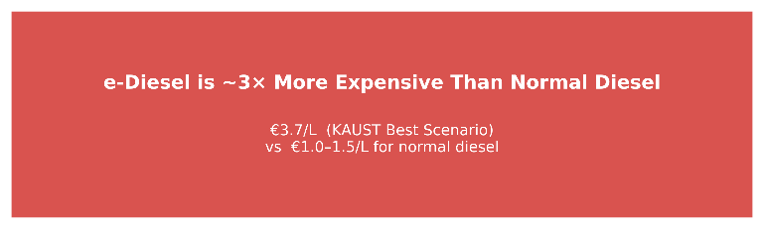
Notes:
In energy terms, even our best case is still about three times more expensive than conventional diesel. But in our pilot-scale model it was about ten times, so scale makes a huge difference.

Slide 15

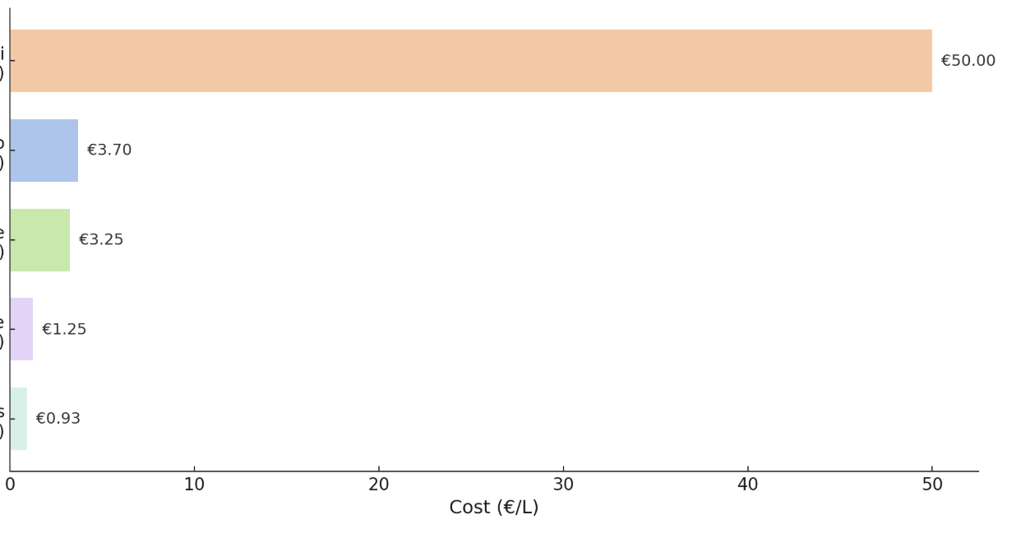



What the literature shows?
E-Diesel costs today and projections scale
$50
(now)
(projection)
$3.25
Our best scenario
(S3)
$2.29
$1.25
(projection)
$0.93
(projection)
Cost: USD/L
Notes:
Compared with industry, HIF's Haru Oni demonstration plant reports around 50 per liter today. Our S3, at 2.29, is more than ten times lower. Developers like Topsoe, Sunfire and Prometheus project between 0.93 and 3.25 per liter, assuming very large scale and very cheap electricity. So our result already sits within that projected range.

Slide 16
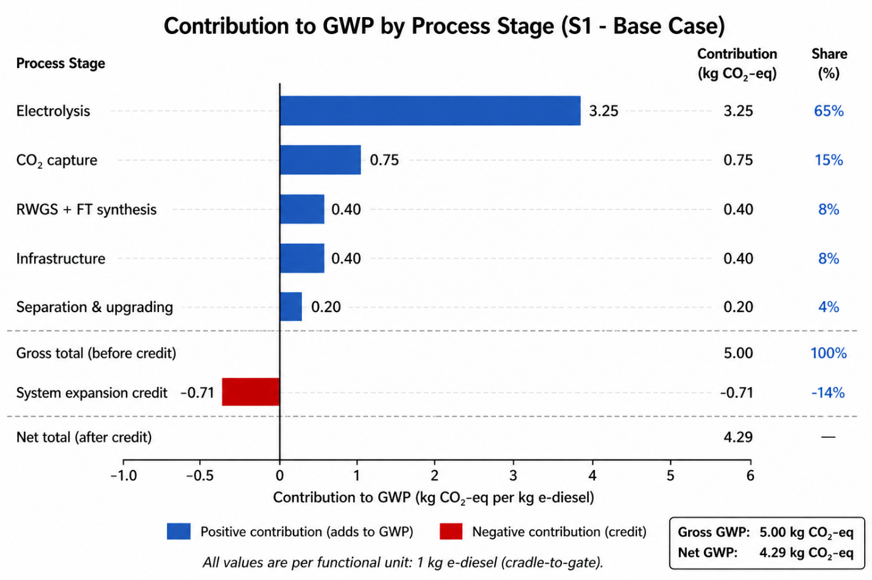
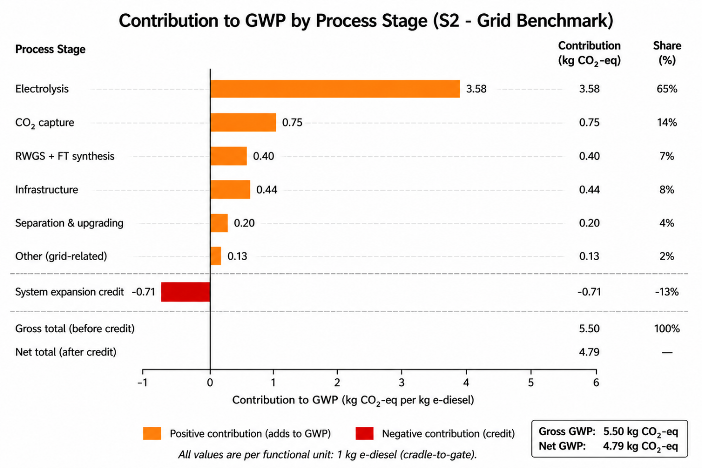
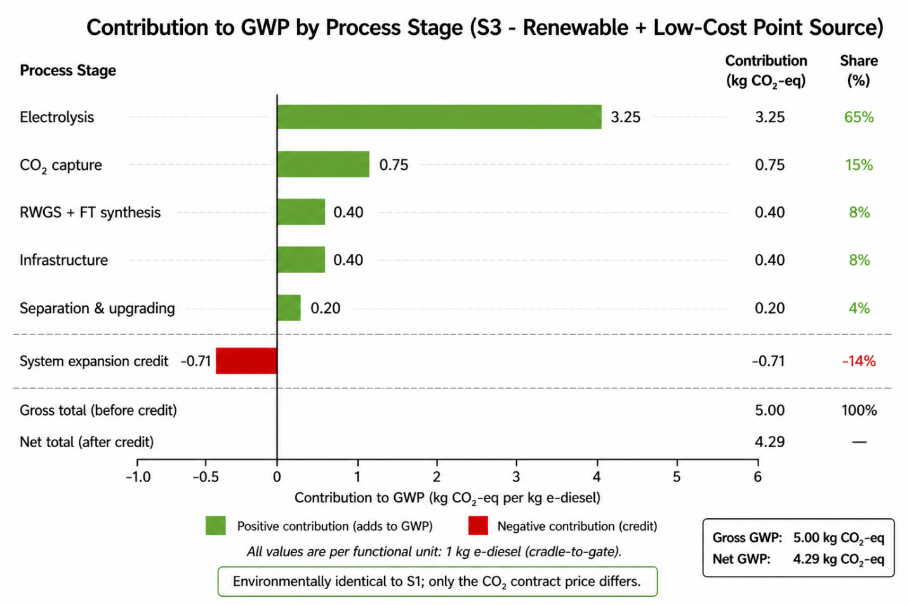
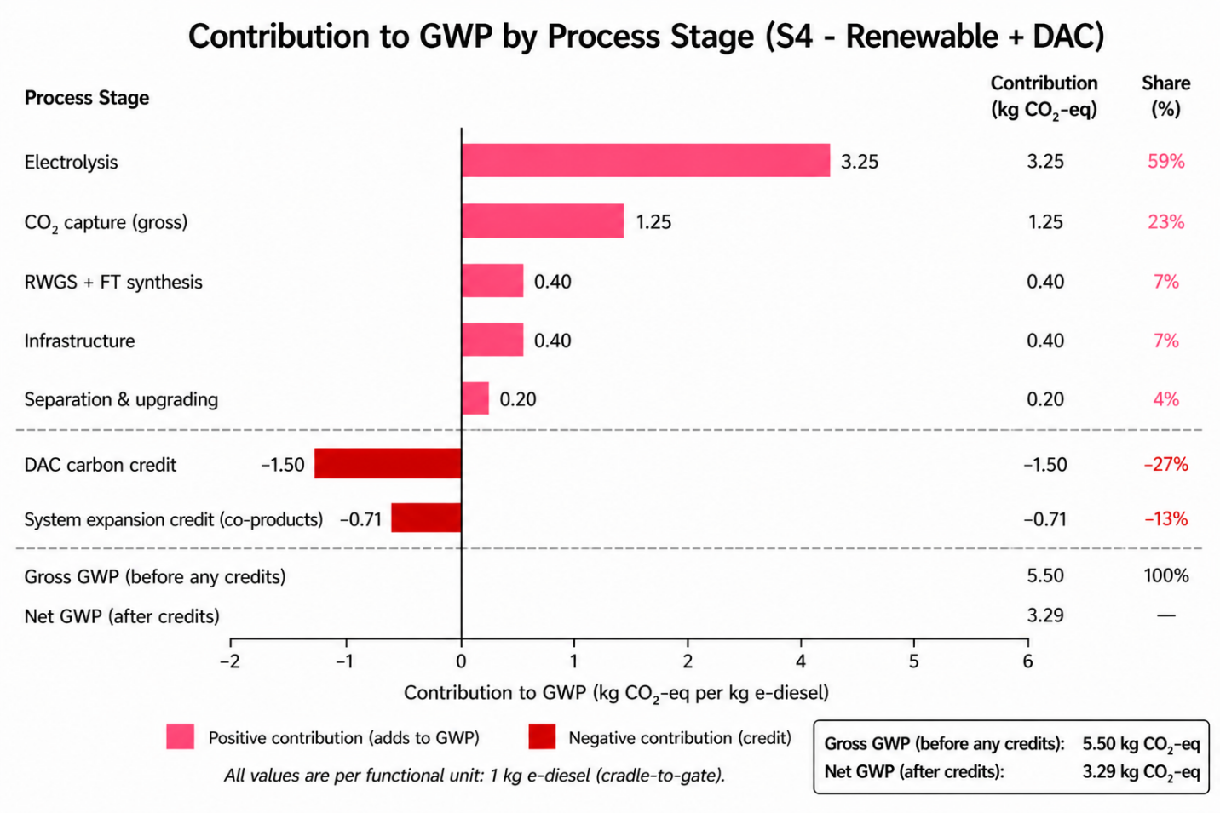
Global Warming Potential (GWP): Contribution Analysis
Notes:
Environmentally, electrolysis is the biggest contributor to global warming potential in every scenario, followed by CO₂ capture. Co-product credits reduce the total by about 14%.
S2 is higher because of grid electricity. S3 is identical to S1, since only the CO₂ price changes. And S4 has the lowest net value, thanks to the carbon removal credit from DAC.

Slide 17




Key Highlights
e-Diesel via Power-to-Liquid for Maritime Decarbonization. Yanbu, Saudi Arabia
$2.29/L
4.29 kg
Lowest LCOD (S3)
Lowest-cost scenario ties for lowest GWP
Commercial scale, renewable H₂ + low-cost CO₂
kg CO₂-eq per kg e-diesel (S1 = S3)
~65%
Net GWP range: 3.29–4.79 kg CO₂-eq across S1–S4
Electrolysis dominates GWP
WTW parity with fossil diesel
Single biggest lever across every scenario
kg CO₂/kg — S4 e-diesel vs. conventional diesel
The cheapest scenario is also the cleanest. S1 and S3 are environmentally identical,
a cheaper CO₂ contract carries zero environmental penalty. The real tradeoff is cost vs. carbon: Direct Air Capture (S4) cuts GWP 23% but costs 89% more, and still doesn’t reach carbon-negative under realistic Saudi conditions.
Notes:
To close: 2.29 dollars per liter is achievable at commercial scale in Yanbu.
S3 has the same environmental footprint as S1, about 4.29 kg CO₂-eq per kg, so a cheaper CO₂ contract has no environmental penalty.
Electrolysis is about 65% of the footprint, so cheaper, cleaner electricity is the main lever.
DAC cuts emissions by 23% but costs 89% more, so it isn't justified yet.
Saudi Arabia's solar and wind resources, combined with its industrial CO₂ infrastructure, make e-diesel both economically competitive and environmentally credible — without waiting for breakthrough technologies.
Thank you."

Slide 18
THANKS

