Slide 1


SALCA-PY: An open-source implementation of the Swiss Agricultural Life Cycle Assessment models in Python
Laura Scherer, Martin Stüssi
24/09/2026, Brightcon

Slide 2
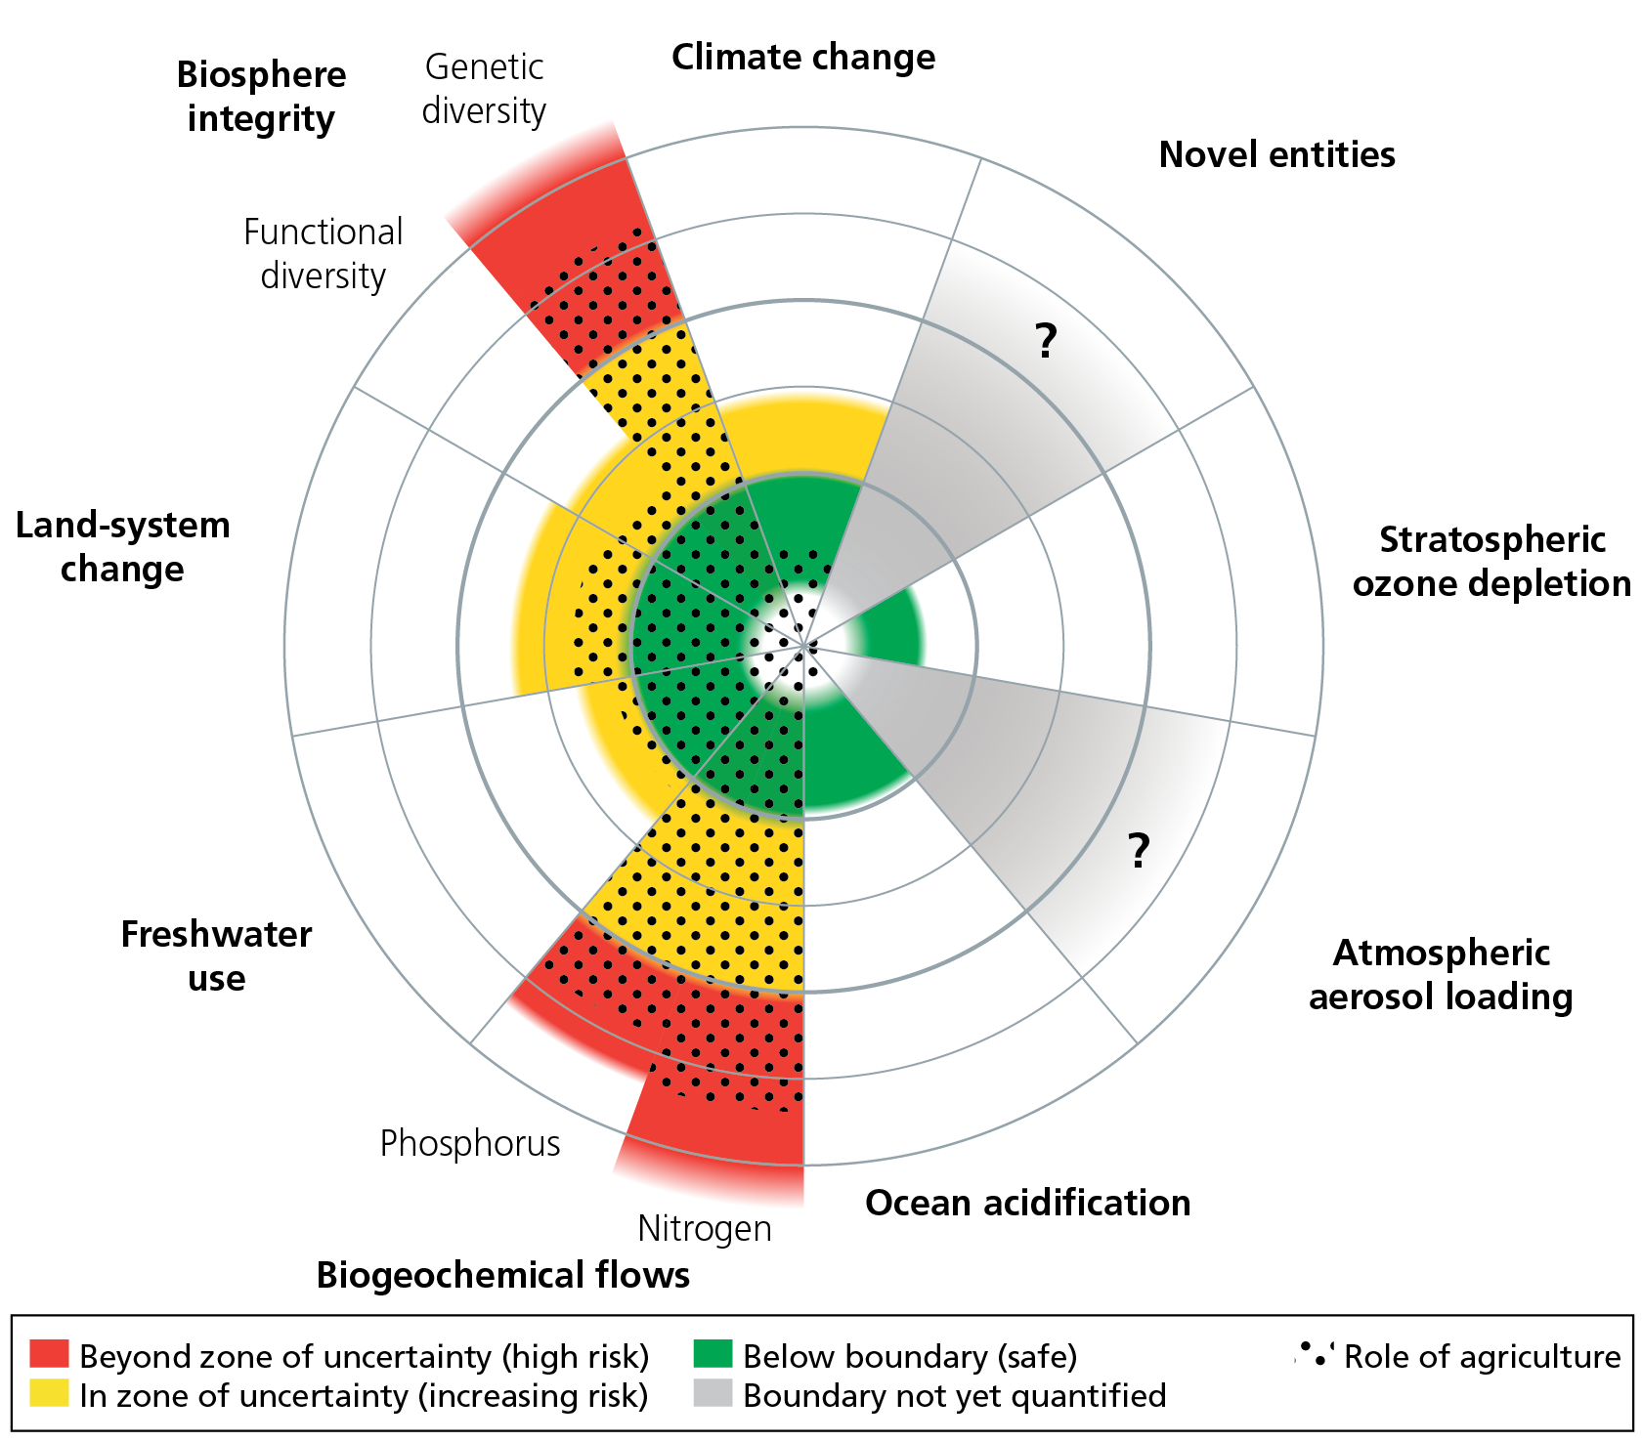
Need for efficient and flexible tools
Agriculture
a major driver of environmental impacts
a complex sector
  Open systems
  Dependent on natural resources
  High spatial and temporal variability
  Numerous products across crop, animal, and mixed production systems
Figure source: Campbell et al. (2017)
10.5751/ES-09595-220408

Slide 3
History of SALCA
Applicable to Swiss and, more generally, Central European conditions
Developed over more than two decades
1997: first life cycle inventory for agriculture published
2001: first version of the SALCA database available internally
2003: ecoinvent v1.0 published, including some SALCA inventories
Until ~2008/09: Use of LCA software TEAM
From ~2008/09: Use of SALCA Excel tool
From ~2018/19: Use of Python code within the SALCAfuture tool (paper on the latter by Lansche et al. under review)
Long-term process and large collaborative effort among researchers across multiple generations and with diverse disciplinary backgrounds – needed to ensure a high quality of the models necessitating different specialist expertise

Slide 4
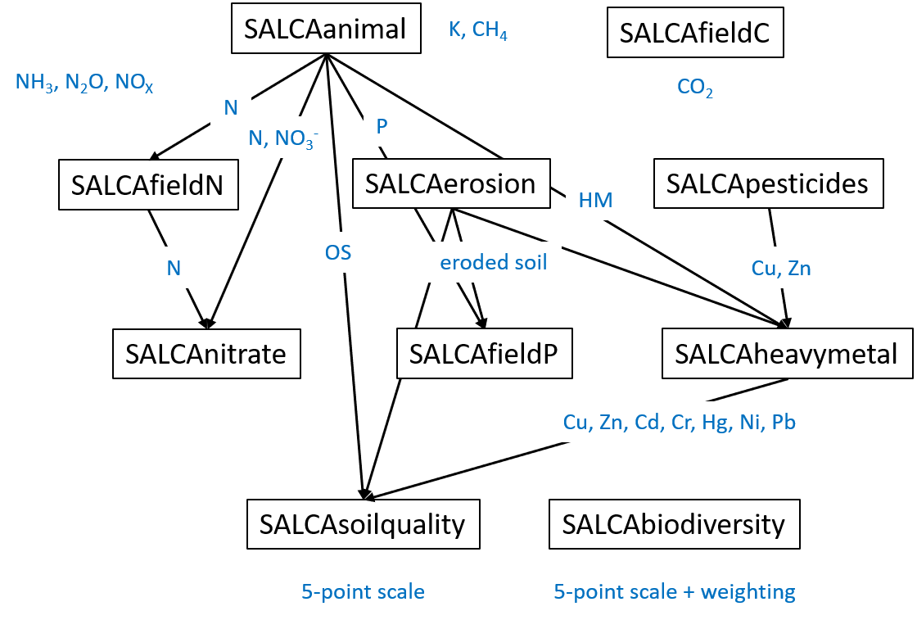
Scope of SALCA models

Slide 5
Motivation for a transition from spreadsheets to Python
Increasing complexity of the models
Connections between some of the models (especially for SALCAanimal and SALCAerosion)
Large input data requirements (up to ~320 input parameters and variables)
Gradual expansion of the set of models (among the latest additions: SALCAbiodiversity)
Need for continuous updates to integrate new scientific findings (latest update: N₂O → LCA Food conference next month)
Interest from external researchers in using such models for their own studies in and outside of Switzerland (e.g., Austria, France, and China)

Slide 6



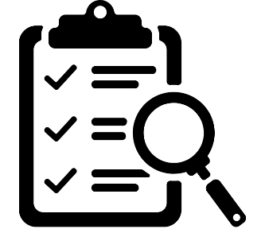
SALCA-PY components
Alternative under dev.
Published
SALCA modules
Calculation modules for direct emissions, farm inputs, and some impacts
Framework / Tool
Project execution
Not available
SALCAfuture
Database
I/E Interface
SALCA-PY
Published soon
Parameter tables
Parameters used in each SALCA module
SALCAtables
Data tables module (commonly used)
Properties of crops, fertilizer, machinery, etc.
Planned to publish

Slide 7
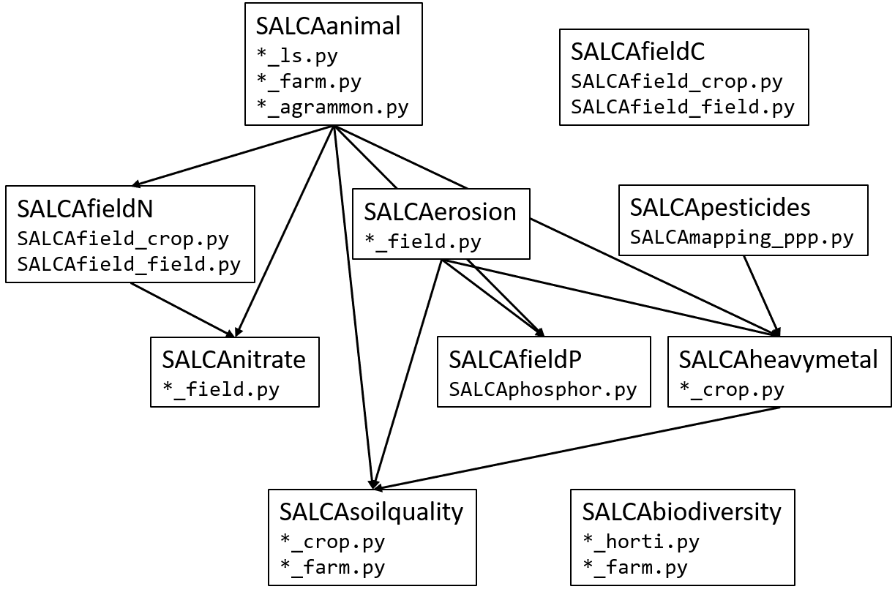
Modular structure of SALCA models
Running the scripts in the right order
Allocation
Mapping to upstream LCIs
Formatting into SimaPro- and Brightway-compatible CSV files
SALCAplausibility
SALCAtables
SALCAprep
SALCAmapping

Slide 8
Transition to an open-source publication
Aims of code improvements:
Facilitating reuse by and collaboration with external researchers
Making the software development process more sustainable
Ensuring continuity despite potential changes within the research team over time
Harmonizing among and accommodating different experience levels and styles in Python programming
In practice:
Definition of guidelines and a short-term plan for cleaning our codebase
Release on 2 June 2026 on GitHub: https://github.com/agroscope-ch/salca
Outline of future plans to further improve documentation and the code

Slide 9

Transition to an open-source publication
Outline of future plans to further improve documentation and the code
Cleaning parameter and data tables
Refactoring for easier overview, reuse, adaptation, and testing
Documenting the code (e.g., using NumPy style and sphinx)
Making the code compatible with newer package versions
Testing (beyond the current plausibility checks)
Priority: models that will be developed further during this work programme
Next release on GitHub planned in October 2026
In parallel
Further developments of some models
Development of an alternative to the SALCAfuture tool → Cédric Furrer

Slide 10
Demo of SALCAsoilquality model in a Notebook

Slide 11
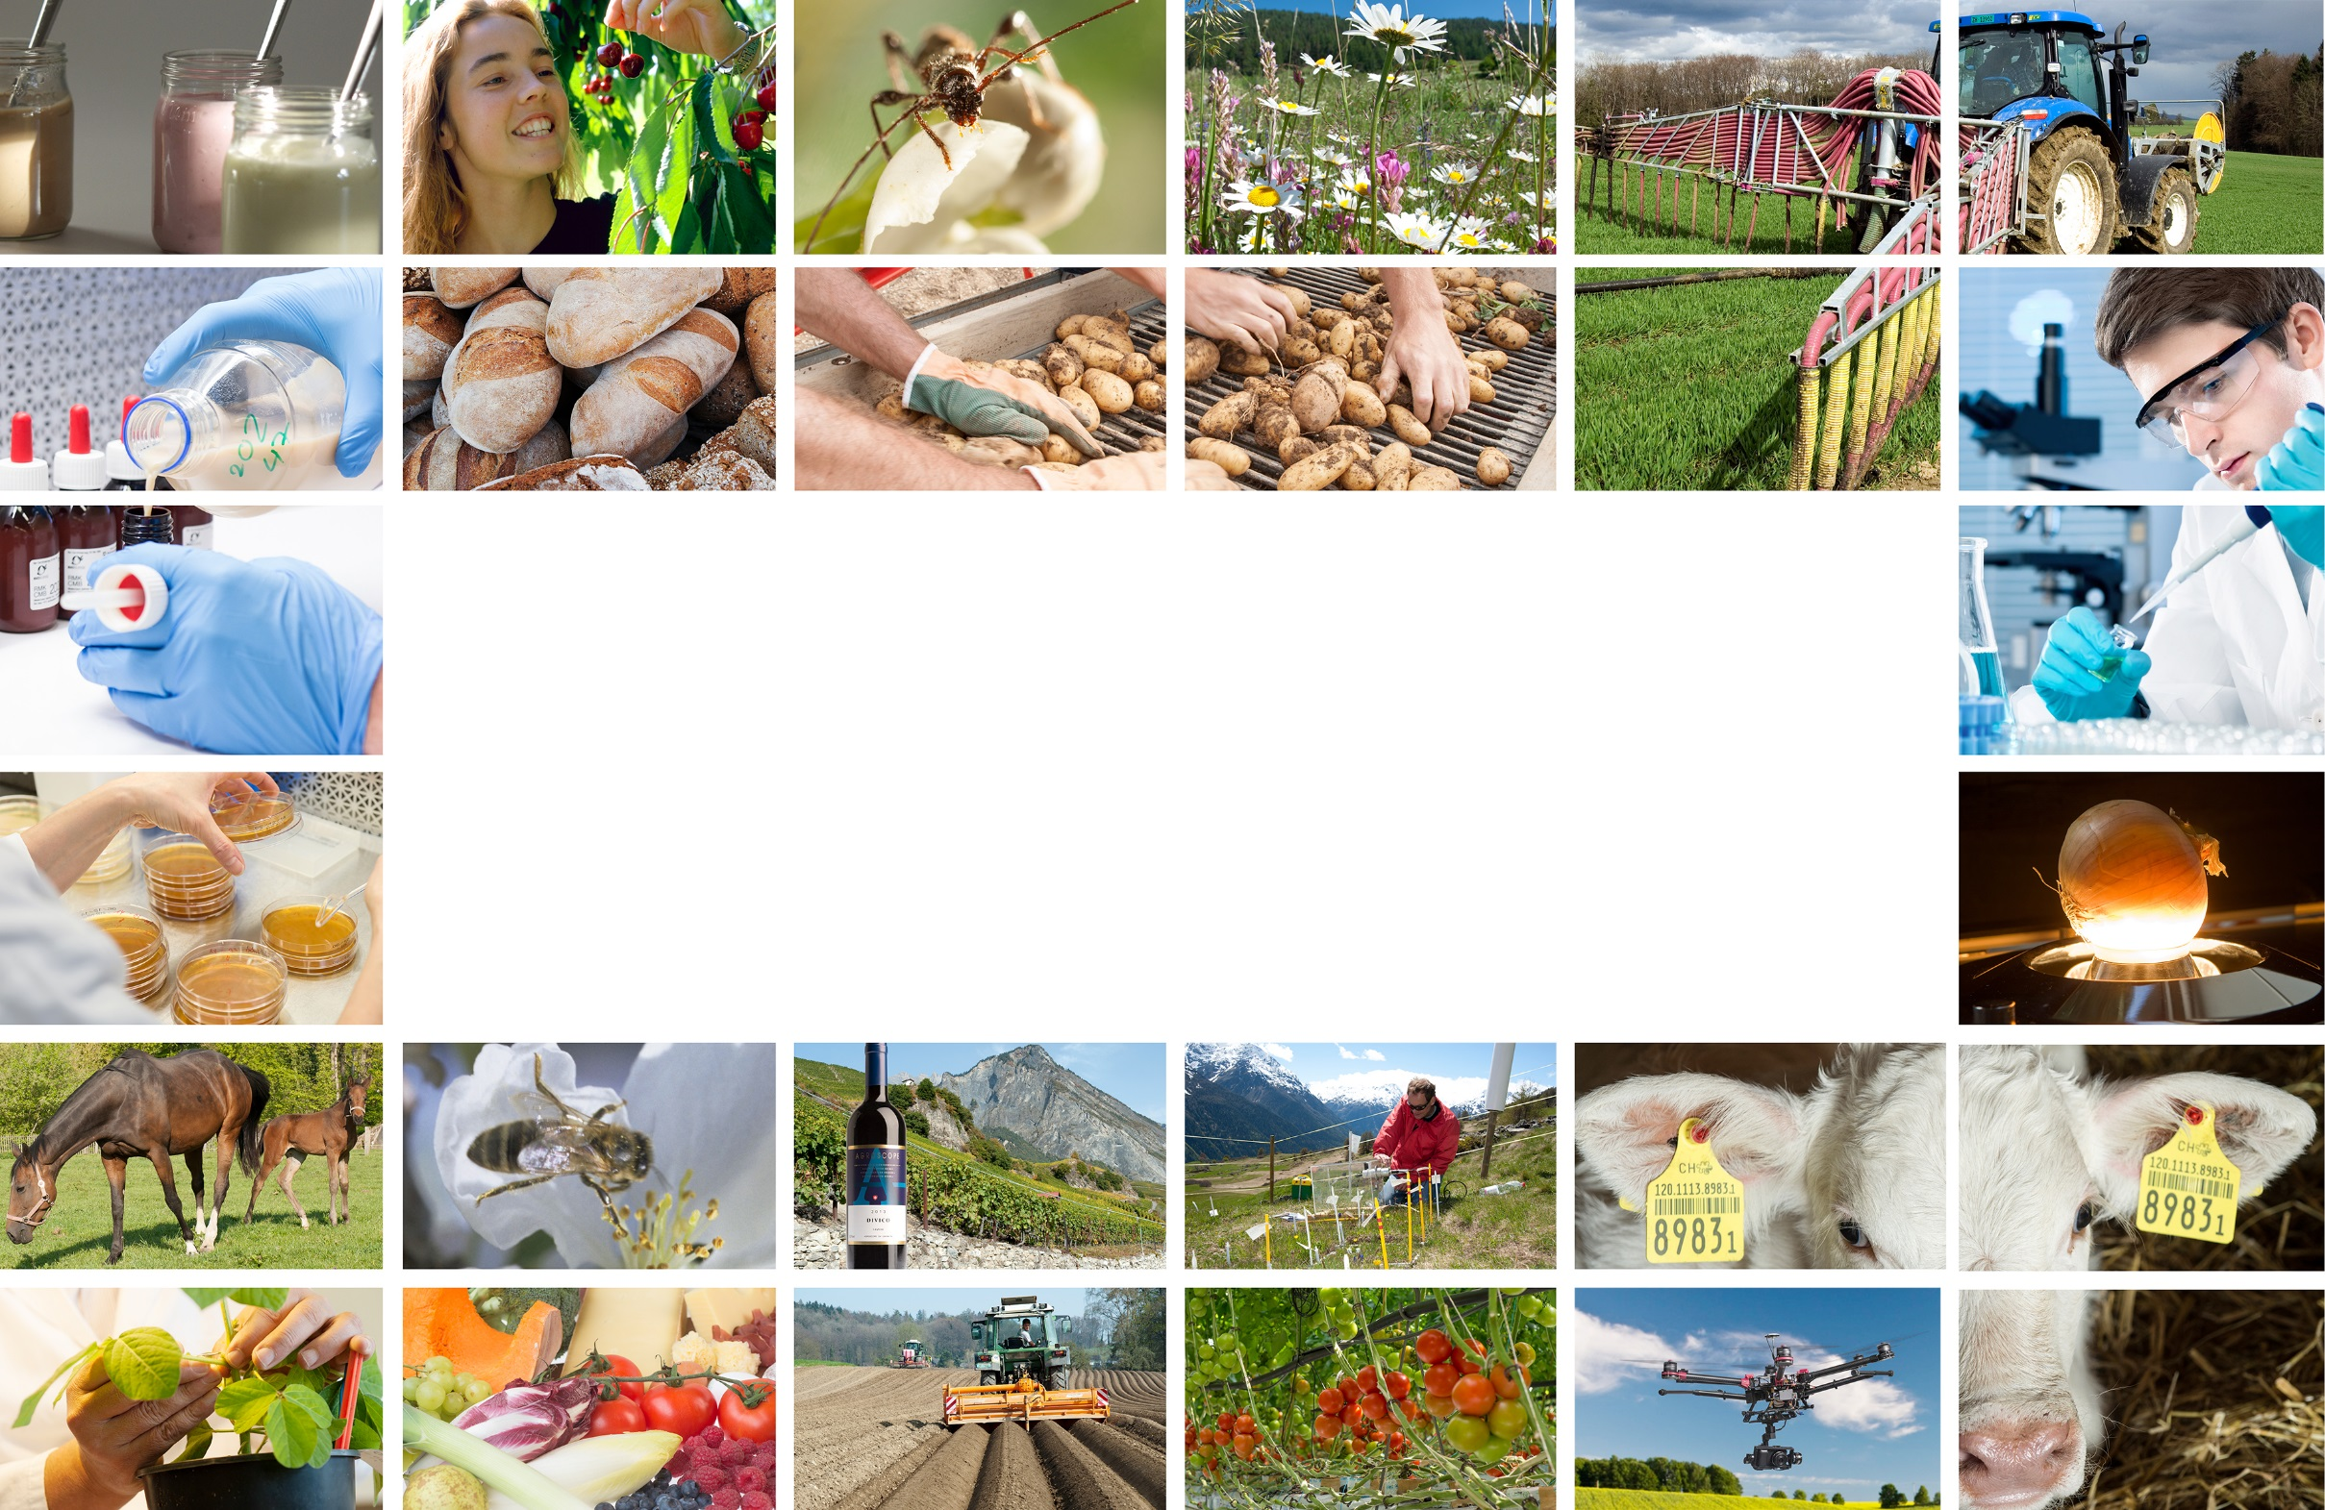
Thank you for your attention
Laura Scherer
laura.scherer@agroscope.admin.ch
Agroscope good food, healthy environment
www.agroscope.admin.ch

