Slide 1
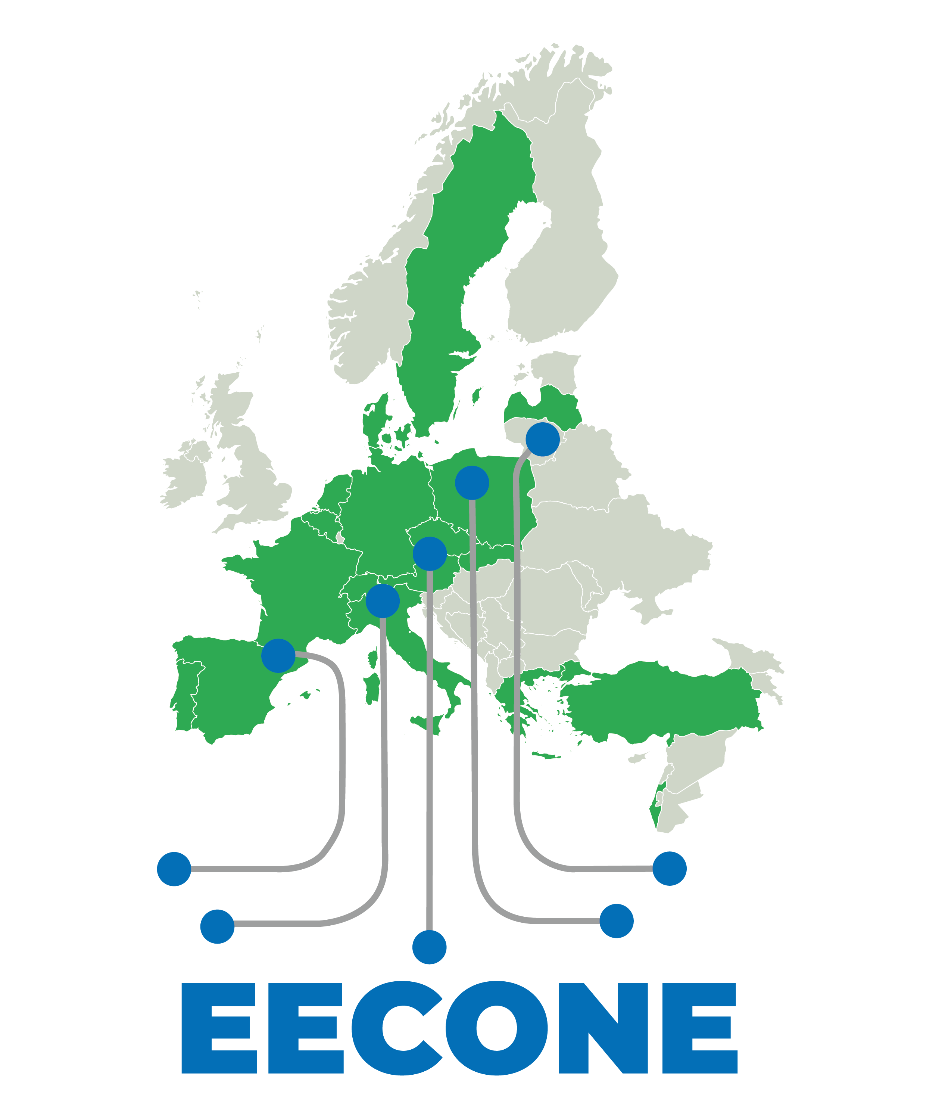


Improving Efficiency and Reusability in Electronics LCA:
An Open-Source Framework
Thomas Antoine, Augustin Wattiez, Robin Dethienne, Justine Lebrun, David Bol

Slide 2
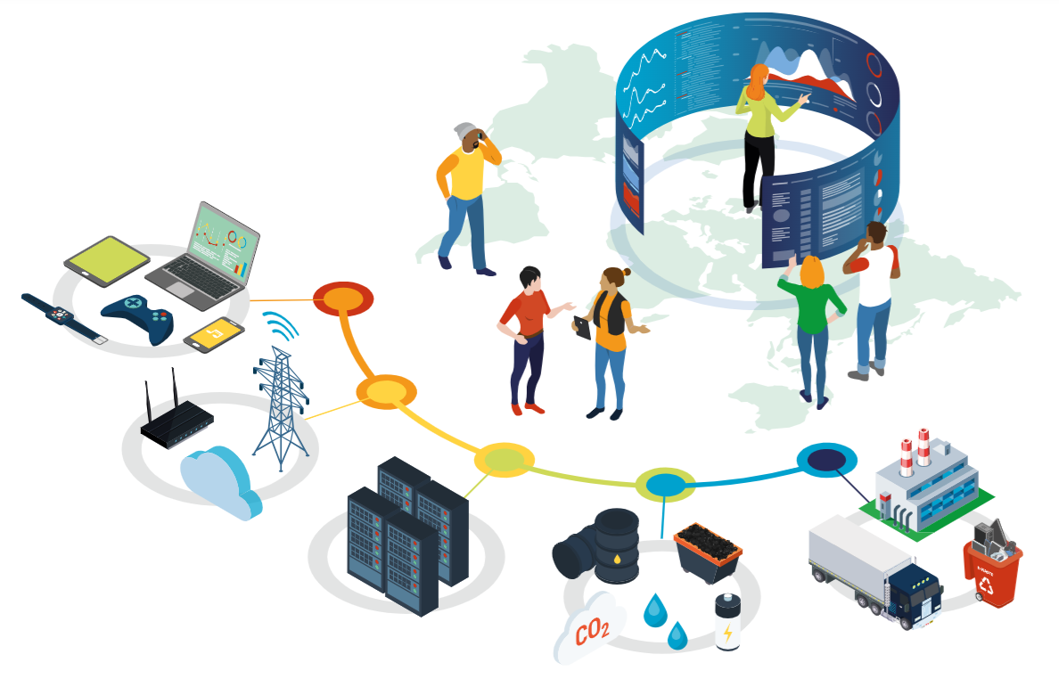
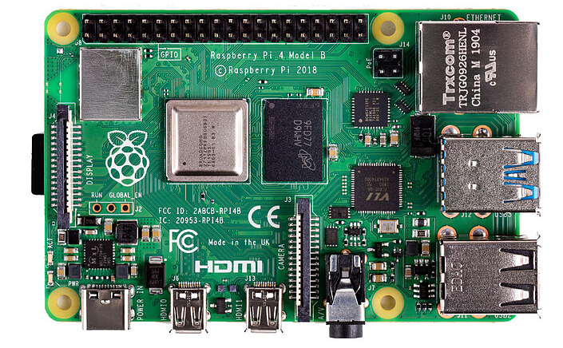
Context
The information & communication technology (ICT) sector relies on electronic hardware to operate.
Tier 1
User equipment
Tier 2
Communication networks
Tier 3
Datacenters
Production phase:
about a quarter
of ICT GHG emissions
Example of electronic hardware: Raspberry Pi 4 model B
2.1-3.9% of global
GHG emissions
Aubet, L. et al. Impacts environnementaux du numérique dans le monde 2025 GreenIT Association report (Analyse du Cycle de Vie multicritère).
Creative Commons CC BY-NC-ND 4.0. 2025

Slide 3
Outline
Modeling challenges for LCA practitioners in electronics
Introducing the open-source framework developed at UCLouvain
Insights into the implementation of the framework
Reflections on the open-source ICT LCA ecosystem

Slide 4
1. Modeling challenges for LCA practitioners in electronics
Two core challenges with current background databases:
Granularity: some components do not exist.
Specificity: existing datasets exhibit poor technological and temporal representativeness.
Total number of disctinct electronic components: $\sim$Millions
Tension
The batteries and electronics sector in the ecoinvent database comprises over 600 datasets, covering the production of various battery technologies and components [1].
In our LCA practice,
we need to create custom datasets
[1] https://support.ecoinvent.org/batteries-electronics

Slide 5
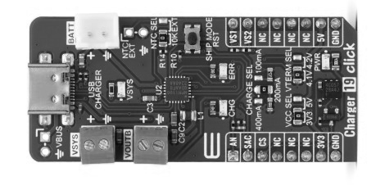
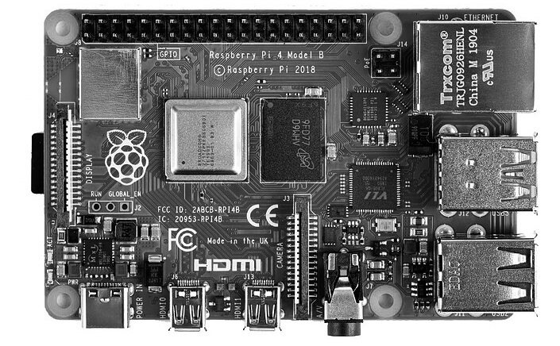
1. Modeling challenges for LCA practitioners in electronics
Creating custom datasets is time- and resource-intensive.
Practitioners sometimes encounter the identical components.
Need to share custom datasets among practitioners
Product system A: Raspberry Pi 4
Product system B: Power charger
Practitioner A has collected data on
Practitioner B has collected data on
USB type C connector
Small Outline Transistor (SOT)
but misses : Small Outline Transistor (SOT)
but misses : USB type C connector

Slide 6
1. Modeling challenges for LCA practitioners in electronics
Product system A: Raspberry Pi 4
Product system B: Power charger
Practitioner A
Practitioner B
Printed Circuit board (PCB) expert that has a model to estimate the amount of copper in a PCB.
Integrated circuits (ICs) expert that has a model to estimate the silicon die area of ICs.
Need to share models
among practitioners

Slide 7

2. Introducing the open-source framework developed at UCLouvain
Summary
Need to:
Create custom datasets
Share custom datasets
Share models
Include uncertainty analysis
ECS-LCA Framework
Shared electronic component datasets among users
Shared models among users
Support advanced uncertainty analysis
Shared
Shared
LCA Algebraic
Brightway 2.5

Slide 8
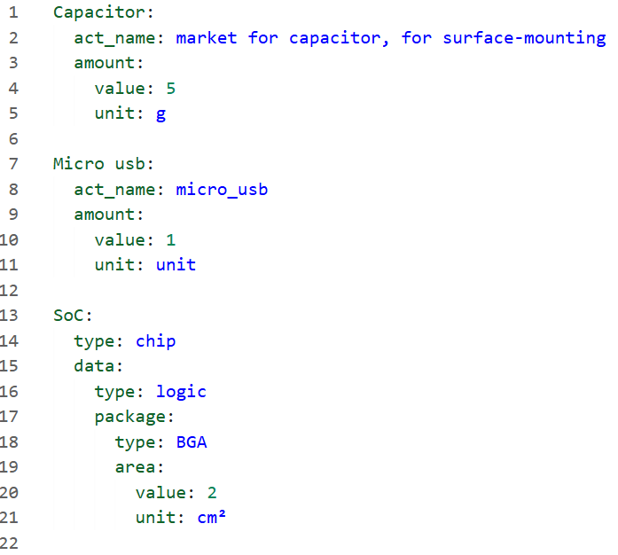

2. Introducing the open-source framework developed at UCLouvain
foreground.yaml
Background dataset
Custom dataset
Made and shared by ECS-LCA users
Input variables for a model

Slide 9
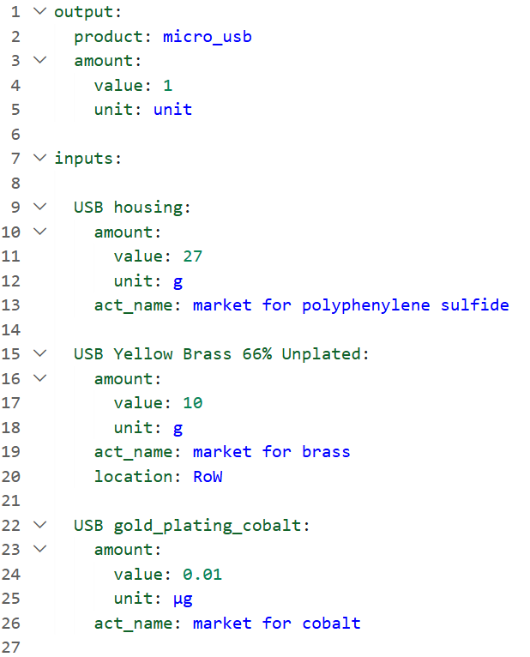
2. Introducing the open-source framework developed at UCLouvain
foreground.yaml
Example: micro_usb.yaml
Custom dataset made
and shared by ECS-LCA users

Slide 10
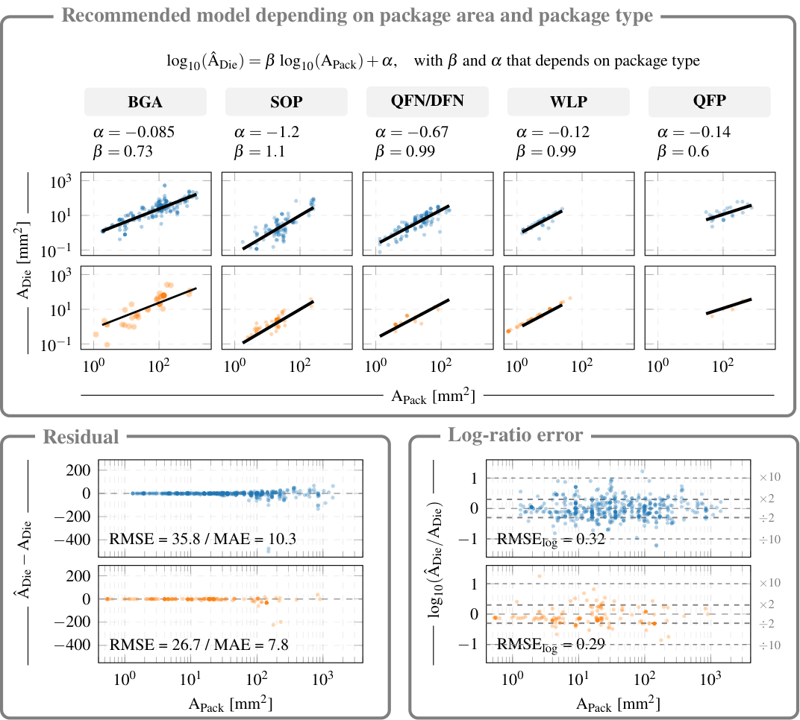
2. Introducing the open-source framework developed at UCLouvain
foreground.yaml
Input variables for a model
made and shared by ECS-LCA users
Wattiez, A., Collin, A.-S., Dethienne, R., Tomasz, R., Proske, M., Pirson, T., Schellekens, V., & Bol, D. (2026). Open-Source Silicon Die Area (OSSDA) [Dataset]. Zenodo. https://doi.org/10.5281/zenodo.18739861

Slide 11
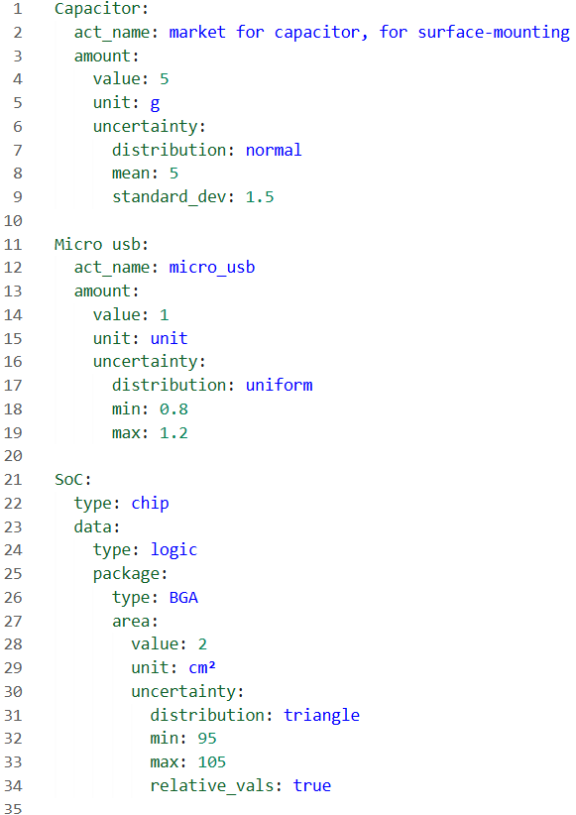
2. Introducing the open-source framework developed at UCLouvain
Example of uncertainty definition
Also supported: correlated uncertainty from data disaggregation
Schulte, S., Jakobs, A. & Lupton, R. When correlation matters: a practical guide to dealing with uncertainty in the case of data disaggregation. J. Ind. Ecol. 30, 665–681 (2026). https://doi.org/10.1007/s44498-026-00048-6

Slide 12

3. Insights into the implementation of the framework
ECS-LCA Framework
Jupyter
Initiation stages:
All activities are created
All activities are correct
Python
Practitioner A
CLI
Custom dataset
→ New activity
→ Modified activity
Practitioner B

Slide 13
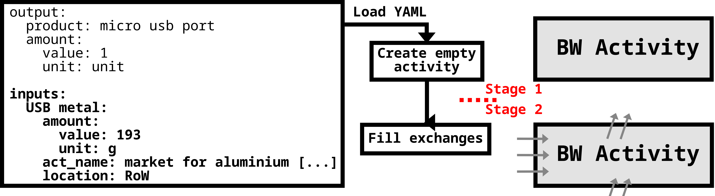
3. Insights into the implementation of the framework
Treatment of new activities

Slide 14
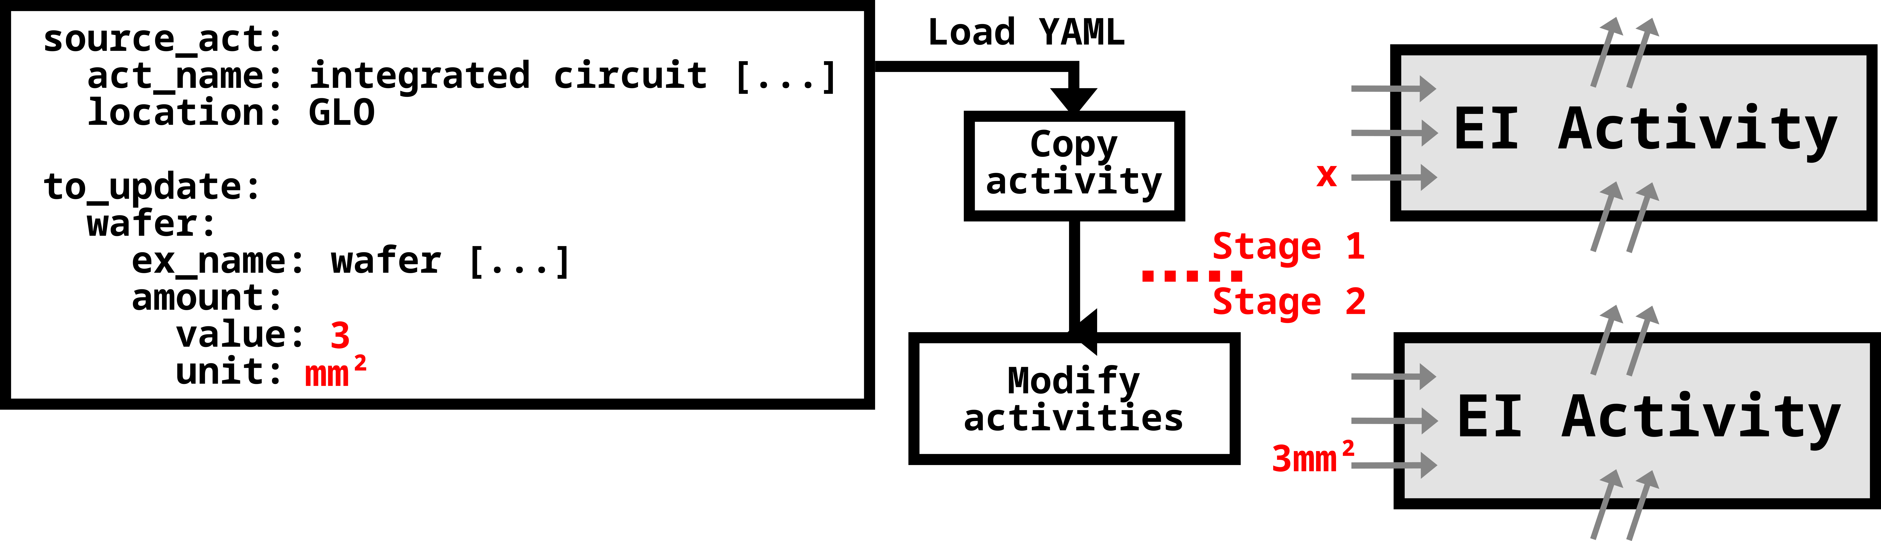
3. Insights into the implementation of the framework
Modifying activities from ecoinvent

Slide 15
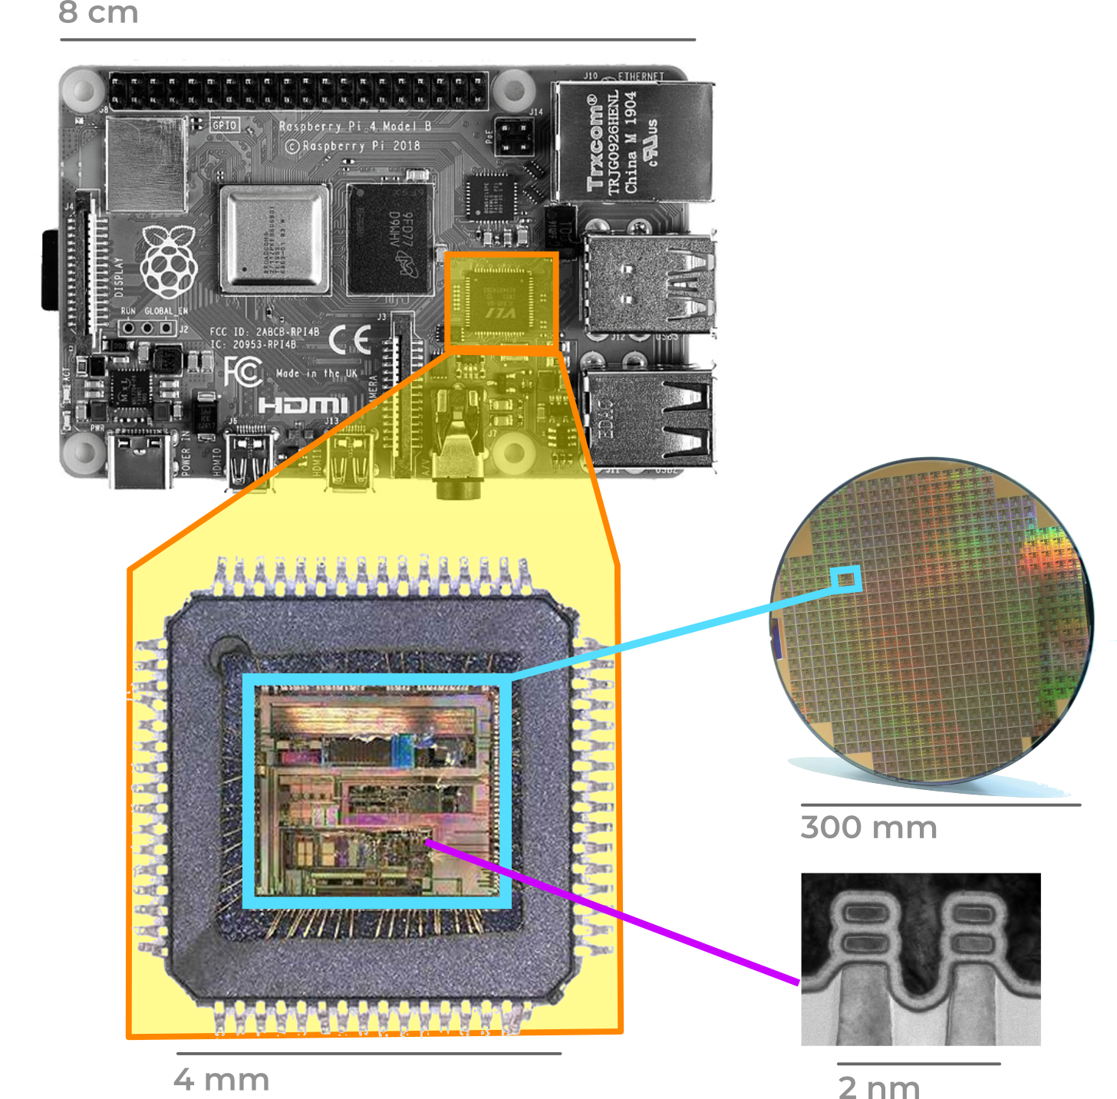
3. Insights into the implementation of the framework
Relation based-system for smart activities
Automatic solver for actual activities quantities
(Package type, Package area) → Die area
[Wattiez A. & al. 2026]
(Die area) → Wafer per die
[D.K. de Vried 2005]
(Technology node) → electric intensity
[Boakes Lizzie, & al 2023]
[Boyd S. B. & al. 2011]
Relationship-oriented algorithm

Slide 16
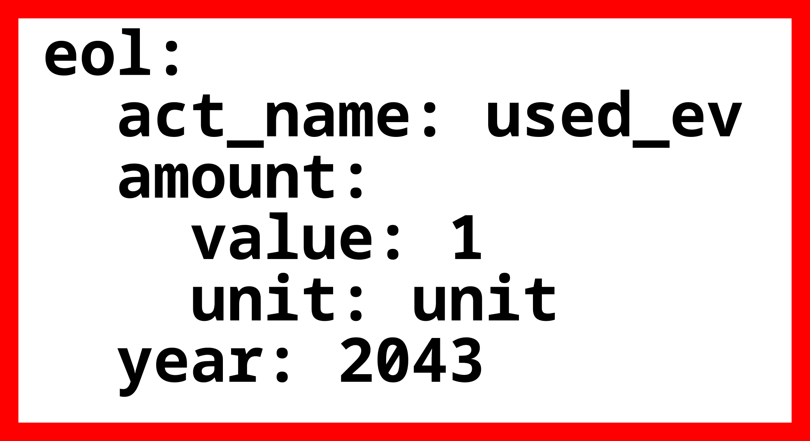
3. Insights into the implementation of the framework
Support for premise and bw_timex
Reproduction of bw_timex example:
Support for Premise
Support for bw_timex

Slide 17
Test it yourself and let’s discuss !
ECS-LCA is available at
It is currently meant to grow with our research group
Undergoing:
Strong documentation
Automatic code testing
https://github.com/Sufficient-ECS/ECS-LCA

Slide 18

Reflections on the open-source ICT LCA ecosystem
AI
Appa-LCA
ECS-LCA
naKnow
Teams call
ElecImpact

Slide 19
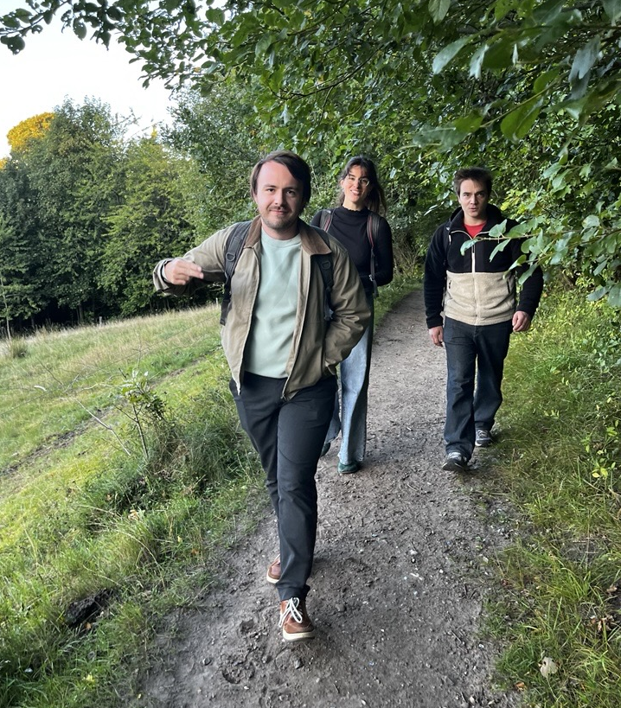
Thank you !
Contact
augustin.wattiez
t.antoine
robin.dethienne
ju.lebrun
david.bol
@uclouvain.be
UCLouvain team on a
« départ de sentier »
These slides were happily made by human beings :)

