Slide 1






naKnow: a collaborative initiative to bridge data gaps in ICT life cycle assessment using parametric modelling
Thibault Simon¹, Marie Reinbigler¹, Anish Koyamparambath², Arthur Removille¹
¹ Resilio
² WeLOOP
Brightcon 2026

Slide 2


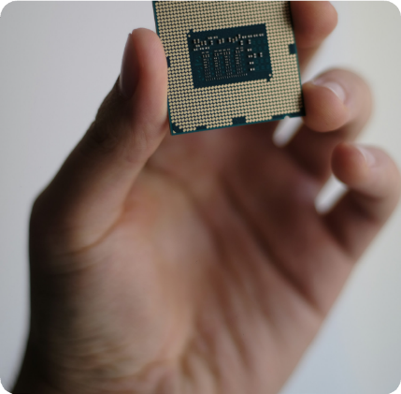
23/09/2026
page <numéro>
Context
naKnow addresses the lack of transparent, reliable, and actionable environmental intelligence for electronic components.
Eco-design and responsible innovation suffer from this situation:
Limited access to high-quality, component-level data
Information that is often outdated or incomplete
Knowledge that is fragmented and difficult to mobilize
naKnow: a collaborative initiative to bridge data gaps in ICT LCA – Marie Reinbigler

Slide 3

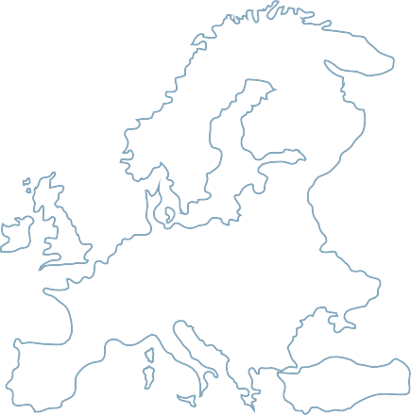
23/09/2026
page <numéro>
Context
naKnow is an international federating platform to build environmental intelligence for the electronics industry
We are a Swiss-Based
Non-Profit Association
A place for the actors of the electronics industry to share their challenges & find solutions together
naKnow: a collaborative initiative to bridge data gaps in ICT LCA – Marie Reinbigler
Notes:
Describe the YAML in short, detailing difference btw element, including the interoperability with other databases/several datasets

Slide 4





























23/09/2026
page <numéro>
naKnow Association
INDUSTRY PLAYERS
Ecodesign improvement
Supply chain impact
Reporting ESG
HYPERSCALERS
CONSULTANCIES
Global impact & ESG reporting improvement
LCA & methods expertise
DATABASES PROVIDERS
PUBLIC BODIES
Provide environmental data expertise
Policy making and regulations
A network of experts in the industry, research and academia
Reliable collaborative LCA data
RESEARCH AND TECHNOLOGY ORGANISATION
ACADEMIA PLAYERS
Provide data, research expertise and laboratory facilities
Knowledge creation and transmission
01
ASSOCIATION GOVERNANCE
02
OPEN KNOWLEDGE BASE
A board with diverse representation
+
Reviewed and traceable knowledge
naKnow: a collaborative initiative to bridge data gaps in ICT LCA – Marie Reinbigler
Notes:
Describe the YAML in short, detailing difference btw element, including the interoperability with other databases/several datasets

Slide 5
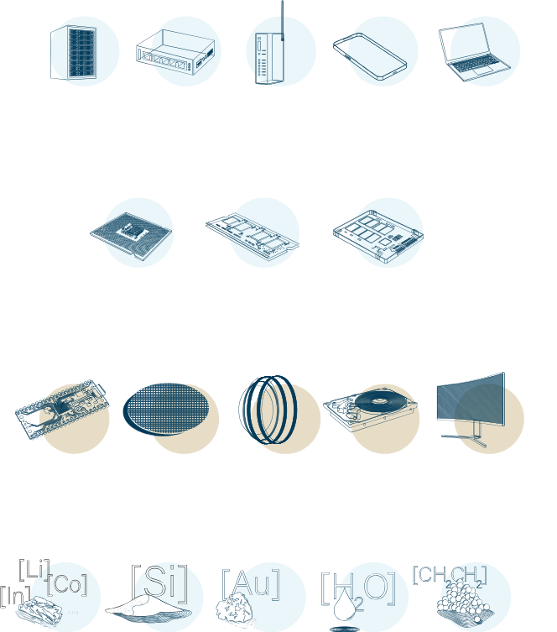


23/09/2026
page 4
Overview of the Method
LITERATURE RESEARCH
Five components
EXISTING MODELS
Printed Circuit Board
support
comparison
Integrated Circuits
PARAMETRIC LCA MODELS
Optical Sensors
testing
correction
Hard Disk Drive
Screens
LABORATORY EXPERIMENTS
naKnow: a collaborative initiative to bridge data gaps in ICT LCA – Marie Reinbigler
Notes:
Describe the YAML in short, detailing difference btw element, including the interoperability with other databases/several datasets

Slide 6
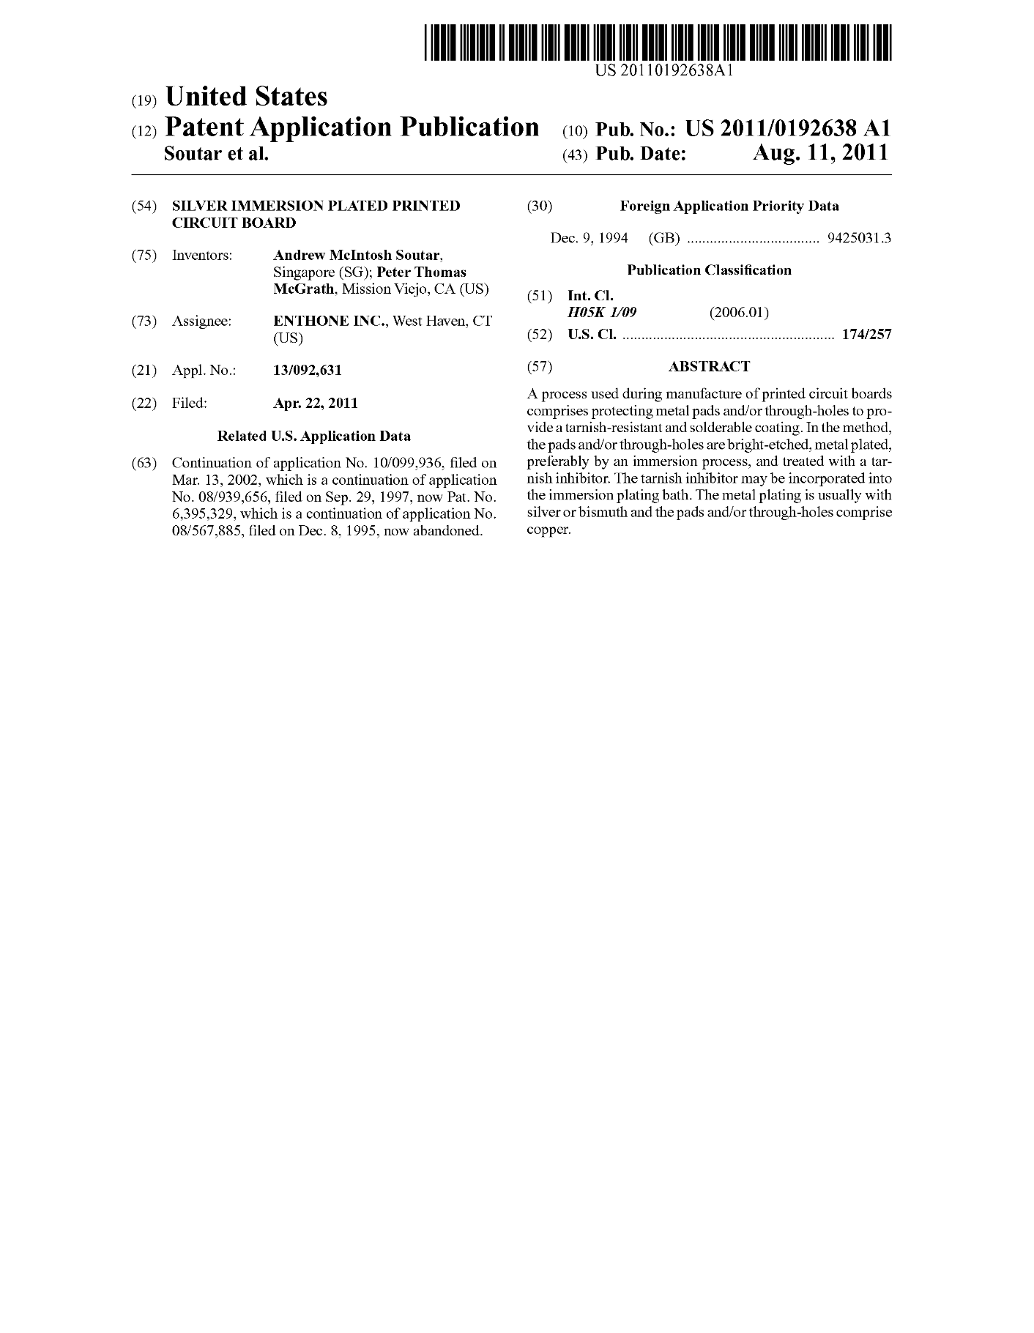
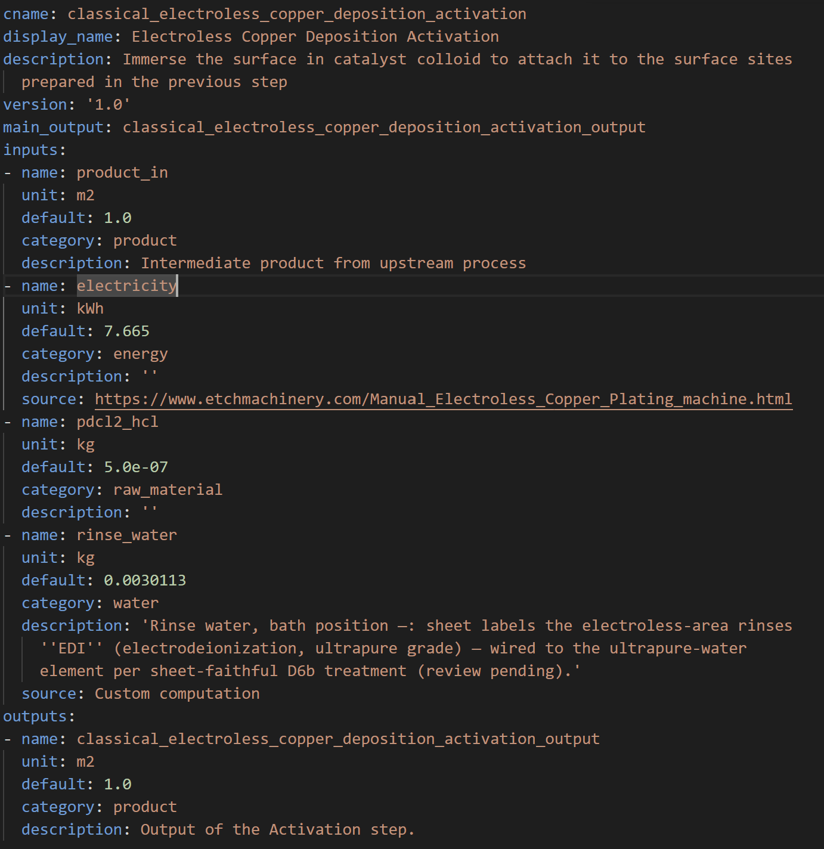

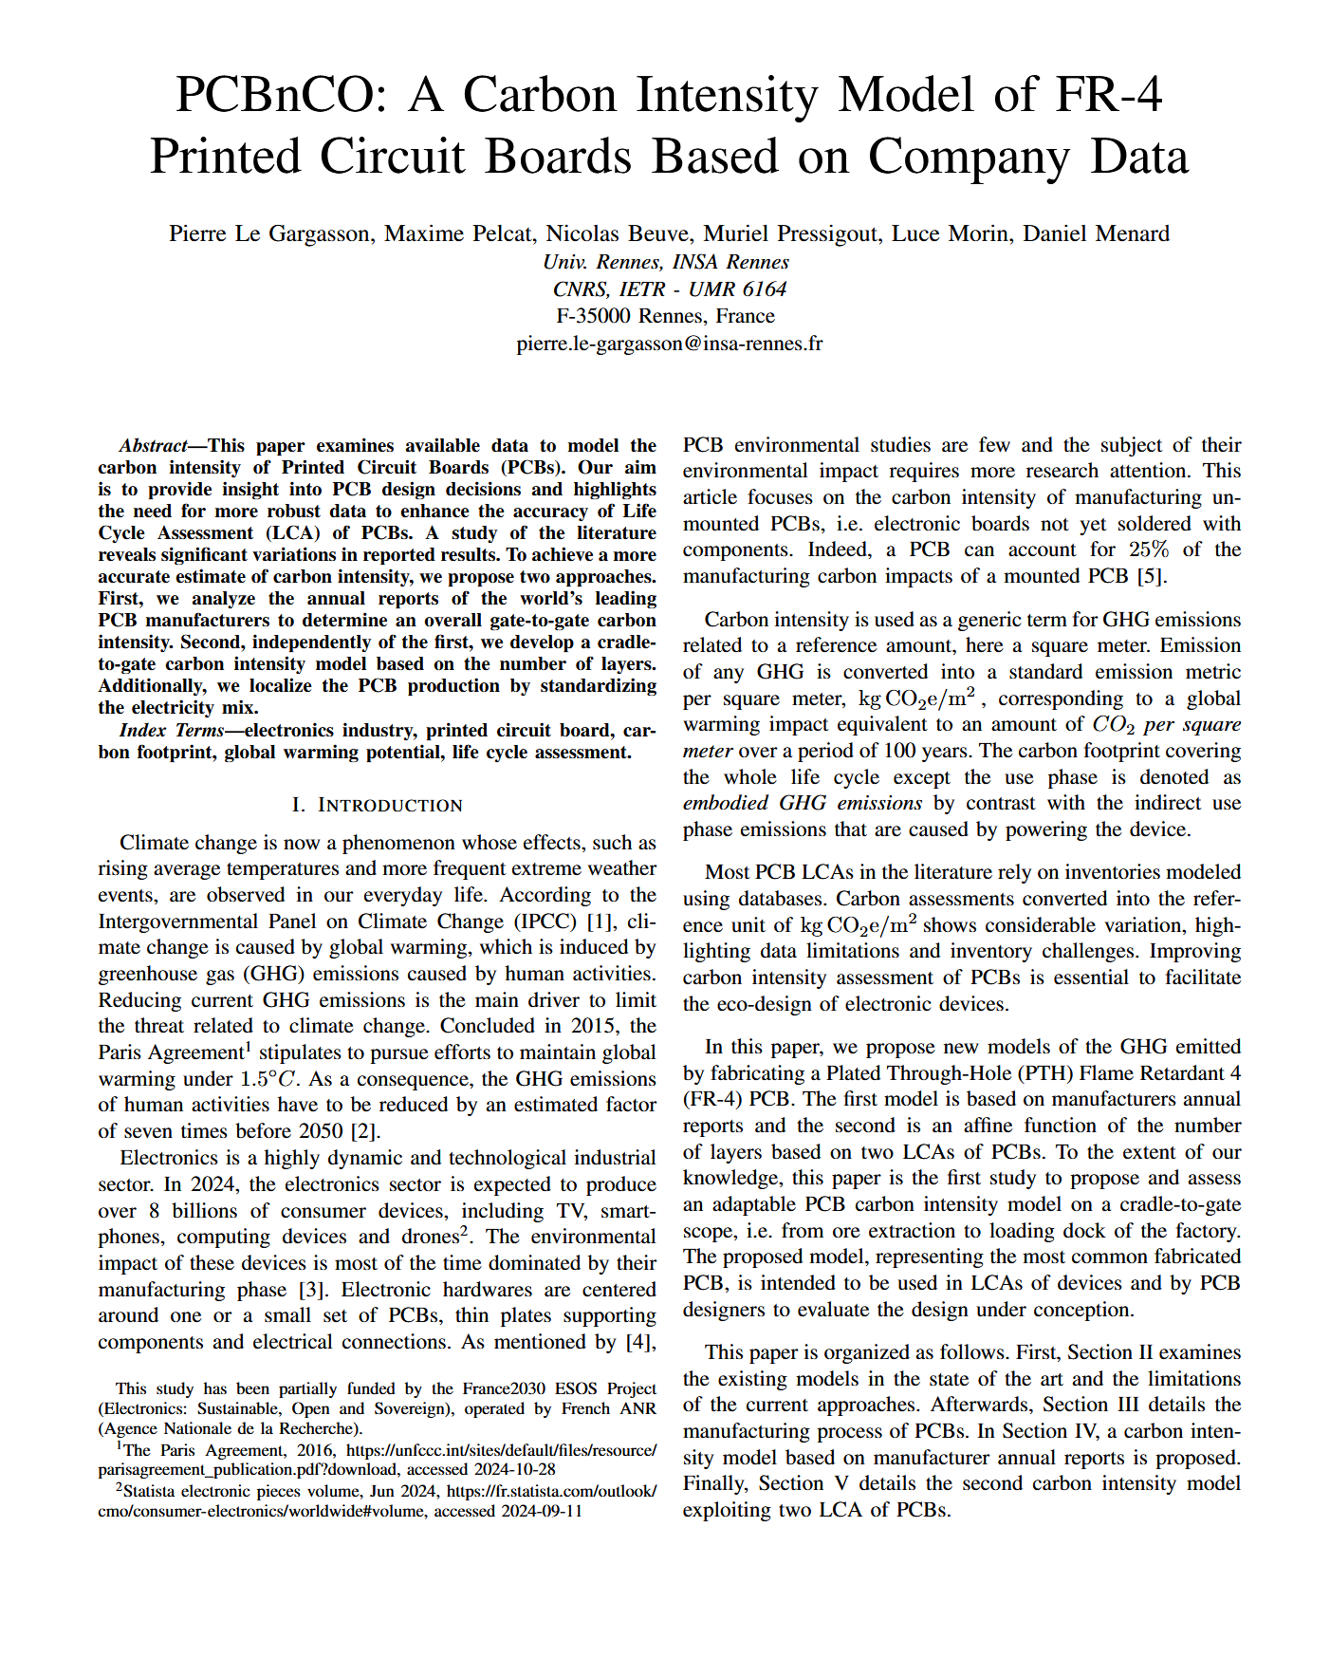
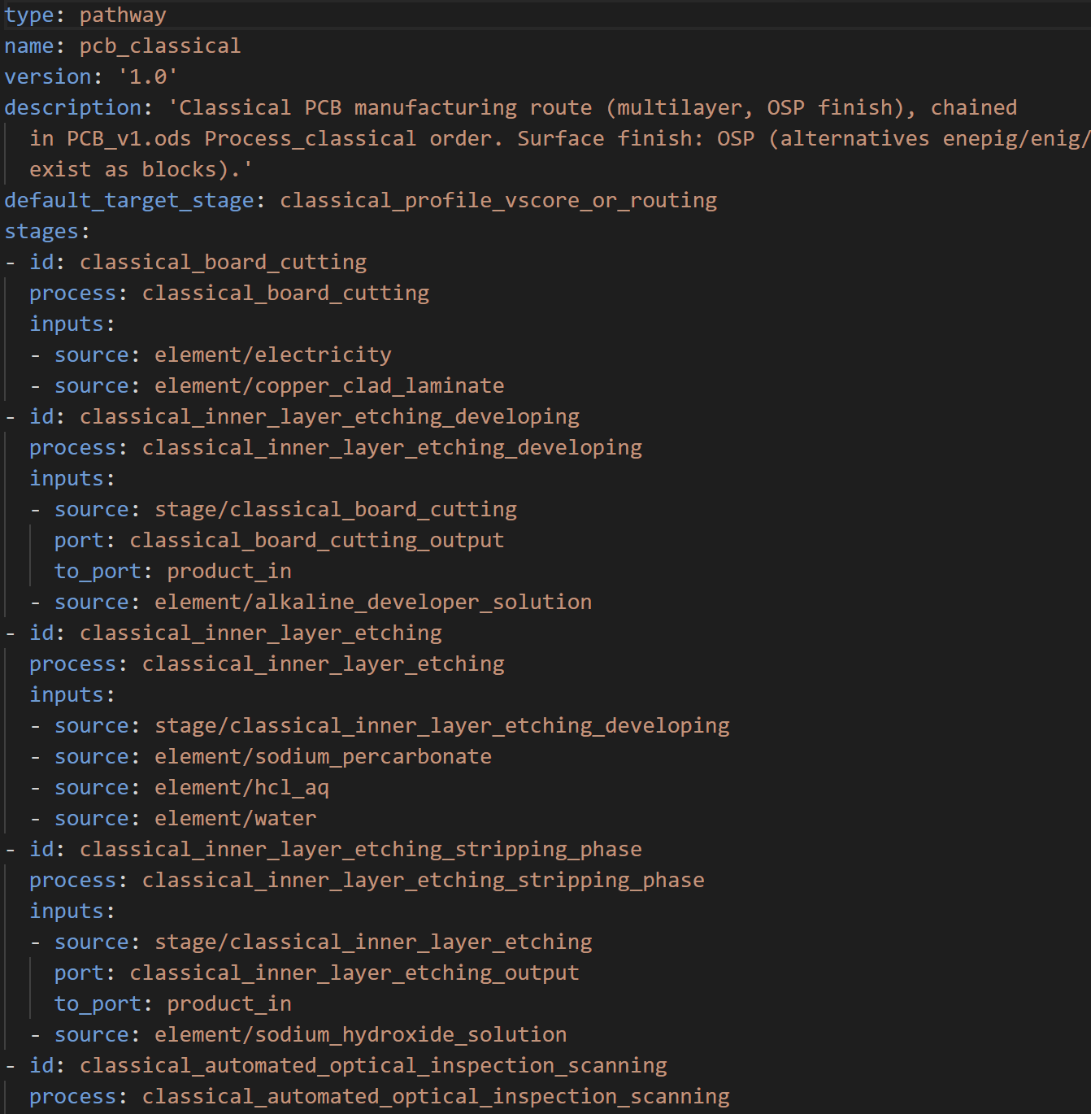
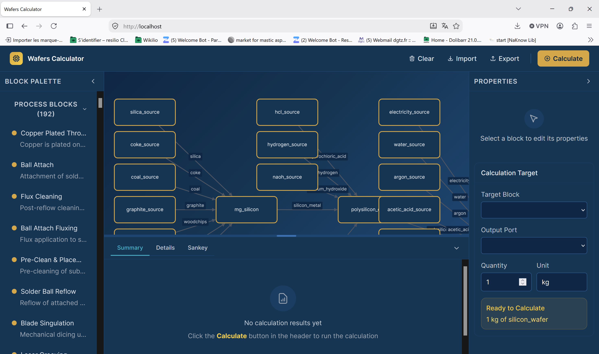
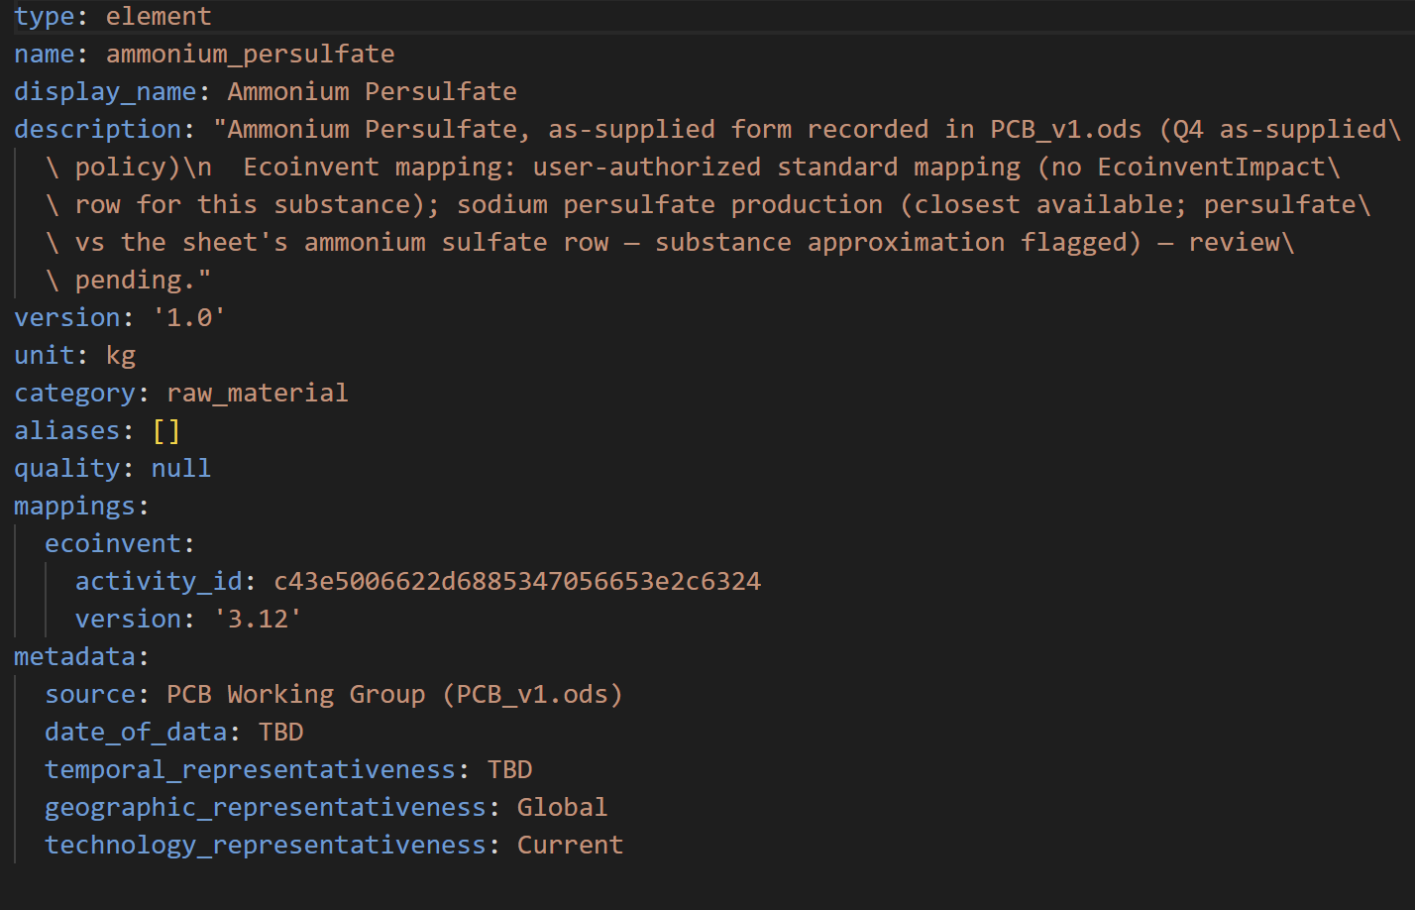


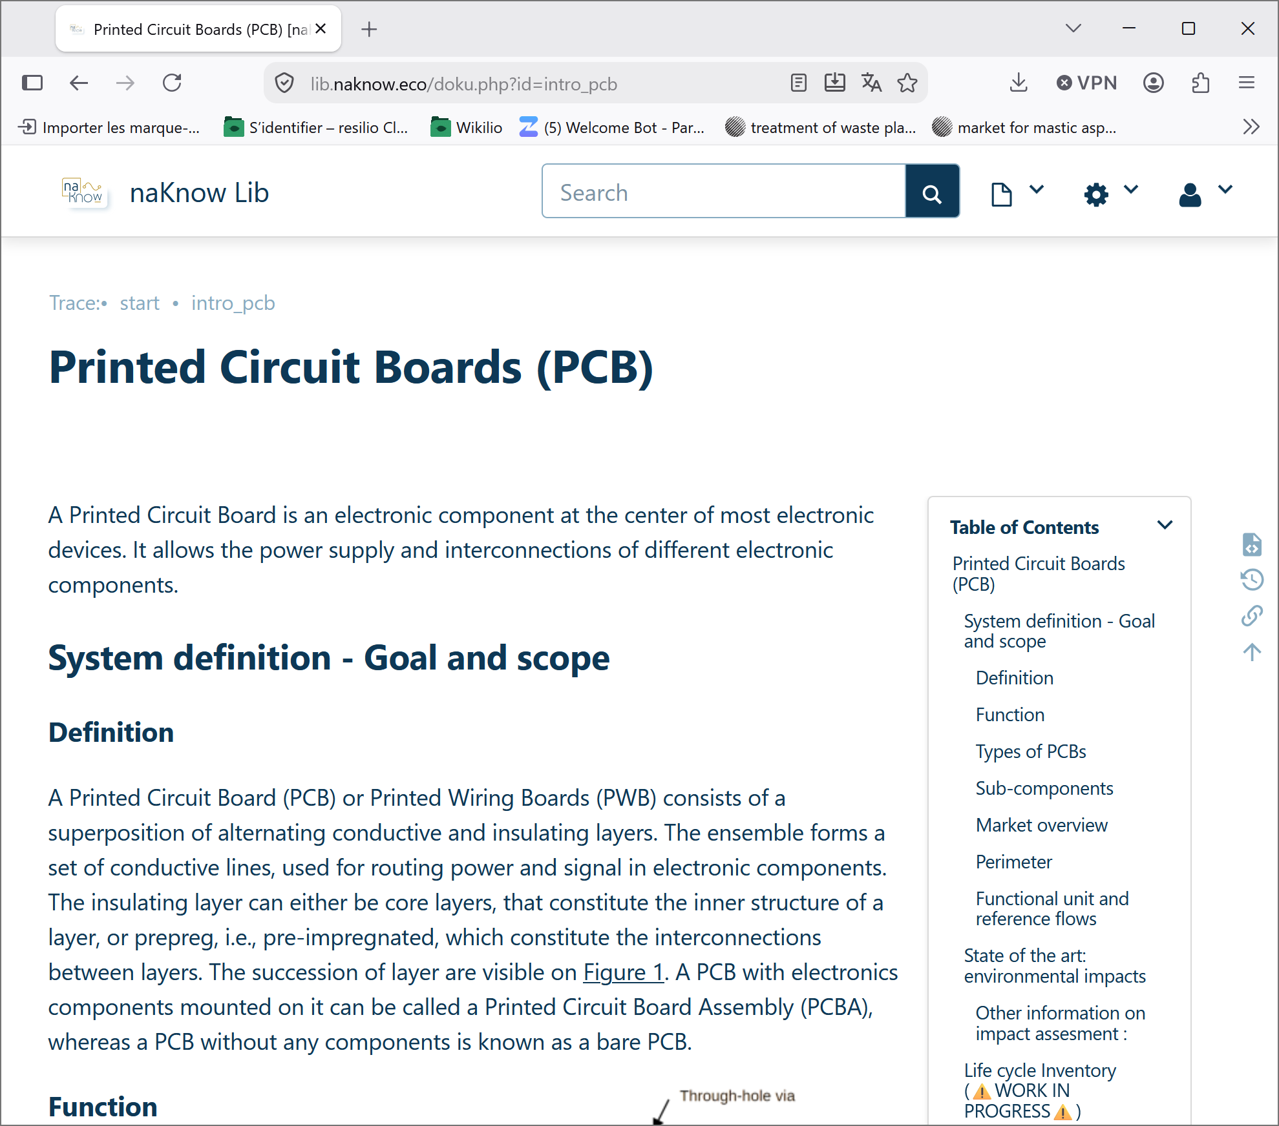
23/09/2026
page 4
Data generation pipeline
LCIA data
Litterature
Expert knowledge
YAML config files
Calculator
Impact characterization
Documented in the knowledge base
naKnow: a collaborative initiative to bridge data gaps in ICT LCA – Marie Reinbigler
Notes:
Describe the YAML in short, detailing difference btw element, including the interoperability with other databases/several datasets

Slide 7
23/09/2026
page 4
Why this approach?
Collaboration: Enable non-LCA experts to contribute and review results
Version control: Track changes to models, data, and results
Data confidentiality: Publish the logic to audit the process, not all the data
Parametric & scalable LCA: Automate calculations across scenarios and models
Integration: Connect naKnow's models to other tools, data sources, and workflows
Background DB: Ease the change of background DB, centralize mappings
naKnow: a collaborative initiative to bridge data gaps in ICT LCA – Marie Reinbigler

Slide 8
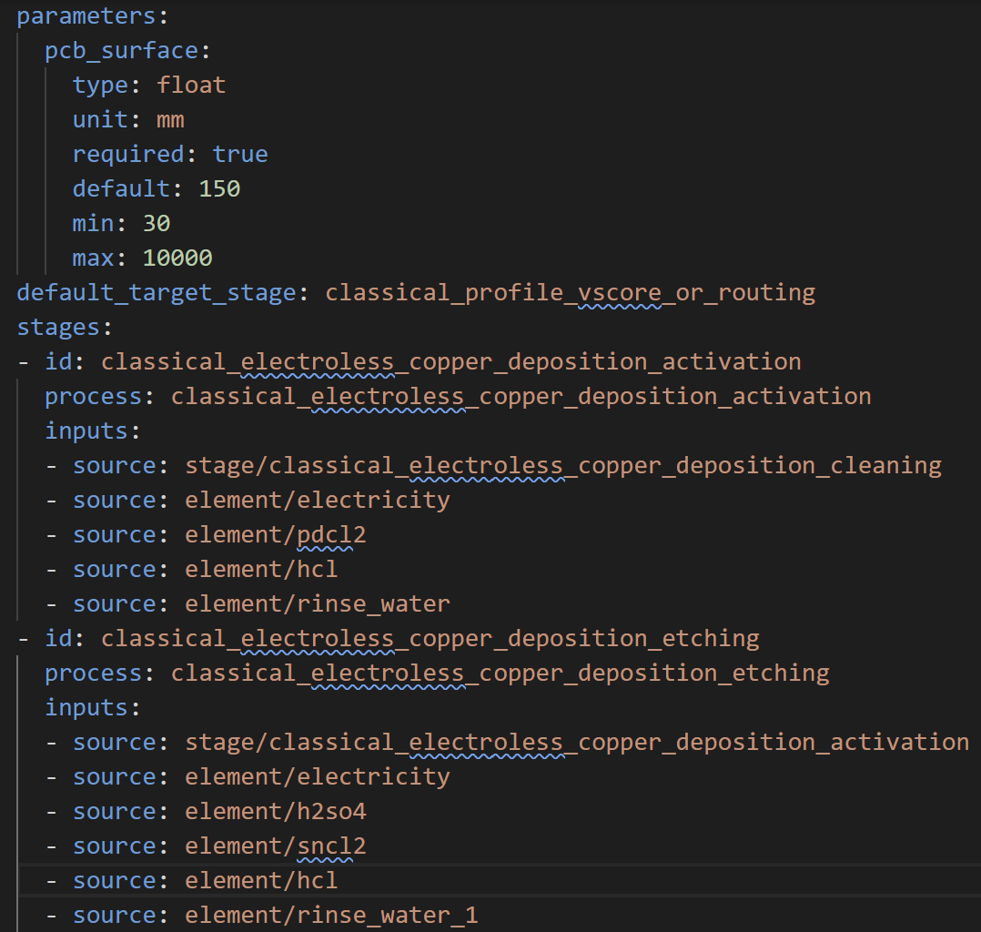
23/09/2026
page 4
Input format
PATHWAYS
Previous steps output
Electricity
Electroless deposition activation
PdCl2
HCl
Water
Electricity
H2SO4
Electroless deposition etching
SnCl2
Water
HCl
YAML
description
Electricity
CuSO4,5H2O
Electroless deposition PTH
NaH2PO2.H2O
Na3C6H5O7,5.5H2O
H3BO3
NiSO4,7H2O
Water
Next steps output
naKnow: a collaborative initiative to bridge data gaps in ICT LCA – Marie Reinbigler

Slide 9
Parameter definition
23/09/2026
page 4
Input format
PATHWAYS
Previous steps output
Electricity
Electroless deposition activation
PdCl2
HCl
Water
Electricity
H2SO4
Electroless deposition etching
SnCl2
HCl
Water
Electricity
CuSO4,5H2O
Electroless deposition PTH
NaH2PO2.H2O
Na3C6H5O7,5.5H2O
H3BO3
NiSO4,7H2O
Water
Next steps output
naKnow: a collaborative initiative to bridge data gaps in ICT LCA – Marie Reinbigler

Slide 10
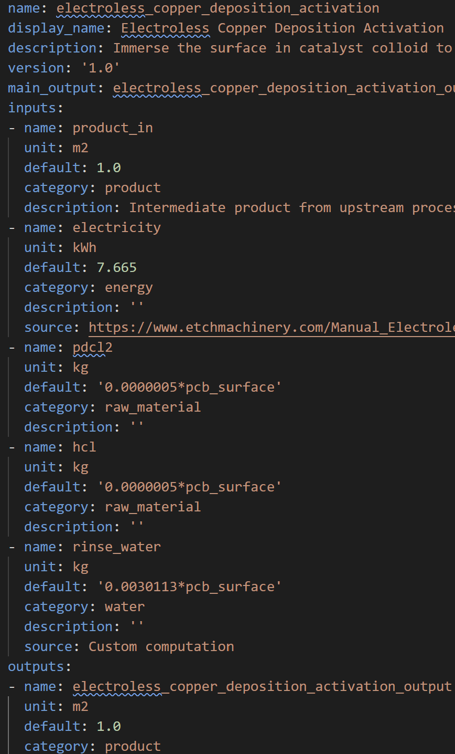
23/09/2026
page 4
Input format
Previous steps output
BLOCKS
Electricity
Electroless deposition activation
PdCl2
HCl
Water
YAML
description
Electricity
H2SO4
Electroless deposition etching
SnCl2
Water
HCl
Electricity
CuSO4,5H2O
Electroless deposition PTH
NaH2PO2.H2O
Na3C6H5O7,5.5H2O
H3BO3
NiSO4,7H2O
Water
Next steps output
naKnow: a collaborative initiative to bridge data gaps in ICT LCA – Marie Reinbigler

Slide 11
23/09/2026
page 4
Input format
Previous steps output
BLOCKS
Electricity
Electroless deposition activation
PdCl2
HCl
Water
Electricity
H2SO4
Electroless deposition etching
SnCl2
Water
HCl
Parametric math formula
Electricity
CuSO4,5H2O
Electroless deposition PTH
NaH2PO2.H2O
Na3C6H5O7,5.5H2O
H3BO3
NiSO4,7H2O
Water
Next steps output
naKnow: a collaborative initiative to bridge data gaps in ICT LCA – Marie Reinbigler

Slide 12
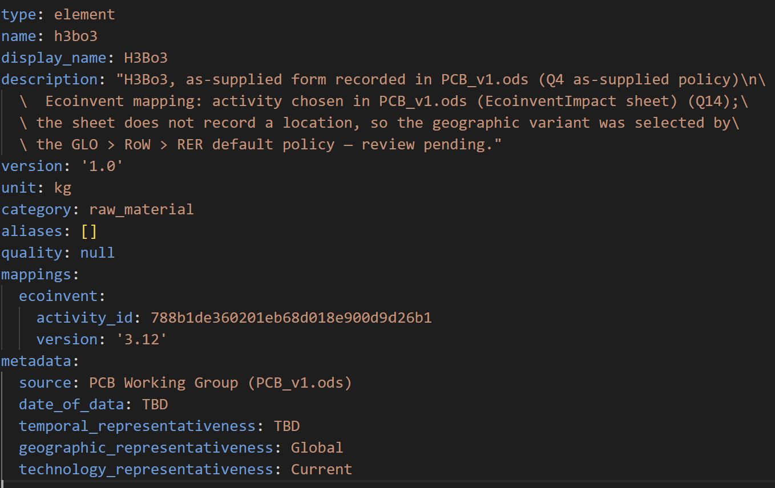
23/09/2026
page 4
Input format
Previous steps output
ELEMENTS
Electricity
Electroless deposition activation
PdCl2
HCl
Water
Electricity
H2SO4
Electroless deposition etching
SnCl2
Water
HCl
Electricity
CuSO4,5H2O
Electroless deposition PTH
NaH2PO2.H2O
Na3C6H5O7,5.5H2O
H3BO3
YAML
description
NiSO4,7H2O
Water
Next steps output
naKnow: a collaborative initiative to bridge data gaps in ICT LCA – Marie Reinbigler
Notes:
Describe the YAML in short, detailing difference btw element, including the interoperability with other databases/several datasets

Slide 13
23/09/2026
page 4
Input format
Previous steps output
ELEMENTS
Electricity
Electroless deposition activation
PdCl2
HCl
Water
Electricity
H2SO4
Electroless deposition etching
Other names
SnCl2
Dataset for each background database
Water
HCl
Electricity
CuSO4,5H2O
Electroless deposition PTH
NaH2PO2.H2O
Na3C6H5O7,5.5H2O
H3BO3
NiSO4,7H2O
Water
Next steps output
naKnow: a collaborative initiative to bridge data gaps in ICT LCA – Marie Reinbigler
Notes:
Describe the YAML in short, detailing difference btw element, including the interoperability with other databases/several datasets

Slide 14
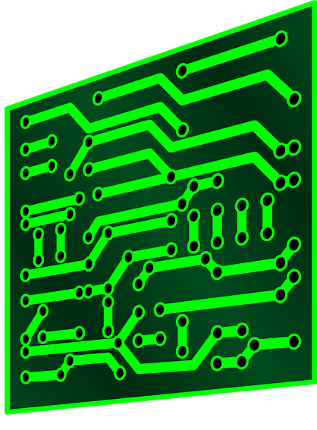
23/09/2026
page 4
LCI compute
Electricity
Water
Electricity
Water
Total intermediary flows
Water: 1.3g
Electricity: 14 kWh
5 kWh
3e-3 g/m²
7 kWh
1e-2 g/m²
Electricity: 19 kWh
Electroless deposition activation
Electroless deposition etching
Electroless deposition PTH
100 mm²
Water:
1.5 g
Water: 1.5g
Electricity: 19 kWh
2e-3 g/m²
Water: 1g
Electricity: 7 kWh
7 kWh
Electricity
Water
Several checks:
- units conversion (Pint)
- allowed mathematical operation (AST)
- other verifications to come
naKnow: a collaborative initiative to bridge data gaps in ICT LCA – Marie Reinbigler

Slide 15

23/09/2026
page 4
LCIA characterization
Characterization methods
Flows
Unit conversion
Brightway activity-key demand
Brightway calculation engine
Impacts results
Element mapping
{(database, activity_id) : amount}
naKnow: a collaborative initiative to bridge data gaps in ICT LCA – Marie Reinbigler

Slide 16
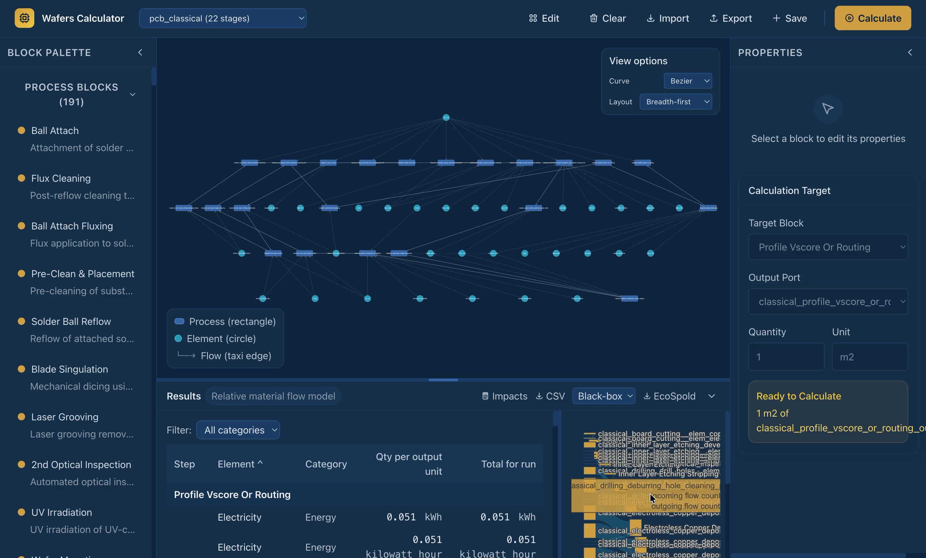
23/09/2026
page 4
Calculator demo
Placeholder for main calculator demo
naKnow: a collaborative initiative to bridge data gaps in ICT LCA – Marie Reinbigler

Slide 17
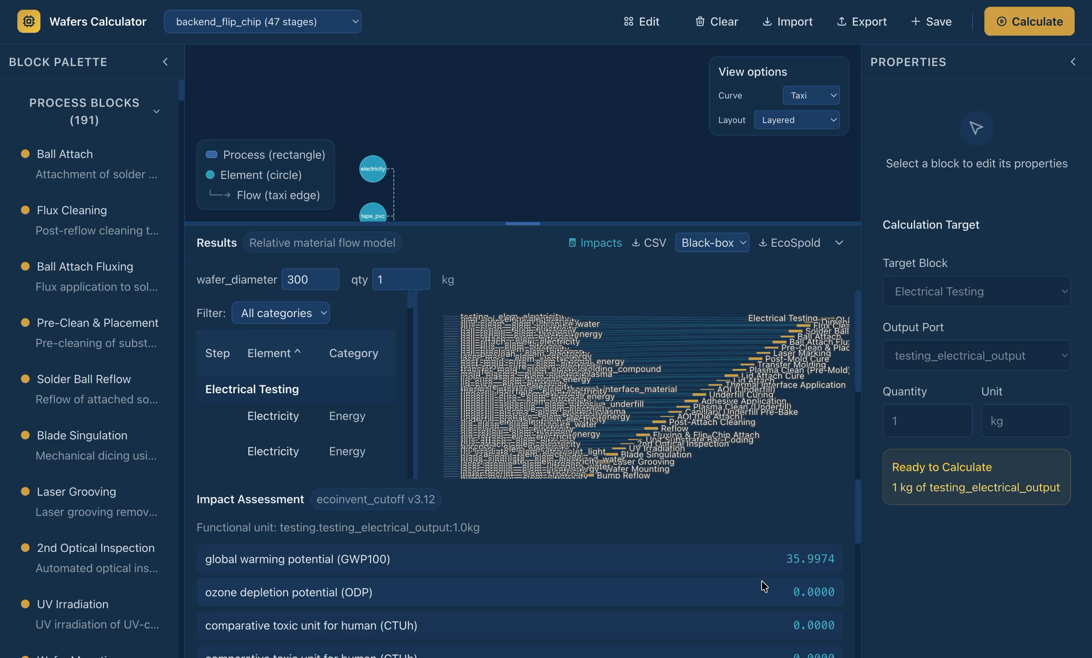
23/09/2026
page 4
Calculator demo
Placeholder for main calculator demo
naKnow: a collaborative initiative to bridge data gaps in ICT LCA – Marie Reinbigler

Slide 18
23/09/2026
page 4
Export
Aggregated export
Disaggregated export
Block flow 1
Block
ES1 XML
Brightway exporter
Aggregated flow 1
.
.
.
Block flow n
Brightway exporter
ES1 XML
zip
zip
.
.
.
.
.
.
Aggregated flow n
Block flow 1
Block ES1 XML
Brightway exporter
.
.
.
Block flow l
naKnow: a collaborative initiative to bridge data gaps in ICT LCA – Marie Reinbigler

Slide 19
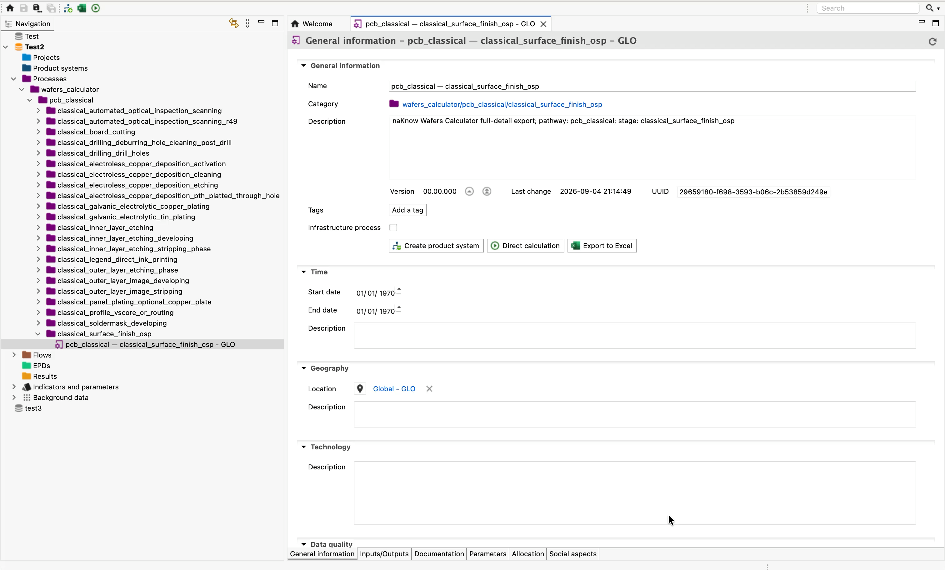
23/09/2026
page 4
Export
naKnow: a collaborative initiative to bridge data gaps in ICT LCA – Marie Reinbigler

Slide 20
23/09/2026
page 4
Collaboration potential
Non-LCA experts: can contribute, build their own models from existing nodes, and compute results
Non-programmers: can build parametric models without coding skills. Conversion from other formats to YAML could be made available.
Version control: Track changes to models, data, and results
Auditability: anyone knowledgable on the modelized device can review the data, propose changes, or build its own version
naKnow: a collaborative initiative to bridge data gaps in ICT LCA – Marie Reinbigler

Slide 21


23/09/2026
page 4
Conclusion
Build a transparent, reliable knowledge base
Governance by representants of the supply chain stakeholders, not LCA experts
Provides open methodologies and tools for LCA parametric modelling
The calculator:
  Graph-based built from YAML format, connected to Brightway and background databases
  Favorizes collaborations via human-readable and reviewable by anyone inputs, including non-coders and non LCA experts
Join us!
naKnow: a collaborative initiative to bridge data gaps in ICT LCA – Marie Reinbigler

Slide 22
23/09/2026
page 4
Model Correction
The initial model estimates elemental fractions from literature and material declarations. ICP tests provide measured fractions for representative samples. The correction keeps the model structure and adds this experimental evidence.
Initial model
+
ICP tests
=
Corrected coefficient
estimate and uncertainty
measured fractions and uncertainty
used in the material inventory
model weight × model value + Σ(test weight × ICP result)
Corrected coefficient =
weight = 1 / uncertainty²
model weight + Σ test weight
A value with lower uncertainty receives more weight. Several ICP samples can contribute to the same corrected coefficient.
After correction
Rescale the remaining fractions so the total composition stays at 100%. Then recalculate the material inventory and environmental impacts to compare the model before and after correction.
naKnow: a collaborative initiative to bridge data gaps in ICT LCA – Marie Reinbigler
Notes:
Describe the YAML in short, detailing difference btw element, including the interoperability with other databases/several datasets

