Slide 1








September 24th, 2026
Titre de la présentation sur
2 lignes de texte maximum
Regionalization in ecoinvent: harnessing trade data for accurate life cycle assessments
Maxime Agez
Sous-titre ou nom de la personne

Slide 2
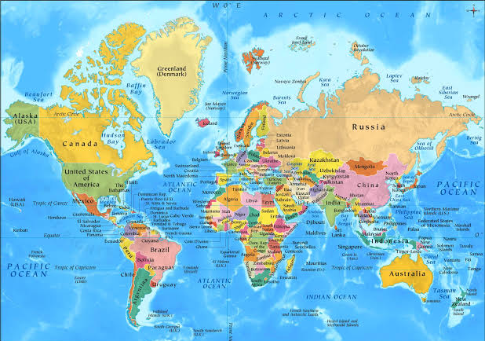

What is regioinvent?
(Regionalized ecoinvent)
-> Regioinvent is an almost fully regionalized version of ecoinvent

Slide 3
A first observation: ecoinvent is barely regionalized
The ecoinvent 3.9.1 database has:
683 processes (excluding electricity, heat and municipal solid waste) for which a specific country is defined.
~4000 GLO processes
~1700 RER processes
~4200 RoW processes

Slide 4
Goal of regioinvent
Regioinvent automatically regionalizes the whole ecoinvent database, creating consumption markets based on trade data.
Non-official goal: Let’s get rid of GLO, RER and RoW processes!!!

Slide 5
Illustration

Slide 6
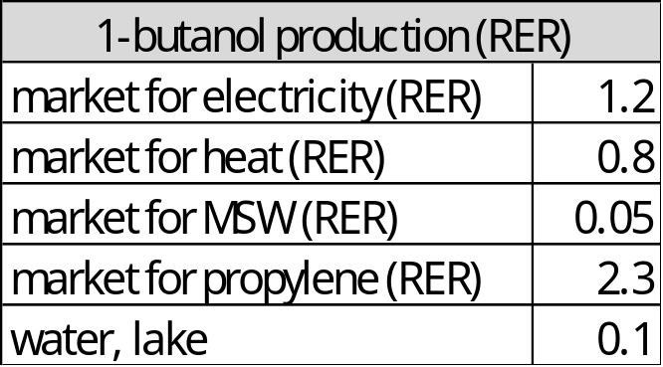
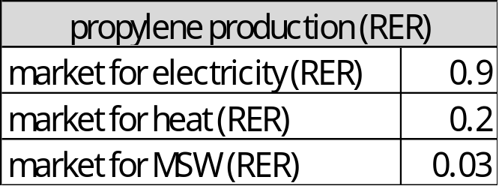
Illustration
To illustrate what regioinvent strives to achieve, let’s consider the case where one would want to create a Belgian version of the 1-butanol production process of ecoinvent.
(Note that processes portrayed are completely fictional)
Ecoinvent

Slide 7
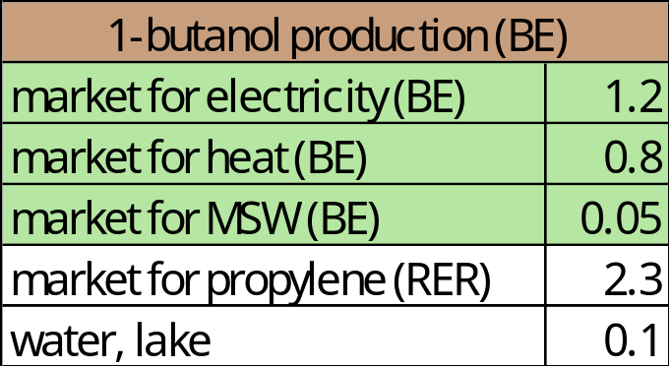
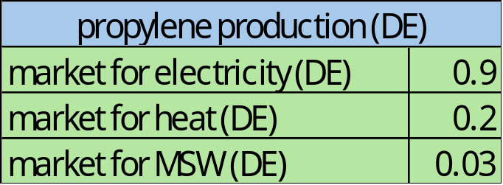
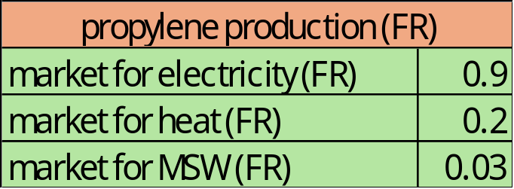
Illustration
To illustrate what regioinvent strives to achieve, let’s consider the case where one would want to create a Belgian version of the 1-butanol production process of ecoinvent.
(Note that processes portrayed are completely fictional)
Ecoinvent
Regioinvent
1. Copy and adapt electricity, heat and waste

Slide 8
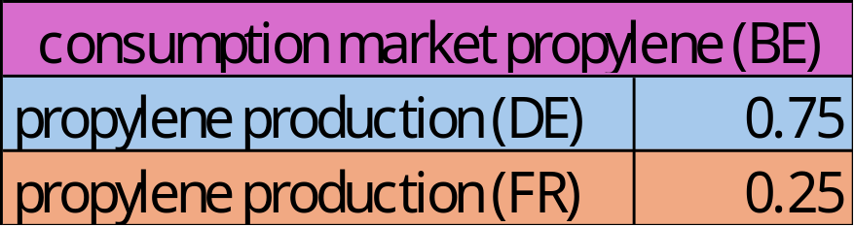
Illustration
To illustrate what regioinvent strives to achieve, let’s consider the case where one would want to create a Belgian version of the 1-butanol production process of ecoinvent.
(Note that processes portrayed are completely fictional)
Ecoinvent
Regioinvent
1. Copy and adapt electricity, heat and waste
2. Create consumption markets based on consumption data

Slide 9
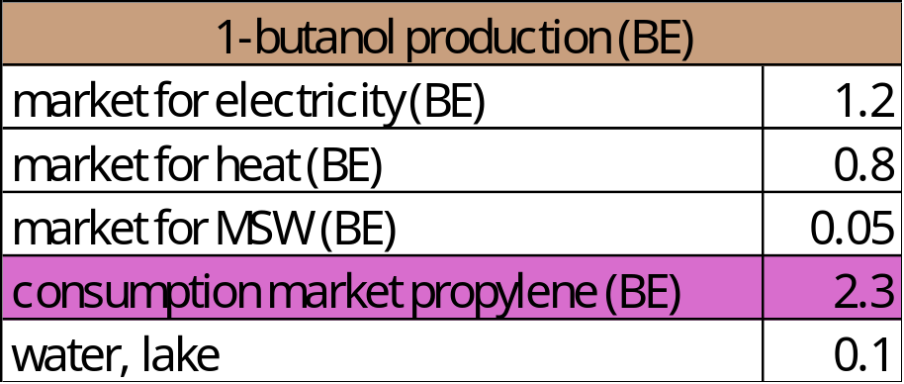
Illustration
To illustrate what regioinvent strives to achieve, let’s consider the case where one would want to create a Belgian version of the 1-butanol production process of ecoinvent.
(Note that processes portrayed are completely fictional)
Ecoinvent
Regioinvent
1. Copy and adapt electricity, heat and waste
3. Link consumption markets to all processes of the database
2. Create consumption markets based on consumption data

Slide 10
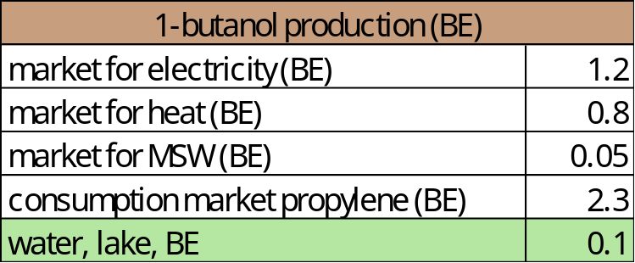
Illustration
To illustrate what regioinvent strives to achieve, let’s consider the case where one would want to create a Belgian version of the 1-butanol production process of ecoinvent.
(Note that processes portrayed are completely fictional)
Ecoinvent
Regioinvent
4. Spatialize elementary flows
1. Copy and adapt electricity, heat and waste
3. Link consumption markets to all processes of the database
2. Create consumption markets based on consumption data

Slide 11












Regioinvent ecosystem
Versions covered: 3.10 / 3.11 / 3.12
Domestic production
BACI
International trade data
(imports & exports)
Regioinvent
Regionalized characterization factors
Performs the LCA calculations
bw2
&
bw2.5
EF
GLAM

Slide 12
Showcase

Slide 13
Consumption market process
Consumption market of nitrous dioxide for Morocco.
Morocco mostly imports its nitrous dioxide from Spain (28%), China (13%) and Sweden (11%).

Slide 14
Regionalized production process
Regionalized production process for nitrous dioxide produced in Spain (based on a copy of the RER process).
Notice how all inputs/outputs are adapted to the Spanish context, from the construction of chemical factory, to the correct electricity grid mix, to the elementary flows released in Spanish air and Spanish freshwater.

Slide 15
Ecoinvent connected to regioinvent
Regionalization of the nuclear electricity process of ecoinvent for the Spanish context.
Notice how all the ecoinvent process now calls regioinvent consumption markets for its consumption of nitrogen, argon, oxygen, etc.

Slide 16
How to use regioinvent
You know where your commodity is produced
Use the corresponding national production process
You don’t know where it is produced but you know where it’s purchased
Use the corresponding consumption market
You don’t know where it is produced nor where it is purchased
You can use the global default option of regioinvent, or the global production market of ecoinvent
Notes:
Idea is to tell people the purpose of each type of process

Slide 17
Results interpretation

Slide 18
Comparison ecoinvent - regioinvent
Comparison of 22 created regioinvent production processes for the production of nitrous dioxide.

Slide 19
Comparison ecoinvent - regioinvent
Comparison of 22 created regioinvent production processes for the production of nitrous dioxide.

Slide 20
Outlooks and future work (if funds allow!)
Continue integrating more and more domestic production data
Refining transportation modeling
Integrate sub-national trade (e.g., CA-QC, US-CA, etc.)
Create nationalized versions of regioinvent, e.g., regioinvent specifically for Denmark
Apply regioinvent methodology to other mainstream LCI databases (e.g., BAFU)
Integrate uncertainty factors for markets in regioinvent, based on yearly fluctuations of markets
Keep updating regionalized LCIA methods and integrate new ones (GLAM & LC-IMPACT)

Slide 21
Miscellaneous information
Regioinvent is free and open-source. Trade data and LCIA methods used by regioinvent are open-access. You only need an ecoinvent license.
Install your regioinvent through this code: https://github.com/CIRAIG/Regioinvent
or through pip (https://pypi.org/project/regioinvent/) -- pip install regioinvent
Check out the corresponding article: Agez, M., Majeau-Bettez, G. Regioinvent: a regionalized version of ecoinvent integrating detailed trade data. J. Ind. Ecol. 30, 727–742 (2026). https://doi.org/10.1007/s44498-026-00053-9

Slide 22


Key contacts:
maxime.agez@polymtl.ca
Merci!
Questions?
ciraig.org

