Slide 1
BRIGHTCON 2026 · ONLINE · CASE STUDY
Does a heat pump always cut carbon?
A reproducible cradle-to-grave LCA of a residential air-source heat pump on Morocco's carbon-intensive grid — built with Brightway2, Ecoinvent 3.12 and Python
Yassine El Ouakour
Python 3.10 · Brightway 2 · Ecoinvent 3.12
Green Energy Park (UM6P / IRESEN) · University Mohammed VI Polytechnic, Morocco
Notes:
(~20s) Good morning. The question I want to address is deliberately simple: does a heat pump always reduce emissions? The common answer is yes. Using only open-source tools, I will show that the answer is conditional — it depends on the electricity grid — with Morocco as the case study.

Slide 2
THE MECHANISM
A heat pump is only as clean as the grid that drives it
FOOTPRINT
≈ grid carbon intensity / COP + equipment + refrigerant
Clean primary-energy mix
Coal-heavy mix
Hydro, nuclear, renewables (Norway, France) → the heat pump wins easily.
Morocco's grid is coal-dominated → high grid CI → the same unit can emit more than a gas boiler.
So the real question is not "are heat pumps green?" but under which grid does electrification actually cut emissions?
Notes:
(~50s) The analysis rests on a single principle. A heat pump does not burn fuel; it runs on electricity and transfers heat, delivering roughly three units of heat per unit of electricity consumed. Its carbon footprint is therefore essentially the carbon content of that electricity, divided by its efficiency. Where electricity is low-carbon — hydropower in Norway, nuclear in France — the heat pump is clearly advantageous. Where it is coal-dominated, as in Morocco, the same device can emit more than a conventional gas boiler. The relevant question is not whether heat pumps are clean in general, but under which grid conditions electrification genuinely reduces emissions.

Slide 3
THE GAP
Most heat-pump LCAs are calibrated to European grids
01
02
03
Evidence clusters on clean grids
Carbon-intensive grids are under-tested
Rarely with open tools + data
Belgium, Germany, France, Nordics — where electrification almost always wins.
North Africa and the wider MENA region are largely absent from the evidence base.
Few reproducible, script-driven studies exist for these contexts — exactly where Brightway helps.
A verdict proven on clean grids is quietly assumed to be universal.
Notes:
(~35s) This reveals a gap in the literature. The majority of studies concluding that heat pumps are beneficial were conducted in Europe, where grids are already relatively clean, so a favourable result is almost guaranteed. Carbon-intensive grids, such as those in North Africa, are seldom assessed, and rarely with open, reproducible methods. A conclusion established on clean grids is thus implicitly generalised to all contexts. Closing that gap is the purpose of this work.

Slide 4
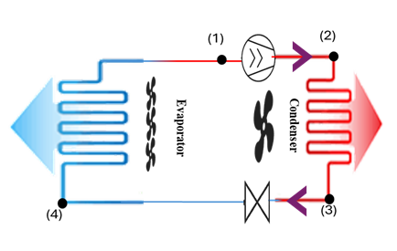
THE SYSTEM
A domestic air-source heat pump
Materials shaping the unit
The manufacturing phase is an editable bill of materials — the NIST BIRDS split-AC inventory — each class matched to an Ecoinvent 3.12 activity:
Steel
Cast iron
Galvanised steel
Stainless steel
Copper
Aluminium
Brass
Polyamide
Rubber
Electronics
Fig. 2 — Refrigerant absorbs heat from ambient air in the evaporator (4→1), the compressor raises its pressure and temperature (1→2), the condenser releases that heat to the building (2→3), and the expansion valve drops the pressure again (3→4) — delivering about 3 units of heat per unit of electricity (COP ≈ 3).
PU insulation
Refrigerant R410A · 2.5 kg
Notes:
(~40s) Briefly, the system under study. A heat pump operates on the same principle as a refrigerator in reverse: a refrigerant absorbs heat from the ambient air, a compressor raises its temperature, and the heat is released indoors. It is also a physical assembly — steel, copper, aluminium, and a refrigerant charge — whose production carries its own carbon cost. Our assessment covers the full life cycle, from manufacturing to end of life.

Slide 5



THE MODEL · WORKFLOW
BUILT ON
How the model works
1 · INPUTS
2 · BRIGHTWAY2 × ECOINVENT
3 · ENGINE
4 · OUTPUTS
Foreground
Hybrid LCA
Results
Country · climate · COP 3.0 · R410A (2.5 kg) · FU = 1 kWh heat
Import + score
GWP = CI/COP + ref + mfg + eol
6 impact categories · regional GWP · break-even · PCM
LV grid carbon intensity · 6 LCIA methods · material-market scores
Working assumption: the footprint is set by grid carbon intensity ÷ COP — a clean grid wins; a coal-heavy grid (Morocco) does not.
Notes:
(~40s) This diagram summarises the model, built entirely on open tools — Python, Brightway, and the ecoinvent database, shown here. We specify the heat pump and the country; Brightway retrieves that country's actual electricity data from ecoinvent; a transparent engine converts it into a carbon figure; and the results follow. Carbon intensity, at the base of the slide, denotes how much CO₂ is associated with each unit of electricity — and the footprint is that intensity divided by efficiency.

Slide 6

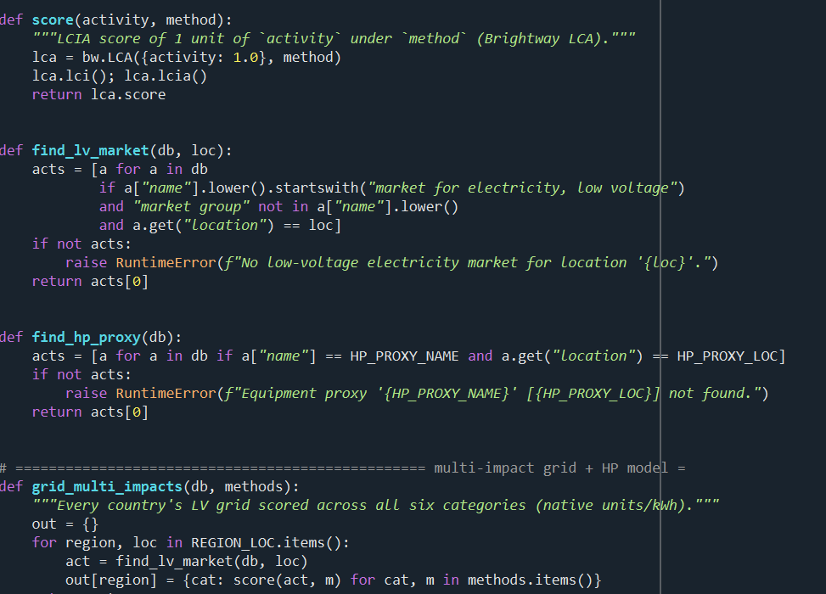
THE OPEN STACK · REAL CODE
Import the LCIA methods, score every grid — in ecoinvent via Brightway2
open_database() · match_lcia_methods()
score() · grid_multi_impacts()
Six categories scored: climate change · acidification · freshwater eutrophication · ozone depletion · CED total · CED non-renewable — strict, no fallback.
Notes:
(~20s, brisk) For the technical audience: this is the actual implementation, not a schematic. It connects to the ecoinvent database, selects the climate-impact method, and scores each country's electricity. For everyone else, the essential point is that the workflow is open and fully reproducible.

Slide 7


METHODOLOGY · THE ENGINE
A hybrid parametric LCA engine
Reproduced: MAPE 4.5% · R² = 0.997
ENGINE
GWP = CI/COP + ref + mfg + eol
cradle-to-grave, per 1 kWh useful heat
HeatPumpLCA.run() — LCA_final.py
Notes:
(~25s, brisk) This is the core engine: a single, transparent equation. The footprint equals grid carbon intensity divided by efficiency, plus the refrigerant, plus manufacturing and end of life. There is no black box. Before applying it to Morocco, we confirmed that it reproduces published European studies with high accuracy.

Slide 8
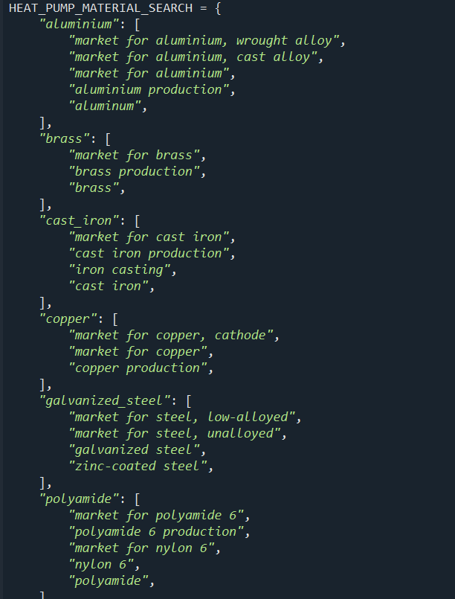
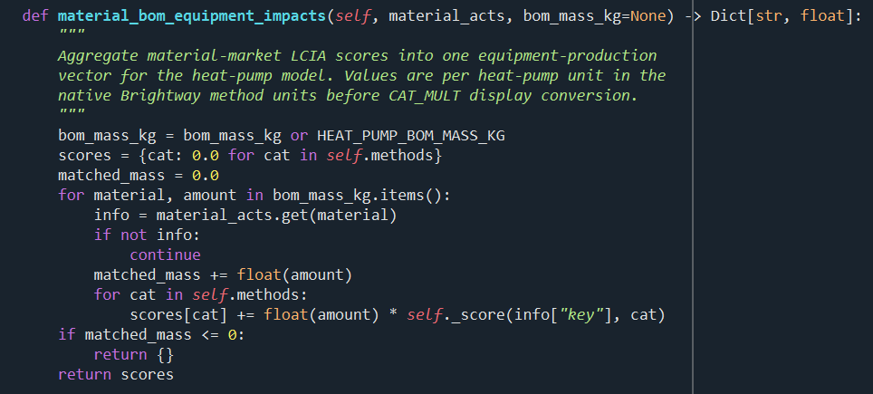
DATA INPUTS · MANUFACTURING
Where the equipment footprint comes from
The bill of materials is matched to Ecoinvent activities, scored in Brightway, and summed — one editable, auditable manufacturing number.
① Each material → an Ecoinvent activity
② Score each with Brightway and sum
RESULT
≈ 450 kg
CO₂-eq / unit → about 7 g / kWh over the lifetime. Small today; decisive once the grid decarbonises.
Notes:
(~25s, brisk) The manufacturing carbon is also computed, not assumed. Each material is itemised, matched to a database process, and summed — approximately 450 kilograms of CO₂ per unit, the one-time cost of building the machine. This is modest today, but becomes significant as the grid decarbonises.

Slide 9
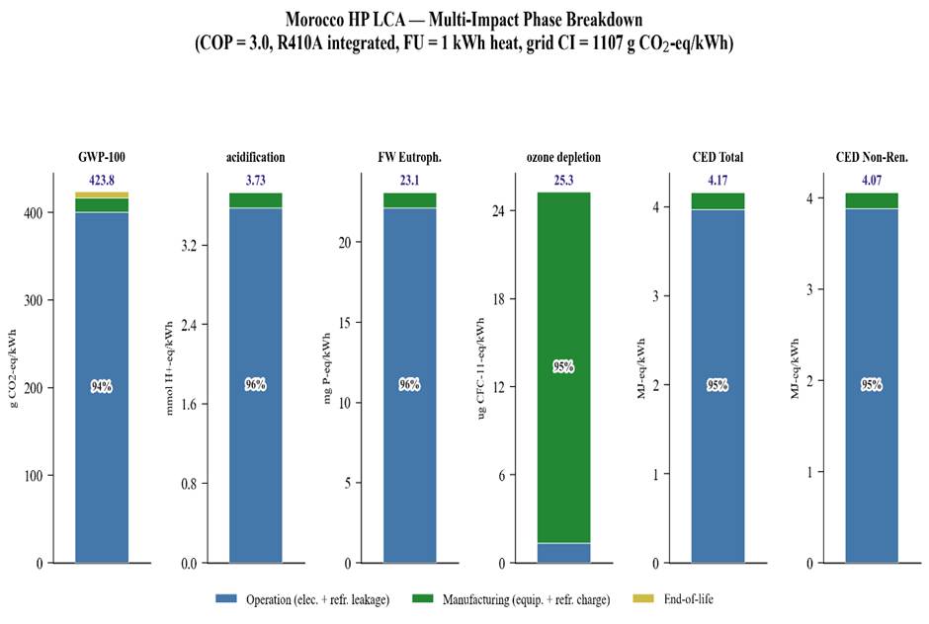



RESULTS · MOROCCO
Multi-impact, cradle-to-grave profile
424
g CO₂-eq / kWh delivered heat (GWP-100)
+73% above the 238 g/kWh gas boiler
Operation is 94–96% of every energy-linked impact
Ozone depletion is the exception — refrigerant-driven
Notes:
(~55s, slow — this is the payoff) This is the central result. In Morocco, delivered heat corresponds to approximately 424 grams of CO₂ per kilowatt-hour — 73 percent higher than the gas boiler it is intended to replace. On the current grid, the heat pump therefore provides no climate benefit. The figure presents six distinct environmental indicators, not climate alone, and the pattern is consistent across nearly all of them: the operational electricity, shown in blue, dominates. This is not a limitation of the technology; it reflects the carbon intensity of the electricity supply.

Slide 10
GWP KEY FINDINGS
Six numbers that decide the verdict
424
1107
71–97%
g CO₂-eq/kWh — ASHP delivered heat
g CO₂-eq/kWh — Morocco grid CI (Ecoinvent LV)
of GWP is the grid (operation) across countries
−8%
−10…16%
2030–50
GWP from switching refrigerant R410A → R290
GWP from PCM thermal-storage integration
grid decarbonisation window; break-even CI ≈ 600–650
Notes:
(~50s) Six figures summarise the case. The grid stands at 1107 — highly carbon-intensive. The heat pump is 73 percent above the boiler. Across all countries, the grid accounts for 71 to 97 percent of the footprint, confirming that the electricity supply, not the equipment, is decisive. A lower-impact refrigerant reduces emissions by about 8 percent, and phase-change thermal storage by a further 10 to 16 percent — meaningful, but secondary. Morocco's grid is projected to reach break-even between 2030 and 2050, which is when heat pumps become advantageous.

Slide 11
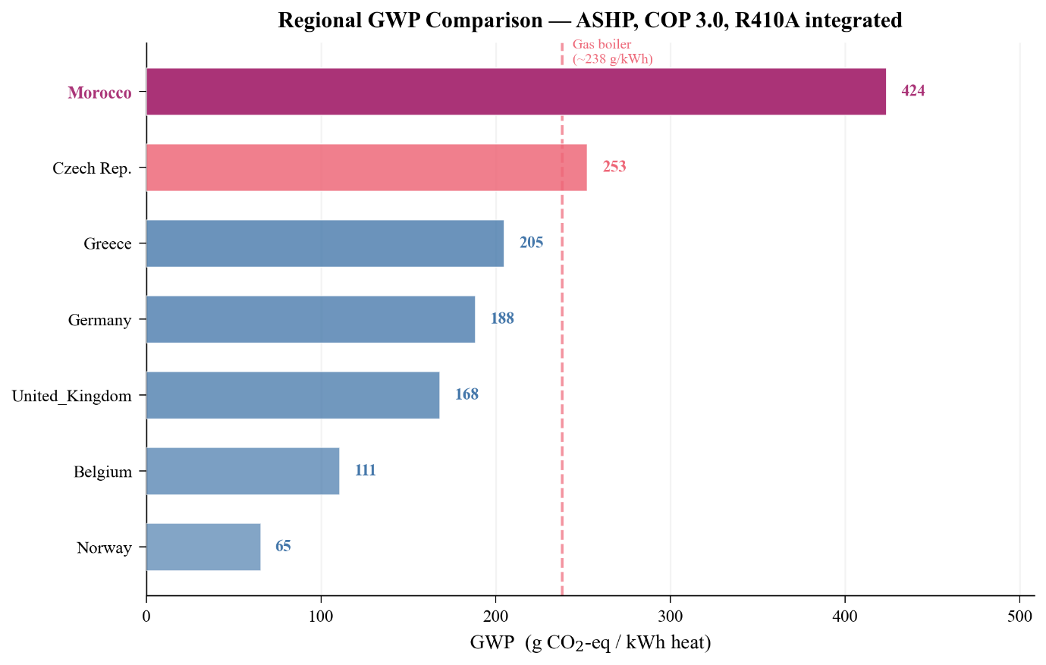



RESULTS · REGIONAL CONTRAST
Same heat pump, opposite verdict
Only Morocco (424) and the Czech Republic (253) exceed the 238 g/kWh boiler line
Norway (65) sits about 73% below the boiler — a clear win
An order-of-magnitude spread from one identical system — the grid decides
Notes:
(~45s) This figure conveys the central finding at a glance. It is the identical heat pump; only the country's electricity differs. In Norway it lies near the bottom — a clear benefit. In Morocco it is at the top, well above the gas-boiler reference. The same technology yields opposite conclusions, determined entirely by the grid. That is the thesis of this work: a heat pump is only as clean as the electricity that powers it.

Slide 12
WHY IT MATTERS
Open tools can falsify a Euro-calibrated default
For policy
For open data
The "electrify heating cuts carbon" default is baked into subsidies and standards — inherited from clean European grids.
North Africa and the wider MENA region are thinly represented in Ecoinvent.
The open workflow makes every activity, location and method auditable — and exposes the gap.
The verdict is conditional on grid CI ÷ COP, not universal.
Sequence deployment to the grid's break-even intensity — not to the calendar.
Better regional inventories are a research-equity priority.
Notes:
(~50s) Two implications follow. For policy: incentives for heat pumps presuppose an emissions benefit that only materialises once the grid is sufficiently clean; the appropriate strategy is one of sequencing — decarbonise the grid first, then scale deployment. For open data: regions such as North Africa are under-represented in life-cycle databases, and our conclusions are only as reliable as that underlying data. Improving regional inventories is, ultimately, a matter of research equity.

Slide 13
TAKEAWAYS
1
A heat pump is only as clean as its grid — on Morocco's 1107 g/kWh electricity it emits 424 g CO₂-eq/kWh, +73% above a gas boiler.
2
Brightway2 + Ecoinvent + Python make that verdict reproducible, auditable and region-swappable.
3
For MENA the bottleneck is grid data, not the method — open regional inventories are the next step.
Thank you — questions?
notebook + data → [link]
Yassine El Ouakour · yassine.ouakour@um6p.ma
BrightCon 2026
Notes:
(~25s) In summary: a heat pump is only as clean as its grid, and on Morocco's current grid it emits more than a gas boiler. Open tools allow this to be verified for any country, and the principal constraint for our region is the availability of quality data. Thank you; I would be glad to take your questions.

